Slide 1
Banner Finance Coding Structure Understanding, Establishing, and Using Index Codes Business Services July 1, 2015

Slide 2
Overview
Departments have some control over the coding that’s used to capture their data.
Coding structures will drive both ability to access information, and how data is presented on reports.
Fund
Account
Program
Index
Reports
Orgn
Activity
Location

Slide 3
Banner Finance Coding Structure
Greater Control by Departments
[Kind of]
Fund
Organization
Index
Activity
Limited Control at Departments
Location
Program
Account
Limited Control at Institutions

Slide 4
Index Code
Provides a short-cut method for quickly locating the other required codes that do all the work in the banner system.
The first three digits are typically used to identify the department who owns the code: “BIO___” = Biology.
Will usually only contain a connection to the Fund, Organization, and Program codes. Users then need to add the Account code to post revenue or expense transactions.

Slide 5
Fund Code (Required Code: Defaulted by Index)
Departments may have some degree of control over the establishing of new fund codes.
Identifies a particular “pool” of money.
Identifies the source of funds: institutional, federal, private, etc..
Identifies the type of funds: Restricted (grants, donation, etc), vs. Unrestricted (general fund, housing fees, etc.).
Identifies those areas where unspent funds are to be automatically “carried over” from one year to the next.

Slide 6
Sample Fund Structure
090000 Service Departments
090014 Printing and Copy Services
090015 Printing and Copy Services
090016 Printing/Copy Svc Depre/Asset Rep
090030 Facilities Mgt & Planning Billing Ops
090031 Facilities Mgt & Planning MotorPool
090032 Facilities Mgt & Planning EquipPool
Etc…
090039 Publications
090040 Publications
090050 Telecommunications
090051 Telecommunications Operations
090058 Telecom Oper Depre/Asset Replacem

Slide 7
Organization Code (Required Code: Defaulted by Index)
Largely controlled by the department. Only requirement: each department must have at least one organization code.
Identifies reporting responsibility relationships throughout the institution.
Identifies delegated spending authority responsibilities.
Identifies the departments who are receiving the benefit of certain funds provided by the institution.

Slide 8
Organization Hierarchy Levels
Level 1: Institution as a whole
Level 2: President and Vice President Level
Level 3: Academic →School Deans
Other → Department Directors
Level 4: Academic →Dept. Chairs
Other → sub-departments
and on…..(up to 8 levels)
Data
can be
reviewed
at any
Level

Slide 9
Sample Organization Structure
300000 Academic Affairs (Level 2)
.
.
332000 School of Business (Level 4)
332010 Dean of School of Business
332020 Business: Dean's Reserves
332021 Business: Enrollment Reserves
332022 Business: Undistributed Reserves
332028 Business: Indirect Cost Reserve
332100 School of Business Operations
332110 Business Dept. Operations
332115 Business Majors Resource Fees
332120 CF Business Special Courses
332121 CF Business
332200 Sch of Business: Hospitality Program
332400 Small Business Development Center
332440 MBA Program
332450 Masters in Management Program
332460 Non-Profit Management

Slide 10
Account Code (Required Code: Selected by Department)
Identifies a specific type of revenue, expenditure, or transfer action.
Identifies a specific type of asset, liability, or fund balance transaction.

Slide 11
Account Codes (Operating Ledger: Revenue & Expense)
The Operating Ledger reflects a summary of annual revenue and expense transactions.
The first digit of the account code represents the type of revenue or expense .
Example, codes starting with:
0 = Revenue
1 = Payroll Expenses
2 = Supplies or Service Expenses
3 = Travel Expenses
4 = Capital Expenses (major equipment, etc)
5 = Student Aid Expenses
6 = Items for Resale
70005 = Indirect Expenses
79 = Internal Reimbursements
8 = Student Loan Expenses
9 = Transfers

Slide 12
Program Code (Required Code: Defaulted by Index)
Identifies the type of “function” occurring within the institution.
Examples:
Instruction, Research, Administration, Student Services, Public Services, etc.
Used to Generate the SOU financial statements in a manner consistent with other colleges and universities throughout the country.

Slide 13
Activity Code (Optional Code)
Provides an additional tool to track revenue and expenditures that can’t be easily tracked by the other existing codes.
Can track activity across other code boundaries (example: simplifying the tracking of expenditures across multiple funding sources).
Can provide additional sub-category of data within existing index codes (example: the Athletic department may want to use an activity code to track travel associated with travel to sporting events verses other department travel. Since the account code does not provide this level of detail, the Activity code can be used to perform this function).

Slide 14
Location Code (Optional Code)
Used to track activity by building, and potentially by room.
Primarily used for tracking Fixed Asset locations.
Also being used by Facilities to track maintenance costs by building.

Slide 15
Banner Codes that Function within “Hierarchy” Structures
Fund
Organization
Index
Activity
Location
Account
Program

Slide 16
Code Hierarchy Structures
Exist to show reporting relationships within a code element.
Allow the ability to pull summarized data at multiple levels, within individual banner code elements, or across multiple code elements.

Slide 17
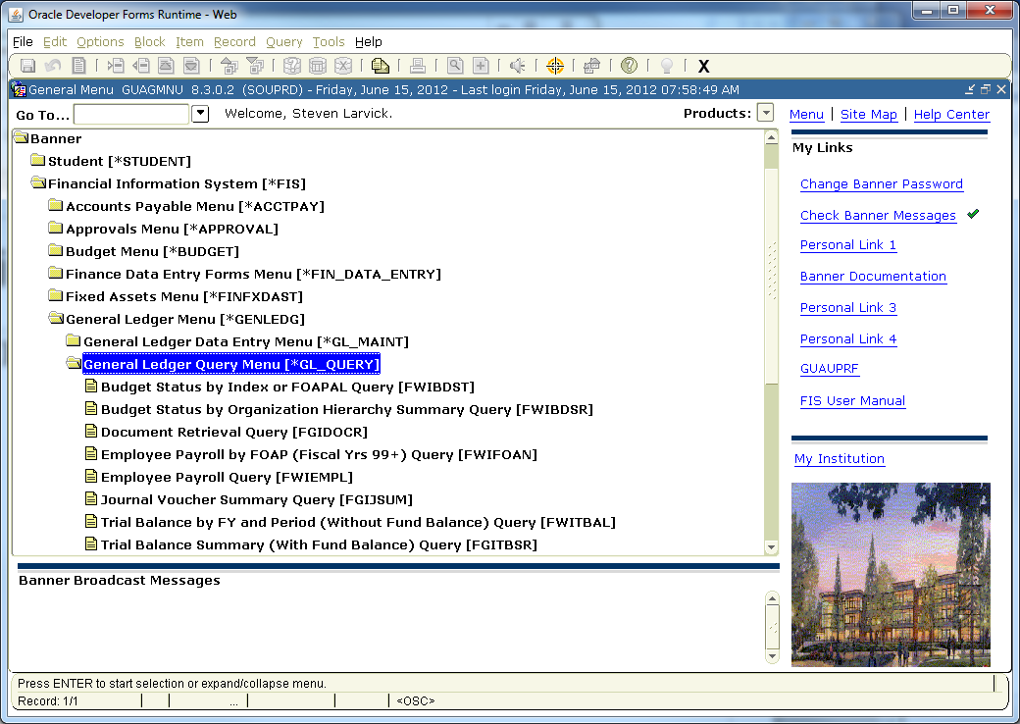
Banner Forms
FWIBDSR: Allows ability to view revenue/expense data at various levels

Slide 18
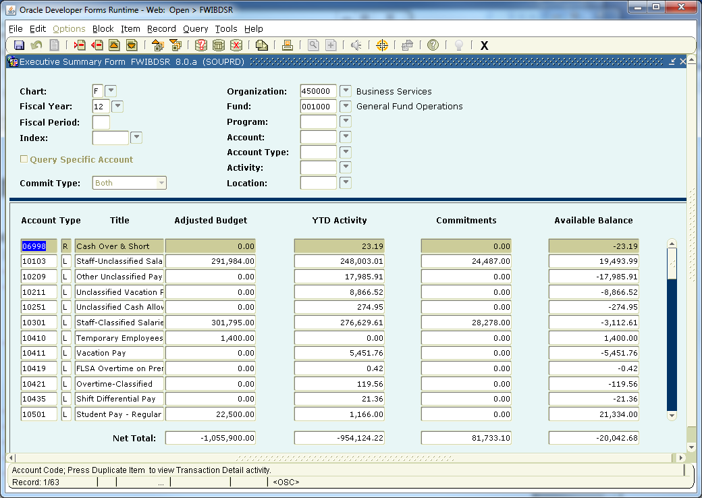
Sample: Using forms to view summary data
Summary of Business Services, total General Fund support across all of its GF index codes:

Slide 19
Contacts
For additional Information contact:
Associate Director of Business Services https://inside.sou.edu/bus-serv/staff.html
552-8536
or
Director of Business Services https://inside.sou.edu/bus-serv/staff.html
552-6594

