Slide 1

Fixed Assets
Business Services
Business Services
July 1, 2015

Slide 2

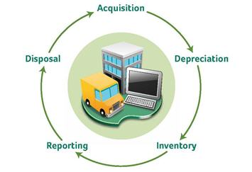
Fixed Assets
Fixed Assets are defined as:
Tangible(physical) property
Owned, leased, controlled, or possessed
Long term in nature (more than 1 year) and
Depreciates over multiple years
Unit value is $5,000 or greater

Slide 3
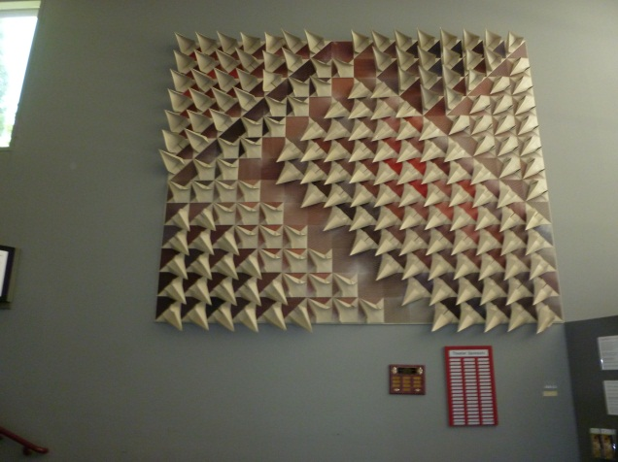
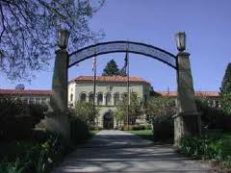
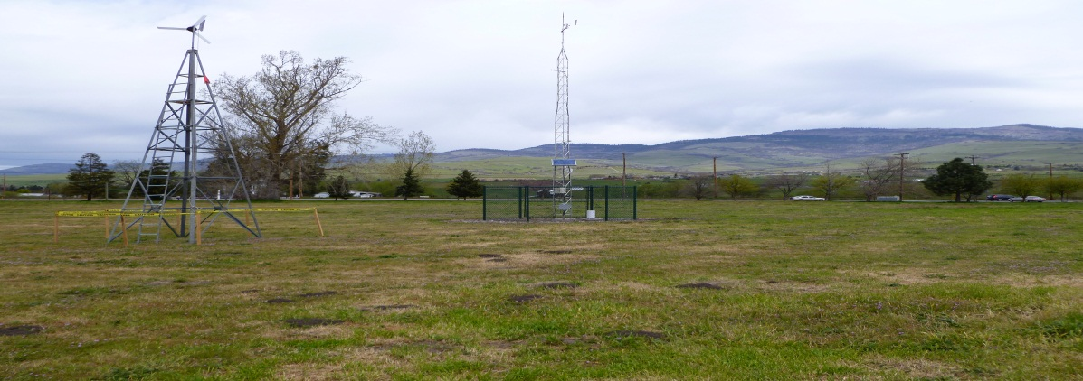
Fixed Assets
Tangible Fixed Assets –
Classified as Two Types:
Personal Property
Real Property
Equipment
Vehicles
Computers and
computer equipment
Library Special Collections
Works of Art
Buildings
Land
Improvements other than Buildings
Infrastructure

Slide 4
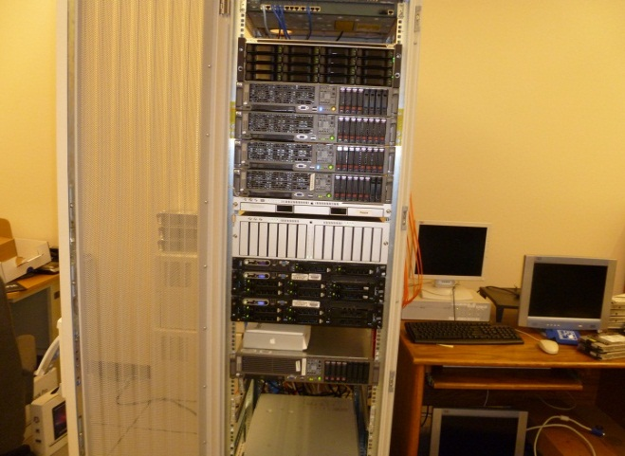
Fixed Assets
Purchasing a Fixed Asset Requirements
Purchase Order
Commodity Level Accounting
Competitive bids
Invoice Processing referencing the Purchase Order
Addition of the item to the Fixed Asset Inventory-Capitalization

Slide 5
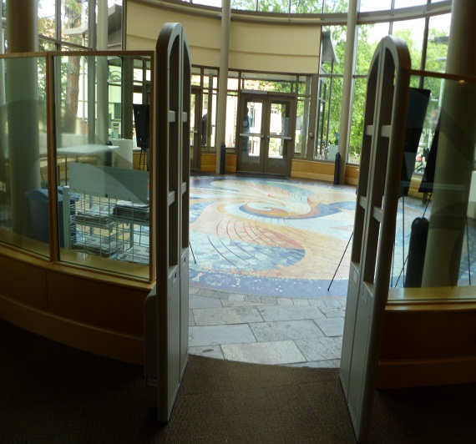
Purchase Orders
Fixed Asset Purchase Orders
For Fixed Assets only
One line item per fixed asset
Document Accounting box unchecked
Separate Purchase Order for items not considered part of the asset (service agreements, licenses, training)
Banner will not allow the mixture of fixed asset and items that are not fixed assets
Closed at the end of the Fiscal Year

Slide 6
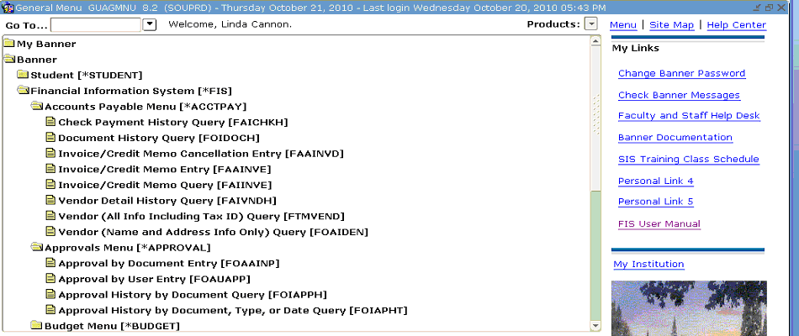
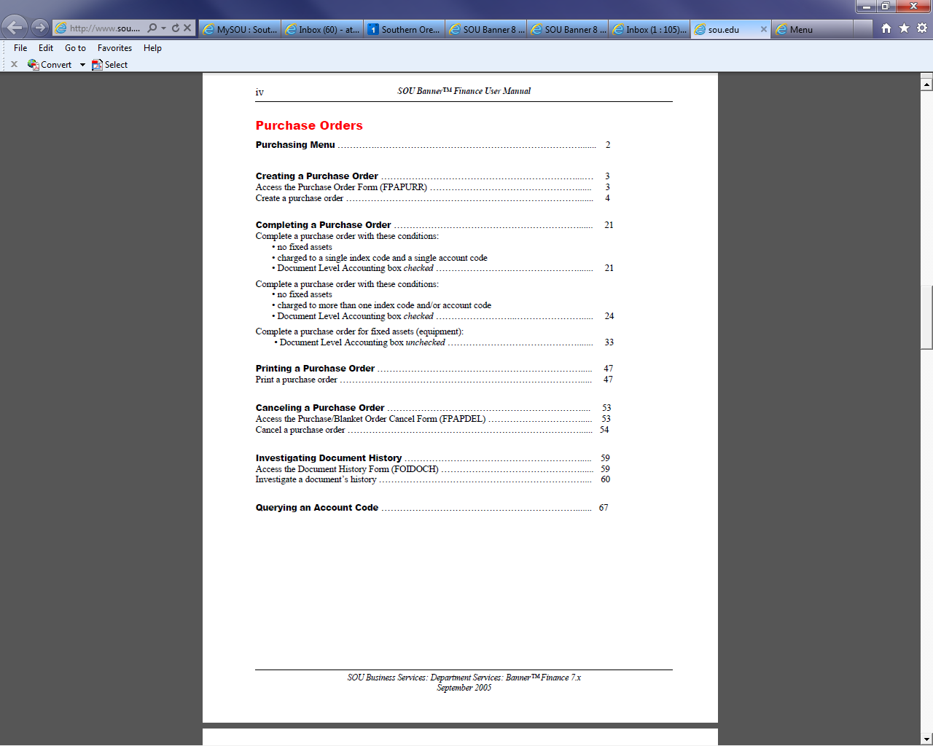
Purchase Orders
Entering a Purchase Order
Refer to the FIS User Manual with a link on the Banner Screen
  Detailed Instruction begins on Page 35
  Banner Samples begin on Page 39

Slide 7
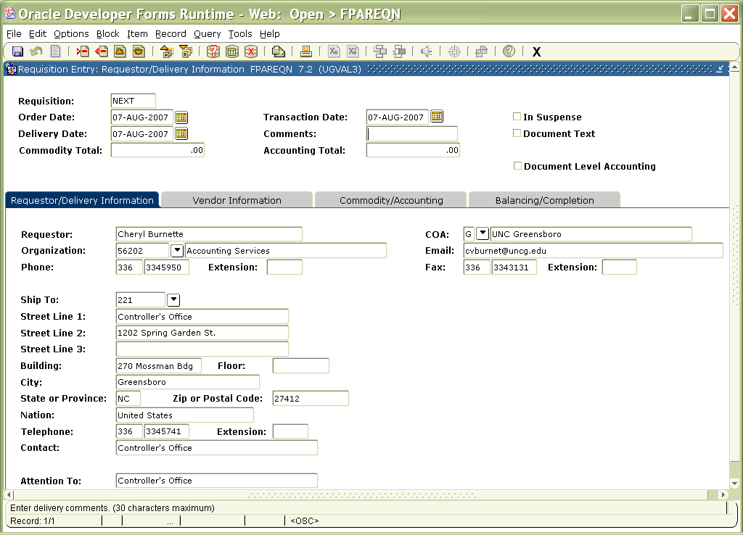
FIXED ASSETS
Commodity Accounting
You MUST leave Document Level Accounting UNCHECKED!

Slide 8
COMPLETING A PURCHASE ORDER
Account Codes
Account Codes used
If the Fund Code begins with “1” or “09” (Proprietary Funds)
A8011- -Equipment
A8012 --Vehicles
A8015 --Vessels
A8031-- Museum Collections
A8032 --Works of Art & Historical Treasures
A8042 --Library Books
Any other Fund Code that does not begin with “1” or “09” (Non-Proprietary Funds)
40101-- Equipment
40102--Livestock
40103– Museum Collections and Works of Art
40109--Library Purchases
40201—Vessels
40109—Construction in Progress(Equipment)
Proprietary=Auxiliary Funds
Non-Proprietary=General Funds

Slide 9
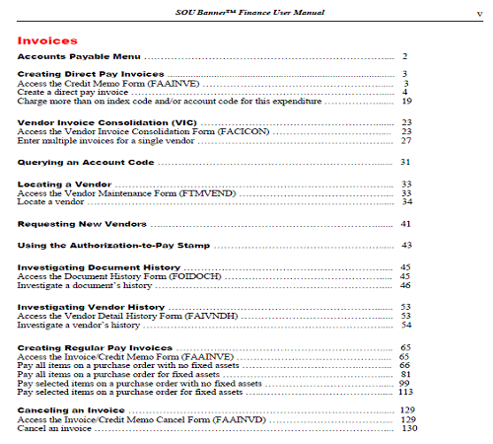
FIXED ASSETS
Invoices
Processing an invoice
Refer to the FIS User Manual with a link on the Banner Screen
Instructions begin on page 81

Slide 10
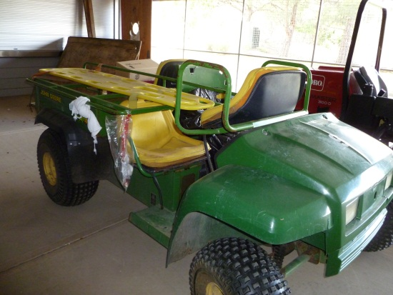
Invoices
Detailed information needed
Invoice entry:
Enter in the Document Text
Input: Note your Name and phone extension
Item Description “John Deere” Tractor
Model: X150
Serial number: S456789
Manufacturer: John Deere
Department/Office: Facilities
Building and room location of equipment: 101MP
Functional Use Codes (See next slide for list):
General Administration and Expense

Slide 11
Invoices
Functional Use:
Departmental Administration
General Administration and Expense
Instruction
Library
Other Institutional Activity
Operation and Maintenance
Organizational Research
Student Administration and Services

Slide 12
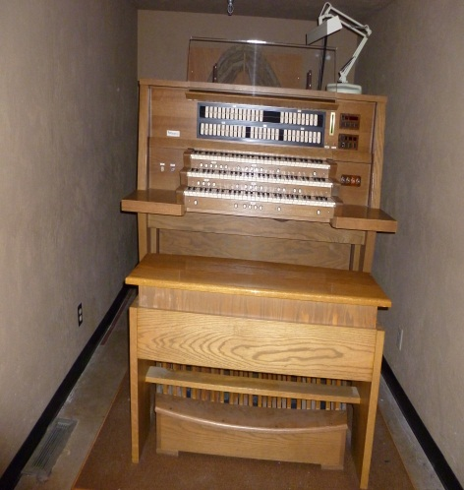
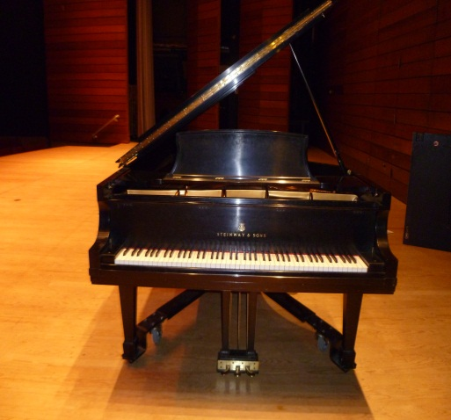
Invoices
Remember:
Be sure to get information in document text.
The original invoices need to come to Business Services for approval and filing.
The fixed asset invoices have to go through two approval queues for additional review.
Allow additional time, up to a week, before each check run for payment to be issued.

Slide 13
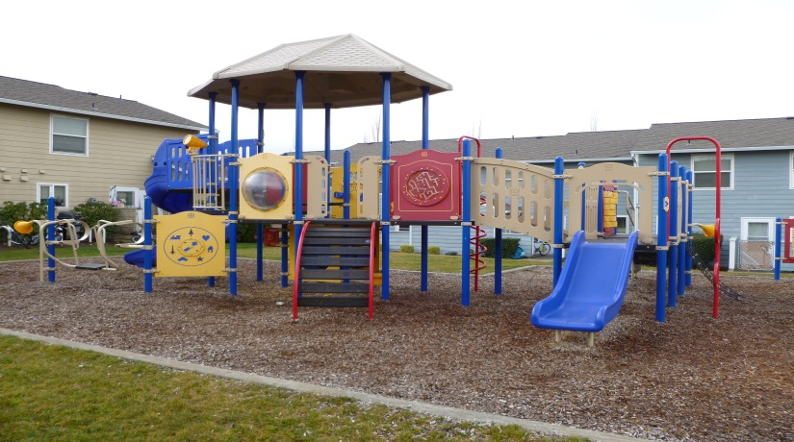
Invoices
Remember:
If the entire order does not arrive within the 30-day payment period, the payment amount on the invoice can be changed in order to pay for what was actually received.
  A note in the text block should include:
    statement that this is a partial payment
    amount still due to the vendor

Slide 14
Fiscal Year End
At Fiscal Year End :
Purchase orders are closed
Assets must be booked prior to fiscal year end and cannot be entered during month of July
Banner Fixed Asset Module stays open and we cannot balance if invoices are entered

Slide 15

Fixed Assets
Contact Business Services if you have questions about:
Fixed Asset Purchase Orders
Fixed Asset Invoices
Payments of Fixed Asset Invoices
or

Slide 16
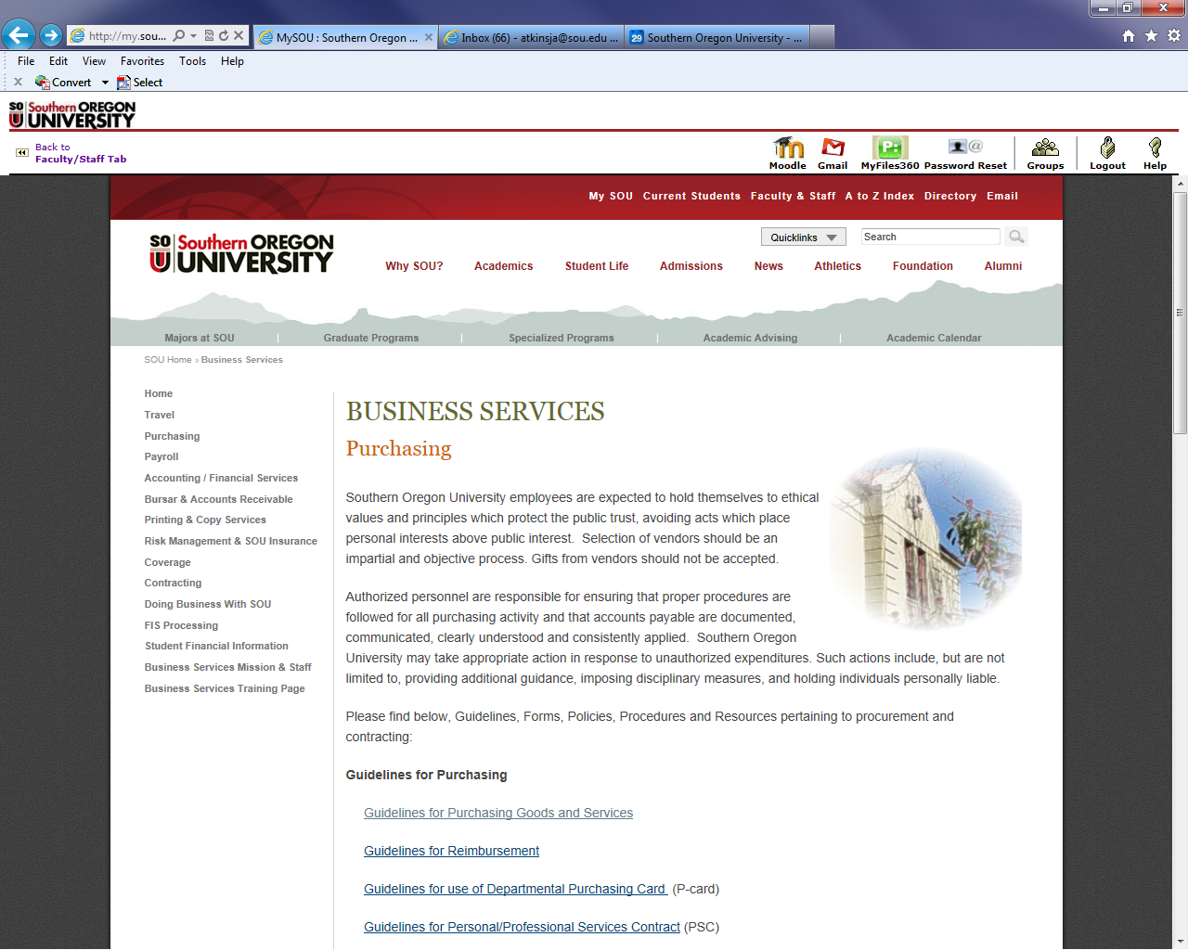
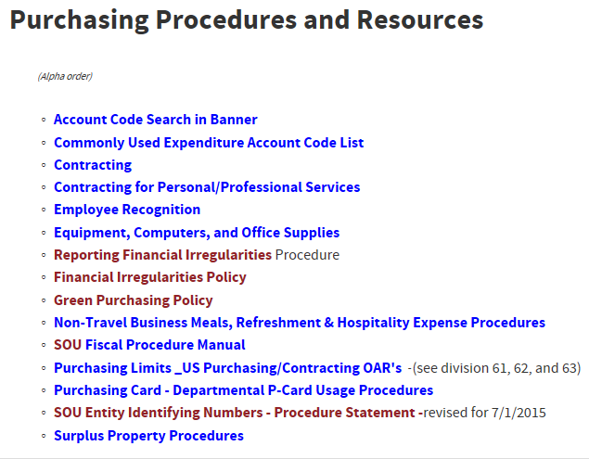
Disposal of Fixed Asset
https://inside.sou.edu/Bus-serv/purchasing/surplus-property.html

Slide 17
Contacts/Questions
For additional Information contact:
Associate Director, Business Services
https://inside.sou.edu/bus-serv/staff.html
552-8536
or
Director of Business Services
https://inside.sou.edu/bus-serv/staff.html
552-6594

