Slide 1
READING AND UNDERSTANDING REPORTS
A Road Map of the Money Trail http://www.sou.edu/bus_serv/
Business Services
Rev . November 11, 2015

Slide 2
PLANNING PROCESS
When you go on vacation you normally plan – Map out the trip
What is the destination?
How much money will I need?
How much am I going to spend on – gas – hotels – food
What if I have an emergency?

Slide 3
PLANNING PROCESS
While on the trip you monitor your spending
Adjust spending as needed
If the gas price is higher the meals cost needs to be lower

Slide 4
PLANNING PROCESS
For a Department at SOU the planning process is similar.
The end result of planning is the budget

Slide 5
PLANNING PROCESS
Reviewing reports provides the tool to monitor the revenue and spending.

Slide 6
PLANNING PROCESS
Ask:
Is the revenue on target?
– SCH higher or lower
Is the State allocation on target?
Are there more students?
Did a computer fail?
– An unplanned event

Slide 7
PLANNING PROCESS
How am I doing compared to last year?

Slide 8
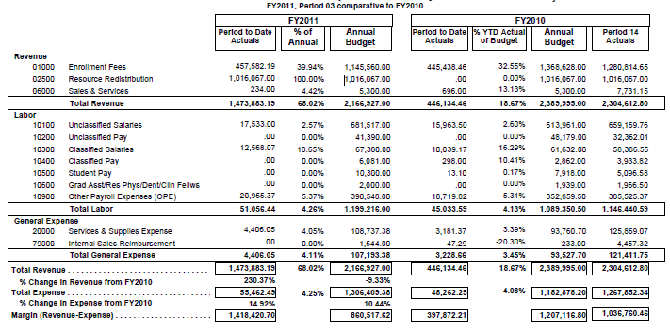
REPORT EXAMPLE
The Art and Art History Department is a good example to review:
All reports have the same categories—the level of detail will vary
This is a summary report - a higher level report

Slide 9
REPORT EXAMPLE
In looking at just revenues:
The annual budgets plans for enrollment fees decreasing.
Actual enrollment fees are a good bench mark to use in analysis – Actual enrollment revenue is higher than FY10

Slide 10
REPORT EXAMPLE
Actual enrollment fees for first quarter are higher than last year
Percentages of Annual Budget provide a quick comparison from one year to the next.
Note: The total % of annual revenue compared to budget is 68.02% and last year was 18.67%
State appropriations have been distributed in FY11, but were not distributed at this time last year

Slide 11
REPORT EXAMPLE
Expenditures
*FY11 *FY10
Actual Budget Actual Budget Actual YTD
Reviewing the categories: Classified salaries are a slightly larger percentage of the budget compared to last year.
Supplies and expenses show spending a little ahead of last year.
As you work in different areas on Campus it is important to understand the budget, monitor actual results, and review actual expenses.

Slide 12
REPORT EXAMPLE
Note: The bottom of each page provides a recap of the report with totals %.
FY11 FY10
Actual Budget Actual Budget Actual YTD
What happens to the Margin?
Each area on Campus supports the overhead costs of the University through their Contribution margin and assessments.

Slide 13
THE MARGIN
Overhead costs consist of expenses to support the Campus, for example:
Building repair and maintenance
Services such as Enrollment Services, Admissions, and Payroll
Utilities

Slide 14
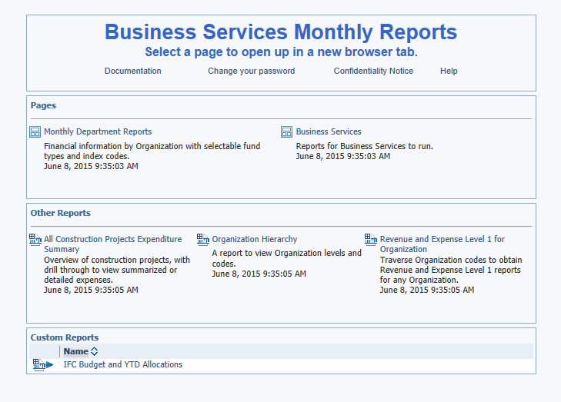
MORE REPORTS
More detailed reports are available through
FIS Banner (COGNOS) Reports

Slide 15
Contacts
For additional Information contact:
Associate Director, Business Services
https://inside.sou.edu/bus-serv/staff.html
552-8536
or
Director of Business Services https://inside.sou.edu/bus-serv/staff.html
552-6594

