Slide 1
Organization Budget Status Form July 1, 2015
es

Slide 2
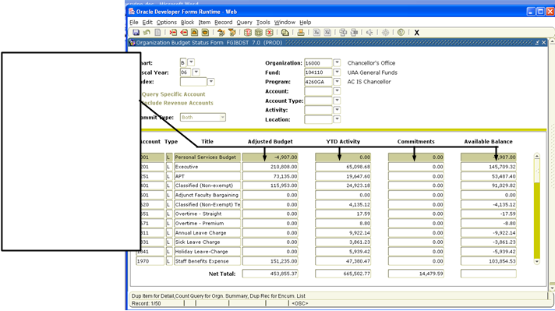
FWIBDST
This form shows the status of the budget for a particular department, including how much budget was assigned, how much was spent, and how much is reserved and encumbered.
“Adj Budget”= Initial budget plus adjustments.
“ YTD Activity”= Amount SPENT from account.
“Commitments”= Amount encumbered from account, but not yet spent. These charges will move over to the “YTD” column after the invoice is entered into Banner.
“Avail Bal”= Column 1 minus columns 2 and 3.

Slide 3
FWIBDST
Chart | Default is “F”, which is correct for all transactions.
Fiscal Year | Defaults to the current fiscal year. Fiscal years start on July 1st, and run through June 30th.
Index | Type in the Index code of your choosing!
Query Specific Account | Check the box to view a single account. Uncheck to view multiple accounts.
Include Revenue Accounts | Check this box to include revenue accounts. The default is checked. If your department has no revenue generating accounts, this box has no effect
Commit Ind | “U”= uncommitted is current fiscal year transactions. Transaction from a restricted fund that rolled from a prior year can also be “uncommitted” transactions. “C”=Committed is prior year transactions that have rolled into the new year. “Both” = U and C
Orgn, Fund | Fill in your organization and fund number. The fund number will come in when you type the orgn. Number-overtype if necessary.
Program | Will default from the organization code.
Account | Leave blank to see all activity or enter an account number to limit what you see
Account Type | Enter a two-digit code to indicate a group of accounts. If you use this option then the “Account “ field above must be blank.
Activity | Codes are used to further distinguish a program within an Index or similar detail.
Location | Used to focus on a particular physical room or building, used by Housing and Facilities.

Slide 4
FWIBDST FGITRND
The lower block provides a summary of the adjusted budget, year-to-date activity, outstanding commitments (encumbrances and reservations) and available budget based upon your upper block criteria.
You can drill down (Options) to view source documents or call other forms.
Click “Options” on this page to bring up the Options Menu
Then select “Transaction Detail Information” FGITRND to “Drill Down” on the selected line.

Slide 5
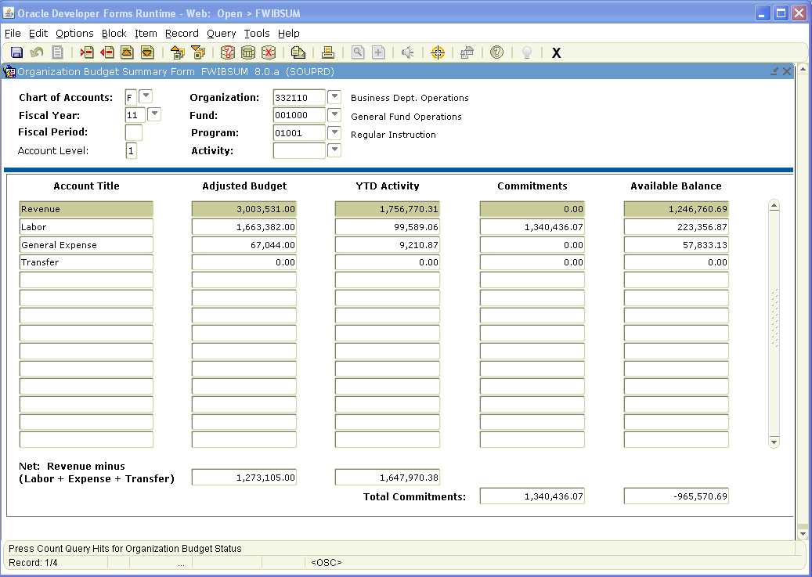
FWIBDST FWIBSUM
Access this form from FWIBDST. This form shows summarized budget information by account type for a selected organization/fund combination. FWIBSUM (under “Options”) provides a view of the organization’s budget, year-to-date activity, reservations (commitments) and available balance summarized by major category type (Revenue, Labor, Direct Expenditures and Transfers).

Slide 6
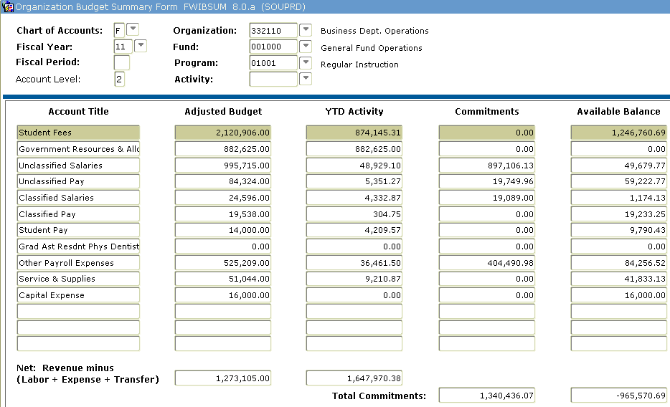
FWIBDST FWIBSUM
To drill down for more detail, type “2” in the Account Level box.

Slide 7
Contacts
For additional Information contact:
Associate Director, Business Services
https://inside.sou.edu/bus-serv/staff.html
552-8536
or
Director of Business Services https://inside.sou.edu/bus-serv/staff.html
552-6594

