Slide 1

Manual Encumbrances
Why, When and How to Post Manual Encumbrances
Business Services
July 1, 2015

Slide 2

Manual Encumbrances
This presentation describes the process for creating and
liquidating manual encumbrance in Banner.
What is it?
A manual encumbrance provides a means to post dollar commitments directly to Banner Finance.
When would you use it?
A manual encumbrance is entered prior to the point where a Purchase Order can be created to generate a system encumbrance.
Why?
By encumbering expenditures you know are coming up, it gives you a better feel of your uncommitted budget amounts.

Slide 3
Creating & Liquidating
Benefit
Provides a means to post commitments directly to Banner Finance, prior to the point where the system will create an automatic encumbrance
Advantages
Allows department to better use the Banner system to allow the ability to track commitments without having to separately track activity
This will allow the department to identify the uncommitted balances remaining in their budgets as the year progresses.

Slide 4
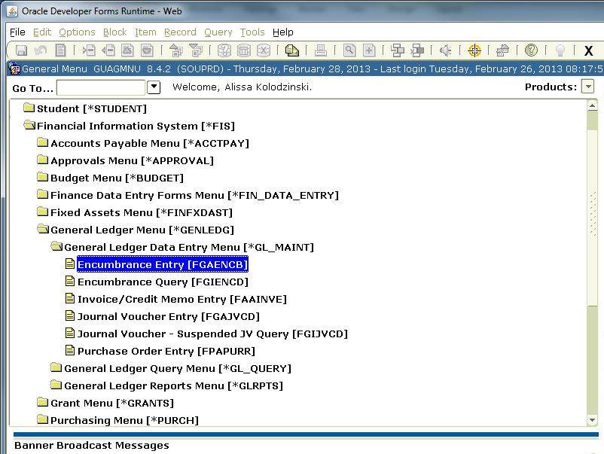
Banner Location

Slide 5
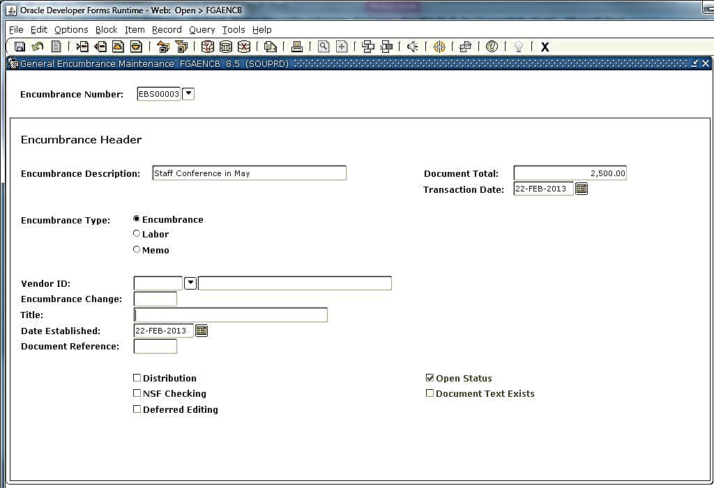
FIXED ASSETS
Encumbrance Maintenance [FGAENCB]

Slide 6
[FGAENCB] Fields Defined
Encumbrance Number: 8 Digit number not defaulted by the system (manually entered).
  Clearly identifies it’s a manual encumbrance
  Lets departments locate their encumbrances from other departmental encumbrances
    1st Digit
      “E” = always use the letter “E” to identify “encumbrance”
    2nd and 3rd Digits
      Use these to identify the “department” creating the encumbrance (Business Services = BS)
    4th and 5th Digits
      “00” for a “new” encumbrance
      “C__“ when making a “change” to an existing encumbrance
      (“C1”, “C2”, etc)
    6th, 7th and 8th Digits
      Identifies the specific encumbrance:(“001”, “002”)
      or if you run out of numeric numbers (“A01”, through “ZZZ”, etc)

Slide 7
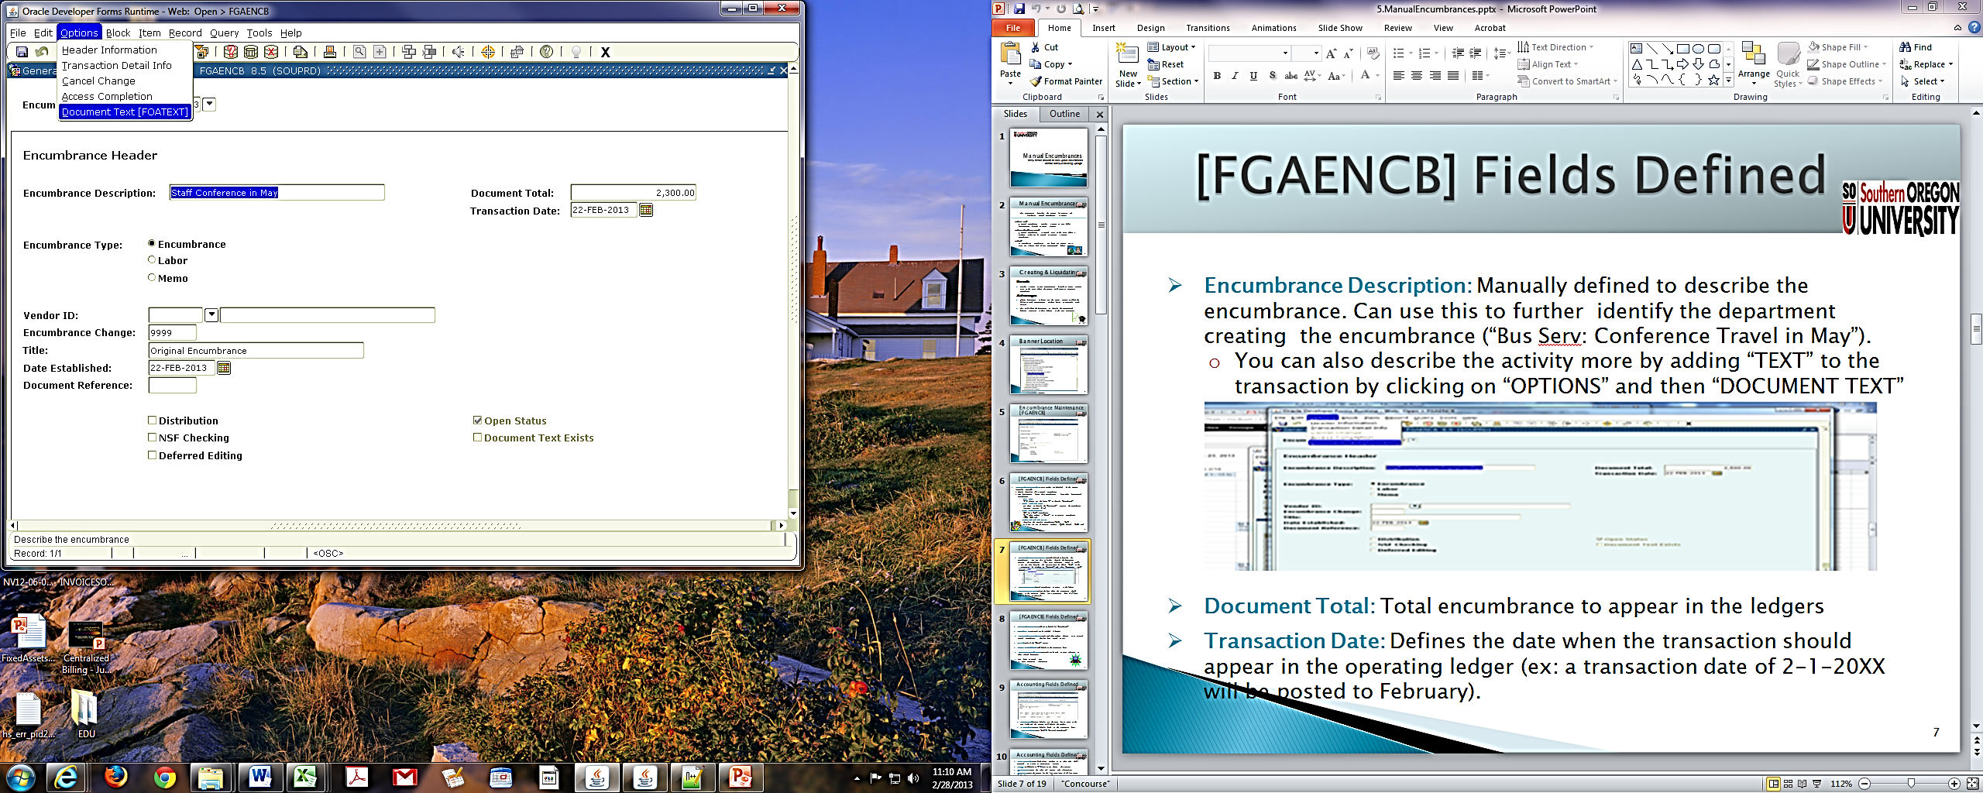
[FGAENCB] Fields Defined
Encumbrance Description: Manually defined to describe the encumbrance. Can use this to further identify the department creating the encumbrance (“Bus Serv: Conference Travel in May”).
  You can also describe the activity more by adding “TEXT” to the transaction by clicking on “OPTIONS” and then “DOCUMENT TEXT”
Document Total: Total encumbrance to appear in the ledgers
Transaction Date: Defines the date when the transaction should appear in the operating ledger (ex: a transaction date of 2-1-20XX will be posted to February).

Slide 8
[FGAENCB] Fields Defined
Encumbrance Type: Will set to default for “encumbrance”
Vendor ID: Optional. Can be included if known.
  Encumbrance Change: Only used when making changes to an original manual encumbrance that has been posted to FIS.
Title: Title of the “Change” action.
Date Established: Will default to the transaction date.
  Document Reference: Optional. Can be used as cross reference to other related documents.
  Page down to second page
    Enter accounting information

Slide 9
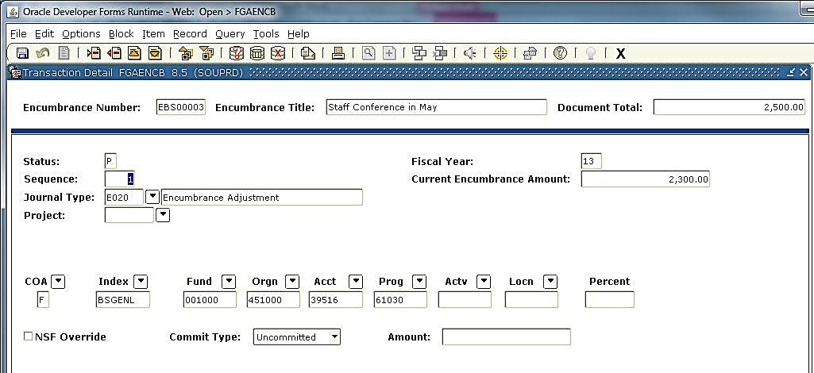
Accounting Fields Defined
2,5000.00
Sequence#: System default. Hit the enter key to move to the next field, and the system will default the number.
Fiscal Year: System default: based on the transaction date.
Journal Type: Enter “2ENC” = “Original Encumbrance”

Slide 10
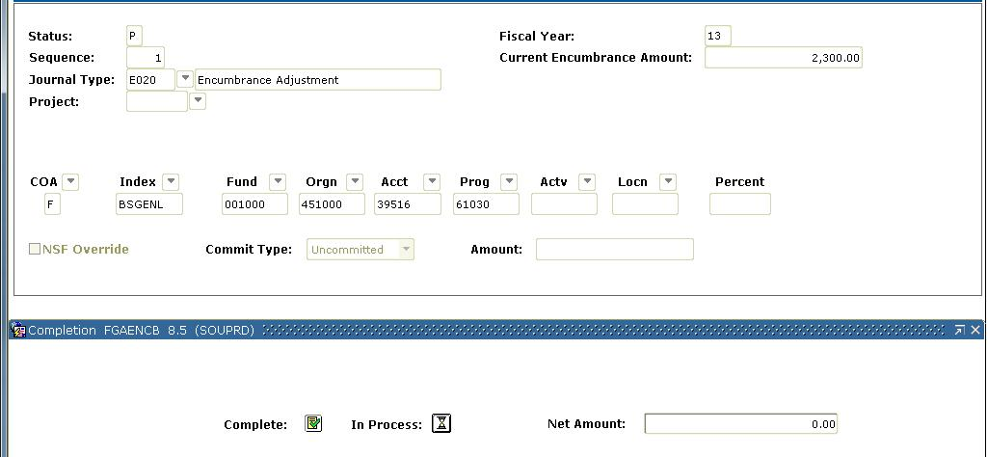
Accounting Fields Defined
Project Code: Leave blank unless working on an index code that’s connected to a Grant or Construction project.
COA: Will default to “F” =SOU. Do not change this setting.
Accounting: Enter the index and account code information.
Amount: Enter the amount for the line item (sum of all line items should balance to the Document Total)
To complete the transaction to post the encumbrance, hit “page down”, or “Record” “Next”: Click on the “Complete” button:
2,500.000
2,500.000

Slide 11
Contacts
For additional Information contact:
Associate Director, Business Services
https://inside.sou.edu/bus-serv/staff.html
552-8536
or
Director of Business Services
https://inside.sou.edu/bus-serv/staff.html
552-6594

