Slide 1
Manual Encumbrances
Post Manual Encumbrances
Business Services
July 1, 2015

Slide 2
Posted Encumbrances
Once posted the encumbered value will appear in the “commitments” column for the Operating Ledger
Once you click “complete, it may take about 5 minutes for the transaction to post and appear on the ledgers.
Currently these transactions are not routing though approval queues, so they do not require further action by the department
View encumbrance by querying down to the transaction detail,
or by going through the Encumbrance Query Menu:

Slide 3
Making a Change
Encumbrance Entry Form [FGAENCB]
Enter the original number and page down
Document Total will default to the current “open” amount associated with the encumbrance
Re-enter the document total for the amount to be changed
(ex: decrease by $200 …enter “-200” in the Document Total field)
Enter a number in the “Encumbrance Change” field.
Easier to find all transactions associated with an encumbrance
Use the same number of the original encumbrance, but modify digits 4 & 5 (ex: “C1”, to identify “change #1”)
Title will default to the Description above
Change it if you wish to add an explanation
The “Date Established” will default current date
Proceed to the second page (“page down”)

Slide 4
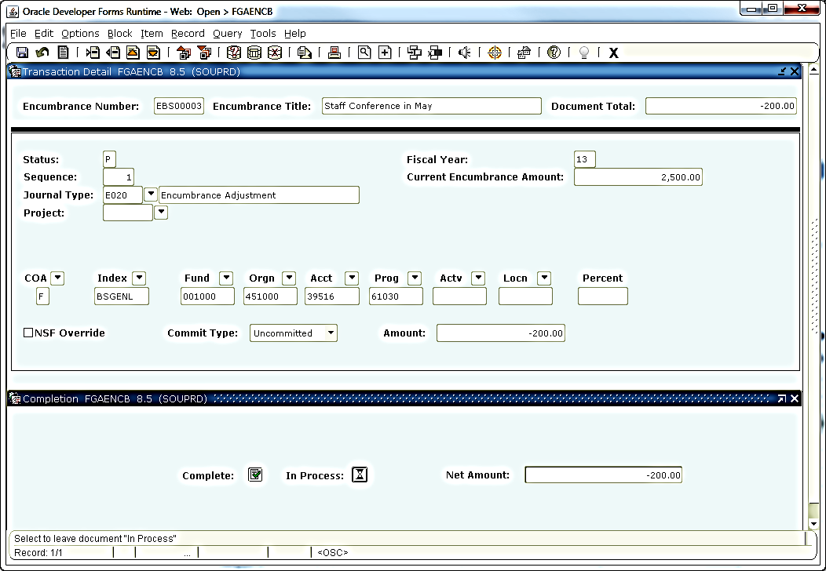
Making a Change
Change the “Journal Type” code to “E020” = “Encumbrance Adjustment”
Re-enter the amount of the change ($200)
Banner knows this may be spread over multiple index code in separate sequence lines
“Page Down” a second time
Click on the “Complete” button
The change will be routed for posting

Slide 5
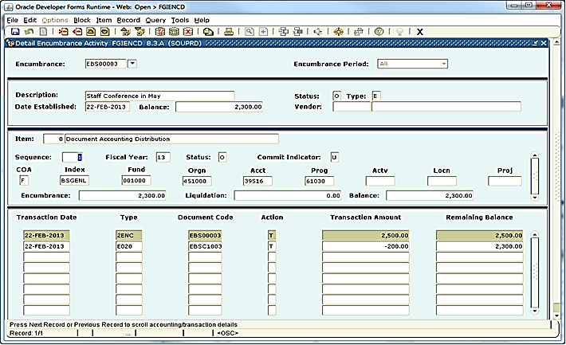
Encumbrance Query Form
[FGIENCD]
All the activity associated with the original encumbrance can be viewed in the Encumbrance Query Form [FGIENCD]
Original Encumbrance
Encumbrance Change
Current Remaining Balance

Slide 6
To View Status
Go to Encumbrance Query [FGIENCD]
Perform a query on the encumbrance number
Click on the [down arrow] box next to the field
Enter a query to isolate your departmental encumbrances
Click on [query][enter] to clear the field
Enter the distinct numbers associate with your department in the Encumbrance Number field
Use the “%” as a wild card character
Execute the query
Results

Slide 7
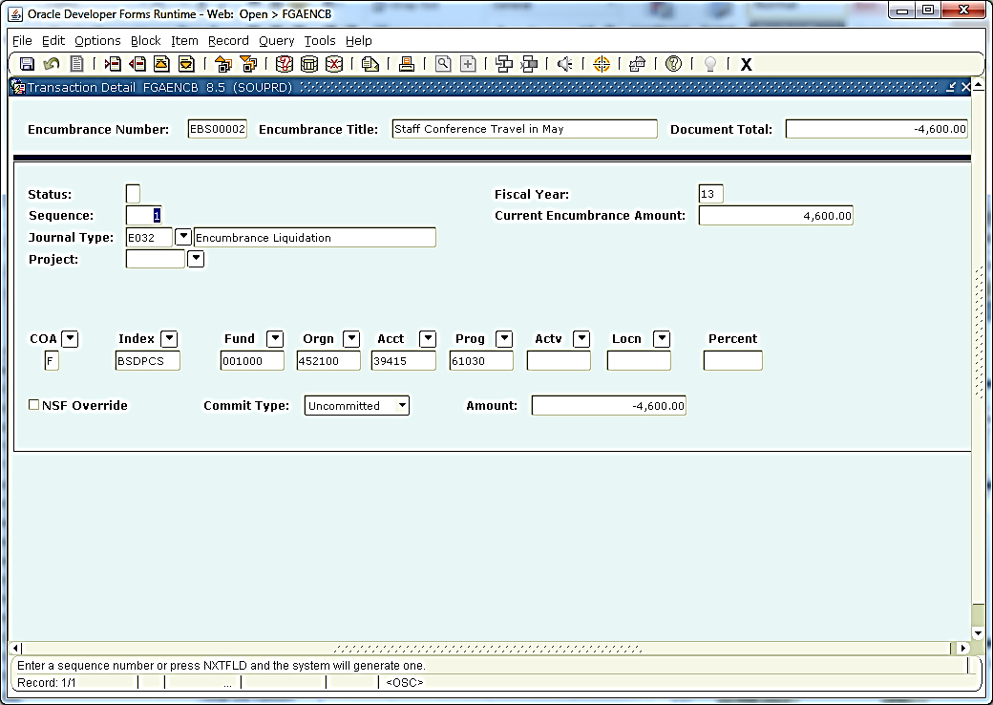
Closing an Encumbrance
All of these documents reflect an “O” (Open) status
To “close” an encumbrance
Create a final “Encumbrance Change” to $0.00
Use the “Journal Type” code of “E032” (“Encumbrance Liquidation”)
When “Liquidating” an encumbrance
“Amount” should be entered as a “positive” number
Use of the “EO32” Journal Type code is telling the system to ‘’reduce’’ the amount by virtue of the fact that it is liquidating that amount
2,300.00
2,300.00
2,300.00

Slide 8
Results

Slide 9
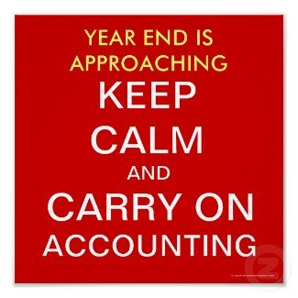
Fiscal Year End
Encumbrances will not be “Rolled Over” to the following fiscal year. All encumbrances need to be zeroed out by July 12th
Re-establish the encumbrance in the new fiscal year where appropriate
Two ways of doing this:
If the encumbrance is no longer valid, zero it out using the Journal Type “E032” to fully liquidate and close the encumbrance
If the department would like to continue to use the encumbrance in future years
The department should still zero the amount out at year, but use the “E020” Encumbrance Adjustment Journal Type code
A reduction here would have to be entered as a “negative” number
Departments can then re-establish the encumbrance in the new fiscal year using the same encumbrance number

Slide 10
Contacts
For additional Information contact:
Associate Director, Business Services
https://inside.sou.edu/bus-serv/staff.html
552-8536
or
Director of Business Services https://inside.sou.edu/bus-serv/staff.html
552-6594

