Slide 1
Business Services Workshop
Supporting the Missions of other Departments
11/20/2019

Slide 2
Agenda 11/20/2019
Time | Topic | Description | Presenter
1:30 PM | Intro Welcome | Format Business Services Overview of Roles & Responsibilities | Debbie Steve
1:40 PM | Grant Roles | Service Center Transactions | Cynthia
1:50 PM | Lease Agreements | GASB 87 Summary re: Change in process | Steve
 | Q&A
2:15 PM | Information Communication | Process Flows – What’s working/what’s not? Technical Discussion Procedures - Web POS/Travel/Hosting/ C-Accounts/Vendor set up? Security Profiles & Classes | Debbie All Patti & Janice
2:30 PM | Index Code Requests | Discuss qualifying information needed to set- up new Index code | Patti
 | Exception Reports | Review FY19 | Patti
2:45 PM | Account Coding | Public Records HB2500 Vendor Listing Coding/Payables/1099 Use of Judgement | Debbie All Steve
3:00 PM | Accelerated Campus Learning | Training of Campus users: FIS Banner; Cognos Reports; Web Tour(s) | Debbie –frame up Steve & All
3:15 PM | What is next... *Act of feedback *Technical daily ops | Training Topics Discussion | Cynthia

Slide 3
Business Services Overview (Steve)
_{PC WEST 1:30 PM - 3:30 PM}

Slide 4
Process & Discussion before changes (Cynthia)
_{PC WEST 1:30 PM - 3:30 PM}
Example: No Change in Grant Role for Service Center
As far as this purchase, no Accountant is "authorizing" a purchase. That is the responsibility of the department Budget Authority, or in this case, the Grant P.I. As long as you have gotten their approval you should move forward with the purchase. It's the Budget Authority (or Grant P.I.) responsibility to identify the appropriate Index, and to also know their funding availability.
The only thing an Accountant would be doing would be to potentially verify funding in a particular index, and/or verify the appropriate Expense Account Code to be applied to the purchasing transaction. If the person processing the invoice already knows the appropriate Expense Account Code to be used on the transaction, then they can just proceed.
If that person is unsure of which Account Code to use, they should be able to approach any Accountant who should then be able to provide that information regardless if the index being used (i.e., regardless of whether it's an General Fund Index, Gift Index, or even a Index associated with a Grant).
The use of Account Codes is to be applied consistently across all index, regardless of the type. If a department has a question regarding the availability of funding, associated with any index (grants included), any Accountant should be readily able to answer the question since all the information is represented in Banner.

Slide 5
Grant Process (Cynthia)
_{PC WEST 1:30 PM - 3:30 PM}
When it comes to grants, the SC Accountants
do not have to address:
Financial reporting to the Granting Agency (done centrally)
Submitting cash request to Granting Agencies, for those that are not funded in advance (done centrally)
Setting up grant indexes and budgets (done centrally).

Slide 6
Grant Process Role for Service Center
_{PC WEST 1:30 PM - 3:30 PM}
SC Accountants should be prepared to address the needs of a department regardless of what index that department may have.
Helping the department when it comes to directing expenses to the proper index. That would also include, helping the department redirect salary costs when alternative funding resources are received (i.e., when faculty or staff will be shifting efforts to specialized projects where separate funding has been received).
Helping the department code their expense, to insure consistency across all indexes (including Grants).
Helping the department understand their financial positions as the year progresses. To exclude grants simply means they will be providing incomplete information to their customers.

Slide 7
Grant Role for Service Center
_{PC WEST 1:30 PM - 3:30 PM}
RECAP:
So as it relates to this specific transaction, as long as you have the approval from the department Grant P.I. you are fine to proceed unless you have a question regarding the account code to be used, there's no need to gain any other approvals.
In this case, it's related to travel, you probably already have to proper codes to use. If the Grant P.I. has a question regarding availability of remaining resources in their grants, anyone should be able to answer that question by going to the Grant Menu in banner, or by using Cognos.

Slide 8
GASB 87 Lease Agreements (Steve)
_{PC WEST 1:30 PM - 3:30 PM}

Slide 9
Communication *Information *Expense *G/L (All)
_{PC WEST 1:30 PM - 3:30 PM}

Slide 10
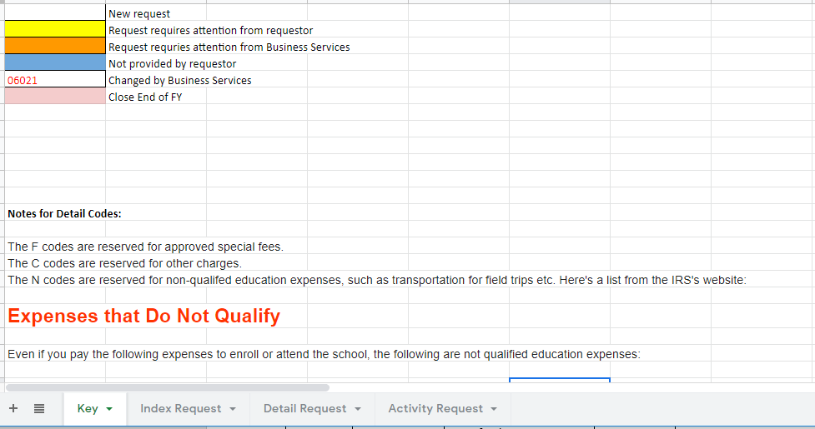
Index Code Requests (Patti)
_{PC WEST 1:30 PM - 3:30 PM}
https://docs.google.com/spreadsheets/d/18ToS0s49SojwU_a5wW7lxO_kp-_mRazK2BJPk2q_u1A/edit#gid=1513805031

Slide 11
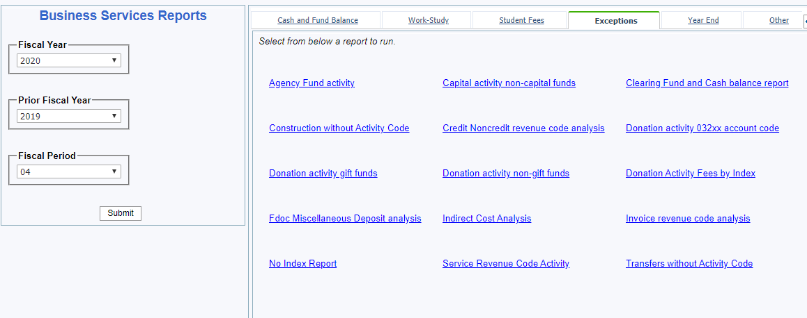
Exception Reports (Patti)
_{PC WEST 1:30 PM - 3:30 PM}

Slide 12
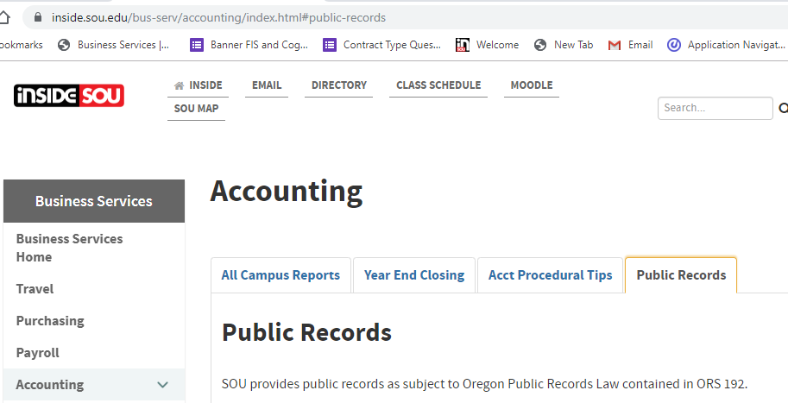
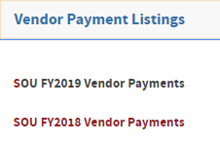
HB2500 Public Records Request (Debbie)
_{PC WEST 1:30 PM - 3:30 PM}

Slide 13
Accelerated Campus Training (Debbie) *SVC Role *Web Role *BSV Role
https://inside.sou.edu/bus-serv/training/index.html

Slide 14
Training Topics (Cynthia)

Slide 15
End

