Slide 1
FIS Reports
Fall 2013
Business Services
Intro to Financial Reports

Slide 2
Outline
Logging In
Initial Setup
Main Page
Monthly Department Reports
Other Reports
Questions

Slide 3
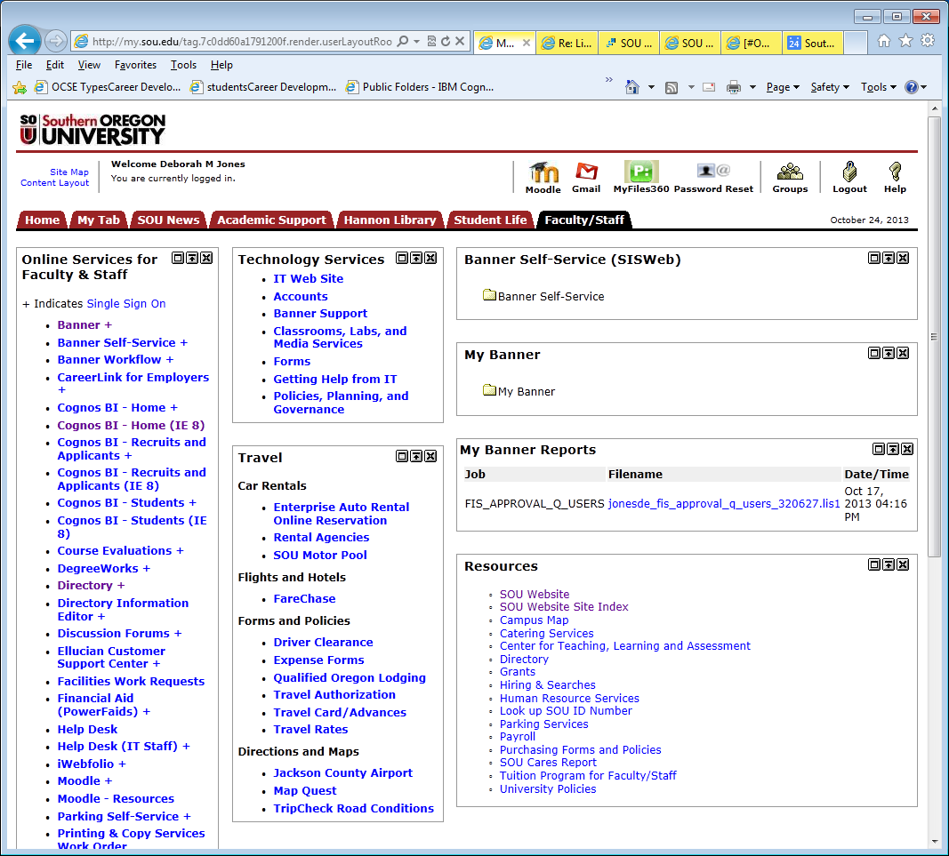
FIS Banner – Cognos BI-home +

Slide 4
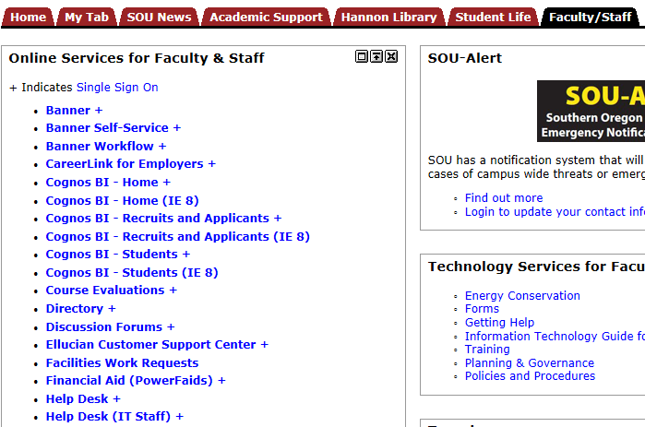
Logging in

Slide 5
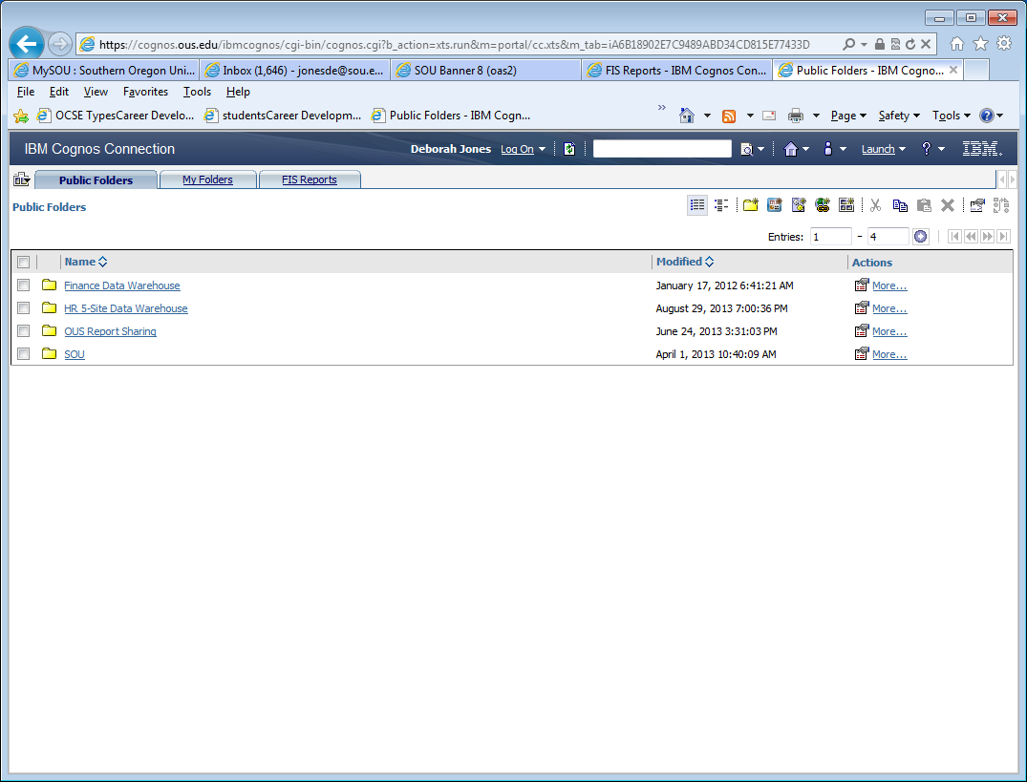
Logging in
Password process
New staff member: Need FIS Banner access and Cognos report access.
Current staff member: If you cannot gain access, you may require an “Increase” in Banner FIS access to include Cognos report access.

Slide 6
Initial setup

Slide 7
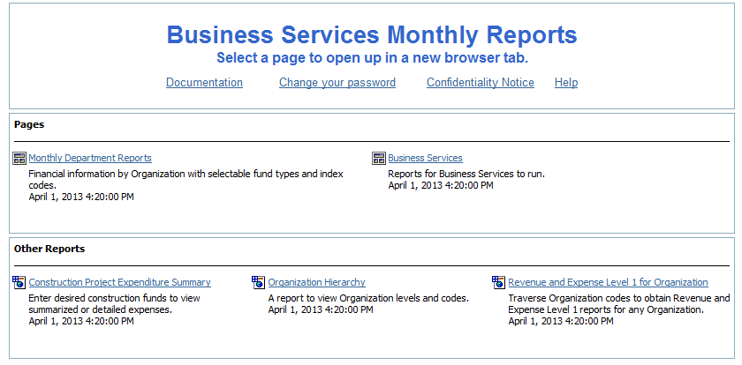
FIS Reports Main Page

Slide 8
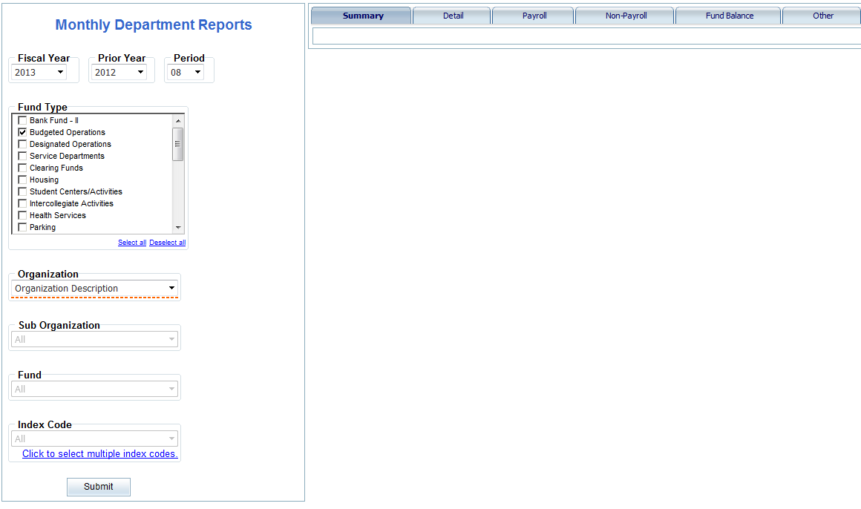
Monthly Department Reports

Slide 9
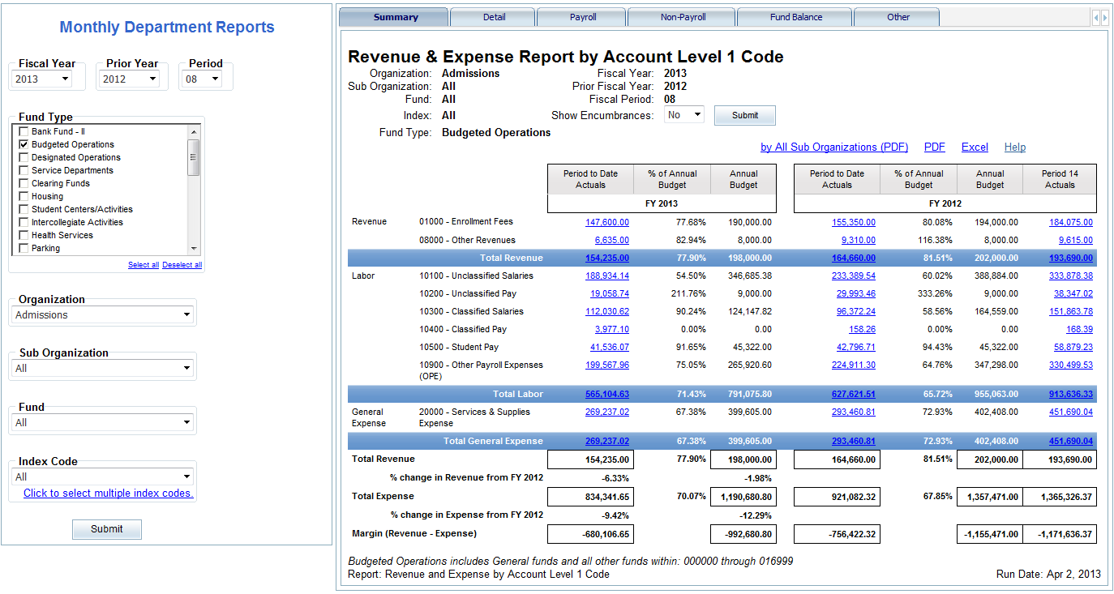
Summary Report Revenue & expense Summary & by Org code

Slide 10
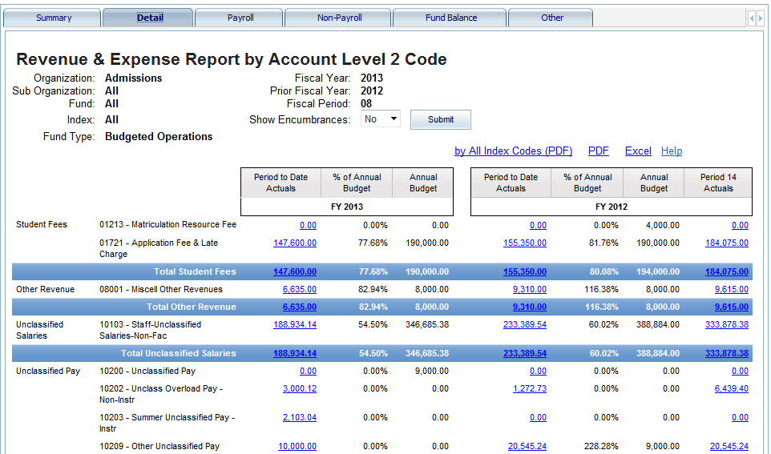
Detail report revenue & expense by index code

Slide 11
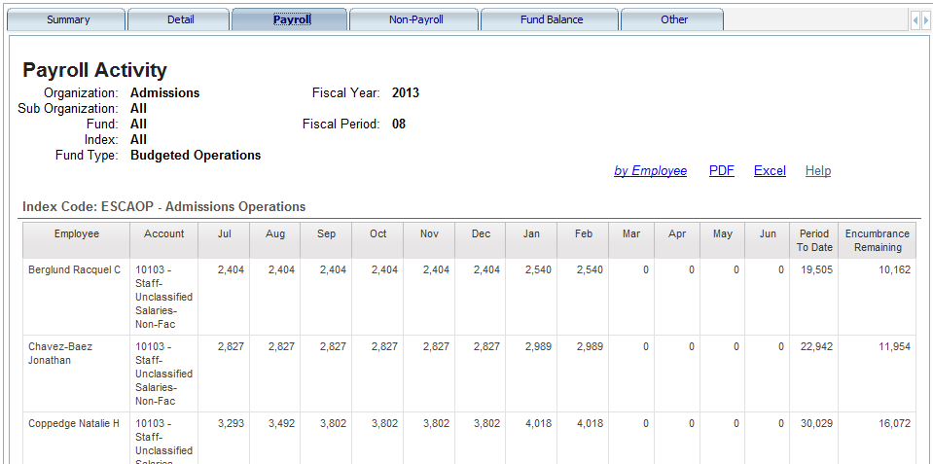
Payroll report BY 12-MONTH WITH ENCUMBRANCE REMAINING

Slide 12
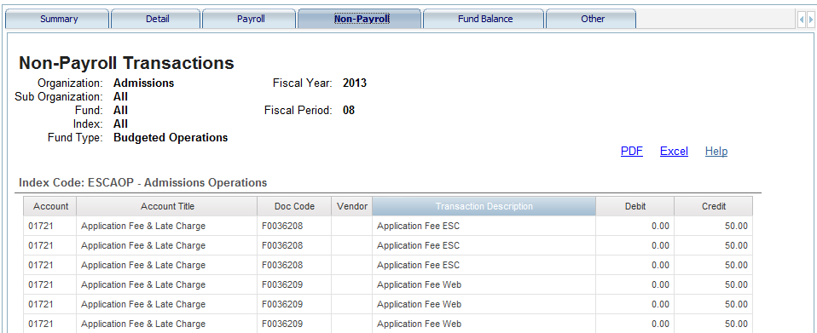
Non-payroll report

Slide 13
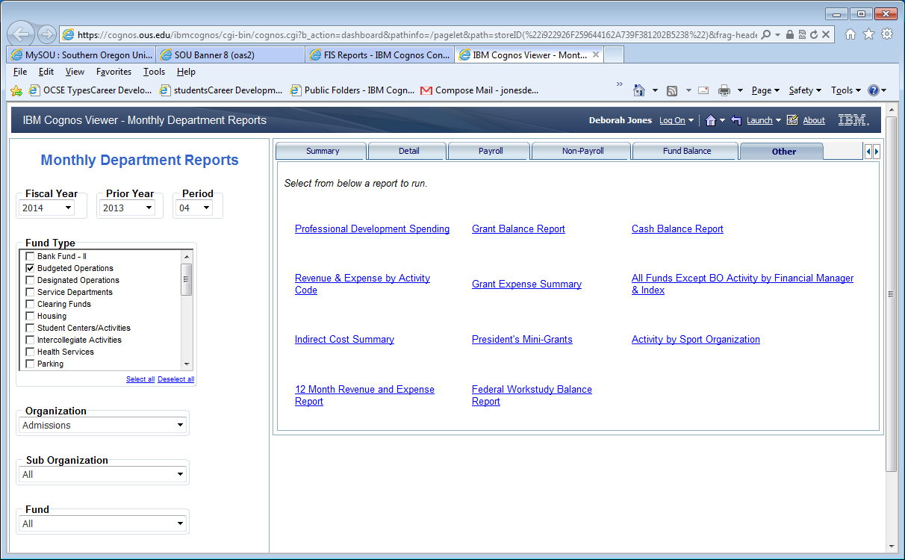
Other reports

Slide 14
Recap cognos reports: budgeted operations
“Monthly” Financial Reports are now “Real Time” Department Reports
Use Cognos dashboard and select:
DATE: Select Date Parameters (default is set to “closed period”)
FUND TYPE: Budgeted Operations
ORGANIZATION: Select your Department Organization Level
SUBMIT (retrieves data from Data Warehouse)

Slide 15
Recap cognos: budgeted operations reports
Recap of Budgeted Operations Reports
Pre-defined Reports are built in Cognos as follows:
1. Budgeted Operations Revenue & Expense Summary [Summary tab]
2. Budgeted Operations Revenue & Expense by Organization [Summary tab by All-Sub Organizations]
3. Budgeted Operations Revenue & Expense by Index [Detail tab]
[All Index Summary] and by [YTD by Index Detail]
4. Payroll Report by 12 months [Payroll tab]
5. Non-Payroll Transaction Report [Non-Payroll tab]
[By Month] and by [YTD]
6. Professional Development Spending [Other tab]

Slide 16
Questions?

Slide 17
CONTACTS
Business Services New reports, issues, training…
Steve Larvick, Director Business Services
Patti Eliot, Accounting Manager
Institutional Research (IR)
Shane Hunter, Research & Reporting Analyst
Information Technology (IT)
Programmer Analyst staff
Training, Access and Reports
Debbie Jones, Fiscal Coordinator Business Services

