Slide 1
Invoices
Processing Regular Invoices – Direct Pay
and Monitoring Status
Business Services
November 2012

Slide 2
Tips
Before entering the Invoice for paying the vendor:
Vendor must be in the Banner FIS system BEFORE the invoice can be created.
Ask the vendor to complete the Substitute W-9 Form available on the Business Services webpage:
http://www.sou.edu/bus_serv/forms/1SubstituteSOUW-9_MWESBDirectDeposit.pdf
Vendor sends the completed Form to Business Services, Vendor Maintenance (address or fax number cited at bottom of form).
After Business Services has added a new vendor, an e-mail will be sent to the List_Serv “Business Services – New Vendor”.
Have your codes ready before entering the FAAINVE form (Index, Account, ….).
Practice Zen invoice-entry techniques. This is NOT Apple software with an intuitive GUI interface.

Slide 3
Locating Data Entry Form
http://www.sou.edu/bus_serv/fis/table-of-contents.pdf

Slide 4
Invoice Entry (Page 1)
Invoice Date = Vendor Billing Date (reference only)
Transaction Date = Determines the Accounting Period the transactions is to be posted to in the SOU General Ledgers.
Payment Due Date = Determines when the payment will be issued (check or direct deposit)
NOTE: Checks are run once a week each Tuesday, at approximately 10 AM
When entering a new transaction, enter the work “NEXT” in the Document Field, and Banner will assign the next invoice number in the sequence when you hit the “page down” to begin creating the transaction.

Slide 5
Invoice Entry (Page 2)
Vendor Name = This is what will appear in the Operating Ledgers, in the “Description” Field.
Commodity = Can select from a list, or leave the number blank and manually enter a description. Although this will not appear in a Banner form summary page, it is fed to the Bi-Data Warehouse, and reports can be generated to view data by commodity.

Slide 6
Invoice Entry (Page 3)
Enter Accounting Information = Can enter multiple accounting distributions by using the “arrow down” feature after completing one entry.
NSF Override = SOU Currently does not have “Non-Sufficient Funds” checking turned on, so these indicators do not drive any actions.

Slide 7
Finding Account Codes One Option
Scroll down this page to find the link - Easily Find Account Codes in Banner
http://www.sou.edu/bus_serv/purchasing/index.html

Slide 8
Finding Account Codes Another Option
Enter FWIBDST Form under the Budget Menu – Budget Status by Index or FOAPAL Query
To view listing of Account Codes Click on the down arrow associated with the field of interest.

Slide 9
Finding Account Codes Another Option
Locating a Specific Type of Expense = Perform a Query (Query/Enter) to blank out the screen, to be in a “query mode”. Type in search letters, using the “%” sign to act as a wildcard to locate common words.
In this case, list all supply expenses (2%), with the “Tele” present somewhere in the description field.

Slide 10
Finding Account Codes Another Option
Results = Account Code Options Available for Telephone Related Expenses.

Slide 11
Invoice Entry (Page 4)
Summary Page = Shows total invoice amounts
Invoice Status = “Completed” indicator (“Y”es, or “N”o). Once marked “complete”, the document is forwarded to “approvals”.

Slide 12
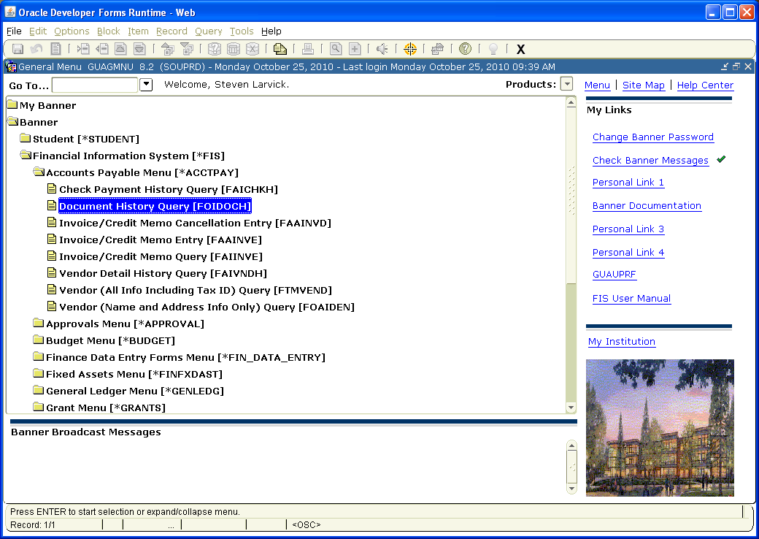
Monitoring Invoice Status

Slide 13
Document History (FOIDOCH)
Sample: Completed but not yet Approved
Invoice Status Indicators:
C = Completed
A = Approved
P = Paid

Slide 14
Document History (FOIDOCH)
Sample: Completed, Approved, and Paid

Slide 15
Locating Approval Queues
Approval by Document Entry = Shows the Approval Queues the document is currently “still” sitting.
Approval History by Document Query = Shows “who” approved the document, and “when” it was approved.

Slide 16
Approval by Document Entry (FOAAINP)
Sample:
Invoice has
Cleared All
Approval Queues

Slide 17
Approval by Document Entry (FOAAINP)
Sample:
Invoice Still Sitting
in an
Approval Queue
ANYONE listed can approve the transaction and have it cleared from the approval queue

Slide 18
Contacts
Processing Invoices:
Mark Gibbons, Purchasing Agent gibbonsm@sou.edu 552-6574
Victoria Vannice, Bus. Serv. Office vannicev@sou.edu 552-8528
Steve Larvick, Director Bus. Serv. larvick@sou.edu 552-6594
Approval Queues:
James Berry, Accounting Manager berryj1@sou.edu 552-6065
Steve Larvick, Director larvick@sou.edu 552-6594

Slide 19
Next Up
Mark Gibbons, Purchasing & Jill Hernandez, Travel Office
Business Travel – What You Need to Know
2:00 P.M.

