Slide 1
Reimbursement Request
When to Use / How to Avoid
Business Services
November 2012

Slide 2
Goals
Ensure adequate documentation and no duplication of payment for business-related supply purchases.
Simplify the reimbursement for the purchase of supplies
(the purchase of equipment should be made through the appropriate departmental purchasing process).

Slide 3
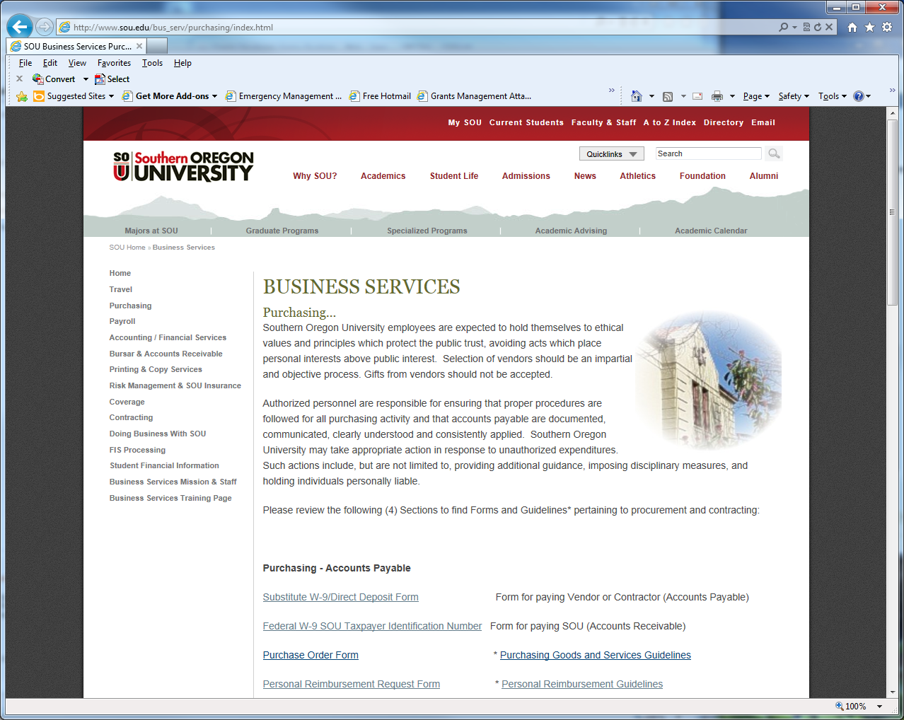
Form & Guidelines
http://www.sou.edu/bus_serv/purchasing/index.html

Slide 4
Guidelines
Cannot be issued to compensate for personal funds that were used to pay for “services”.
All items reimbursed become the property of the university or granting agency, if grant funds were used. See “Professional Development Account (PDA)” of the APSOU Collective Bargaining Agreement (p.11, Section B) located at :
http://www.sou.edu/apsou/contracts/2011-2013/20112013agreement.pdf
Requests for reimbursements must be submitted in a timely fashion in order to be issued in the same fiscal year of the purchase.
Reimbursements for hosting groups and guests still require the submission of the Hosting Form.

Slide 5
Tips
Take advantage of the Departmental Purchasing Card to avoid the need for filing the form necessary for processing reimbursement requests.
(Note: Hosting groups and guest will still require the submission of the appropriate “hosting” form, even if paid by the P-card; kept on file Card Custodian in the Department).
If access to the Departmental Purchasing Card is limited, remember that departments can have more than one Purchasing Card assigned to their responsibility.

Slide 6
Reimbursement Form
Form: http://www.sou.edu/bus_serv/purchasing/reimbursement_request.pdf
Tips
Be complete. Incomplete forms will be returned.
Be specific on the “Business Purpose” (More is Better).
Make sure receipts are itemized to clearly identify the item being reimbursed.
Use SOU ID, not personal SSN.
Enter Direct-Pay Invoice into Banner Finance, and forward documentation to Business Service Purchasing.
If reimbursement includes food/beverage, must include the Hosting Groups & Guests form http://www.sou.edu/bus_serv/purchasing/entertainment.html ...(proceed down to “Hosting Groups/Guests/Candidates” form ).
Include Activity Codes where necessary (ex: PDA funds).
Obtain appropriate approval signature (Chair, Dean, Director, VP). Note: Even if an individual is authorized to sign for a given index, they can’t sign for their own reimbursement: A Chair reimbursement must be approved by their Dean, a Director reimbursement must be approved by their respective VP, etc.
Can only be used to reimburse for supplies (not services).

Slide 7
Documentation
Receipts: must clearly itemize the items to be reimbursed.
Hosting Groups and Guests: in addition to receipts, the Hosting Form is still required to help clarify the Business-Related purpose for the event.
Equipment: typically should not be purchased outside of normal university purchasing channels, but if necessary:
Computer Equipment must still be cleared, and inventoried, by the IT department, before any reimbursements will be issues (confirmation from the IT department will be required).
Other equipment (ie,. digital cameras, phones, etc.) will require the submission of the “Off-campus” use form. Even if it’s not intended to take the item off campus, submission of the form identifies the individual in the department who will be taking responsibility for the assets while it’s entrusted to the department’s use. (Off-campus Use of University Property Form: http://www.sou.edu/bus_serv/forms/Off-campusEquipmentUse.pdf)

Slide 8
Contacts
Jill Hernandez, Travel Office
Accounts Payable Specialist
hernandj@sou.edu, 552-6553
Mark Gibbons, Purchasing Agent gibbonsm@sou.edu, 552-6574
Steve Larvick, Business Director larvick@sou.edu, 552-6594

Slide 9
Next Up
Donna Holtz, Business Services
Payroll Processes
3:00 P.M.

