Slide 1

Purchase Order Creation
Mark Gibbons-Purchasing Agent
Jayne Atkins-Fixed Asset Purchase Orders
November 30, 2012

Slide 2
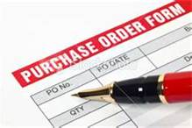
Purchase Order Outcomes
Purchase Orders Accomplish three things:
Holds aside (encumbers) funds
Produces a hard copy for the vendor
Provides the only method to enter a Fixed Asset into Banner Finance

Slide 3
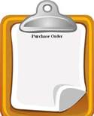
When to Create a Purchase Order
Purchase Order is required:
    To encumber funds
    Need to produce a hard copy for the vendor
    Purchasing a Fixed Asset (physical asset costing $5,000 or more – most often Equipment)
    Purchasing a Non-Fixed Asset such as
          Copier lease
          Software license
          Service / Maintenance Agreement
          Training for Equipment usage

Slide 4
TIPS – critical details to achieve success.
Do your homework BEFORE going into Banner FIS – you will need at least NINE critical elements.
Make sure you have a Buyer Code - Contact Jim Berry in Accounting.
Know whether or not you are buying a FIXED ASSET.
Practice ZEN keystroking – this is not Apple software with a friendly, touch-screen GUI (graphic user interface). KEYSTROKES matter !
Make friends – cultivate a good relationship with an SOU SME (Subject Matter Expert).
PRINTING a Purchase Order (see pages 51-57 of the FIS User Manual)
    Know the purchase order #.
    PO must have been approved and posted in Banner FIS.

Slide 5
Purchase Order Request Form
Found on Business Services Website
PO Request form must include:
  Vendor name
  Remit address
  Phone & fax number
  Index & account code
  Quantity, price per unit, shipping & total cost
  Signature by person requesting product and supervisor
  Description of item
  Manufacturer number
  Vendor product number

Slide 6
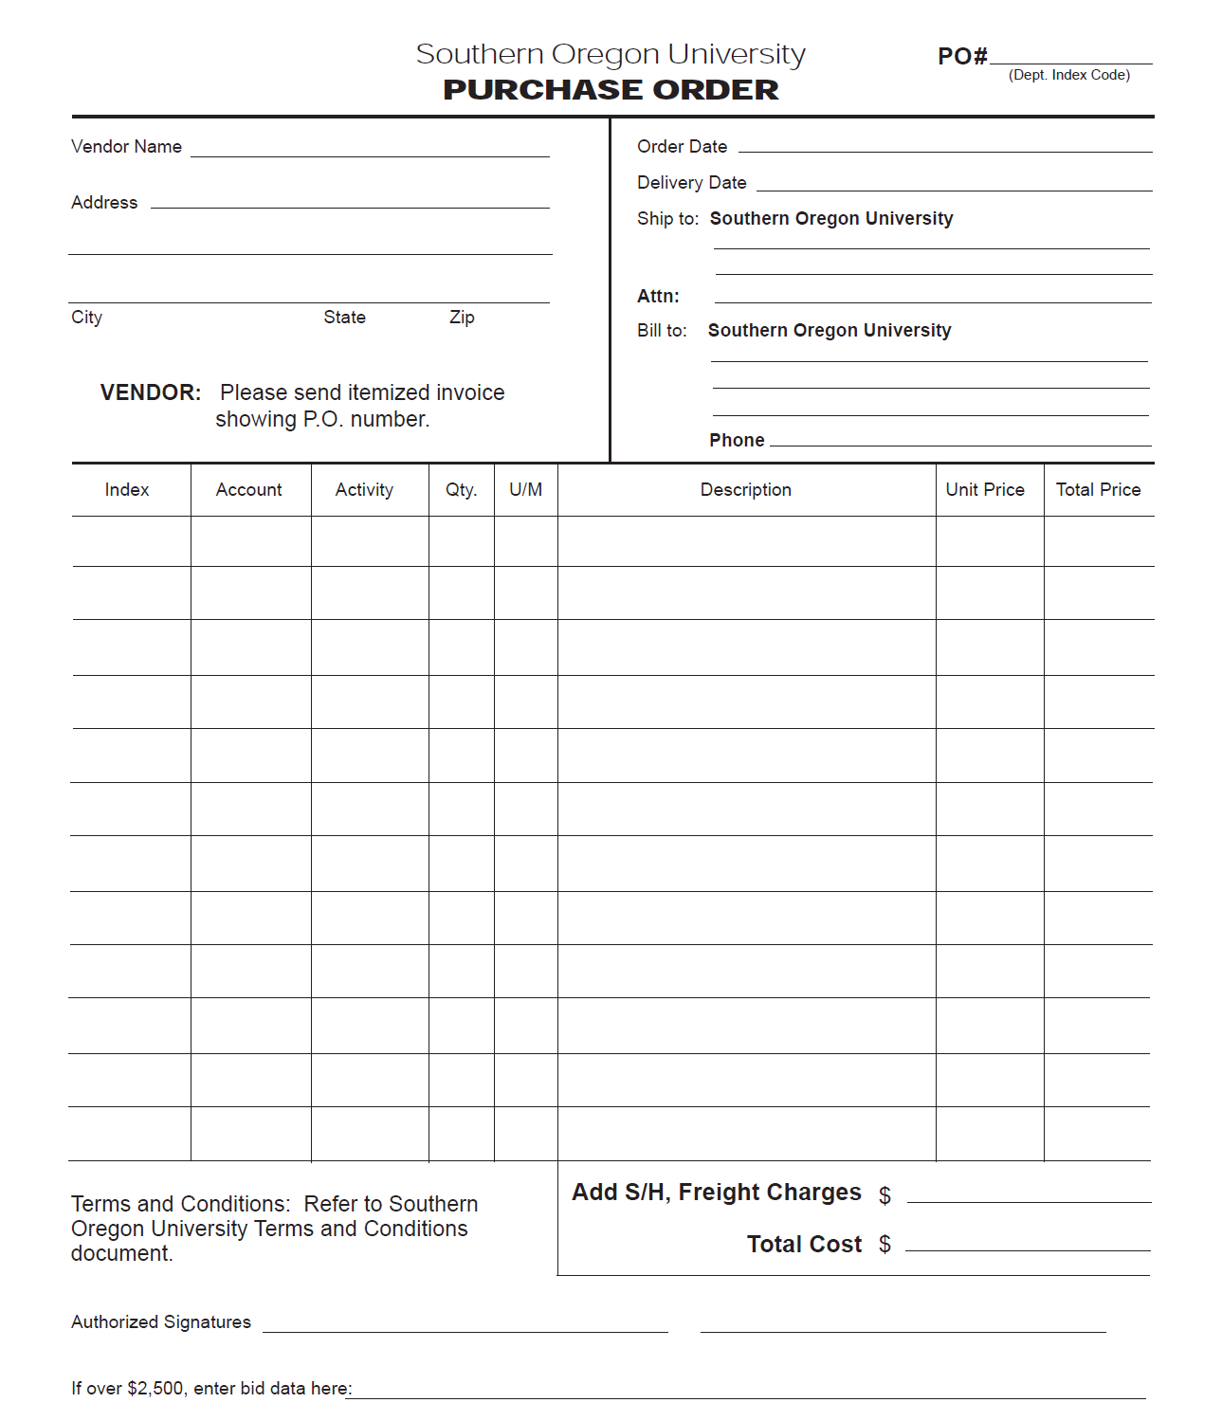

Request Form Example
Must be signed by supervisor or authorized person

Slide 7
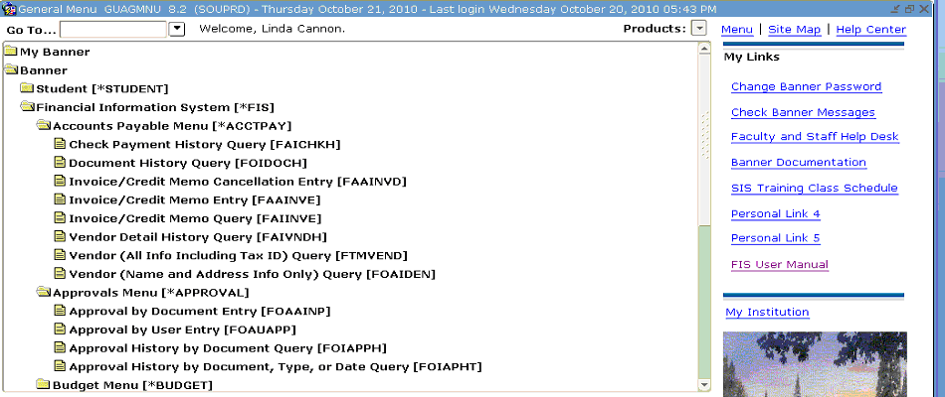
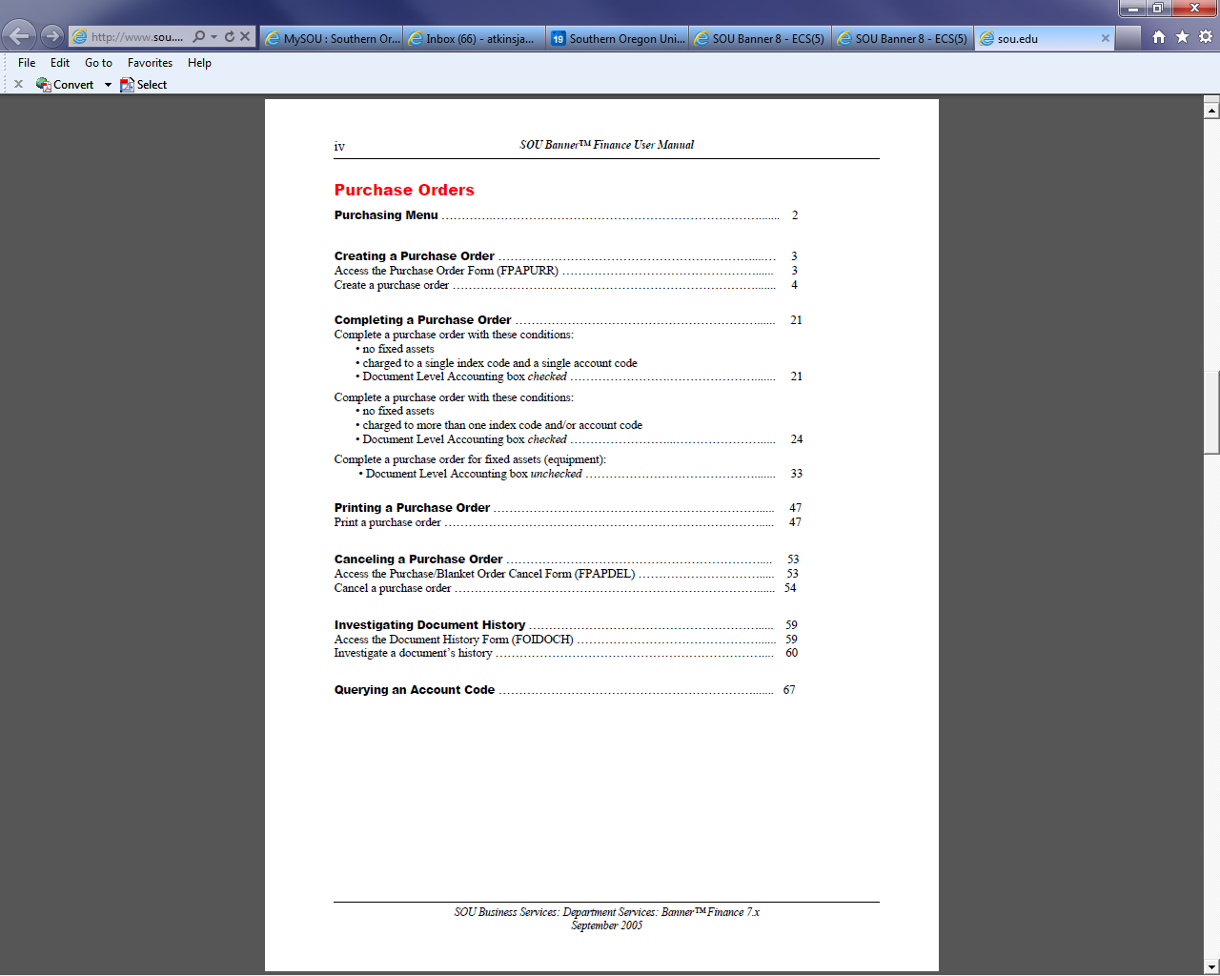
Purchase Orders
How to enter PO in Banner
Entering Purchase Order in Banner
FIS User Manual
From the Table of Contents click on the link in Red

Slide 8
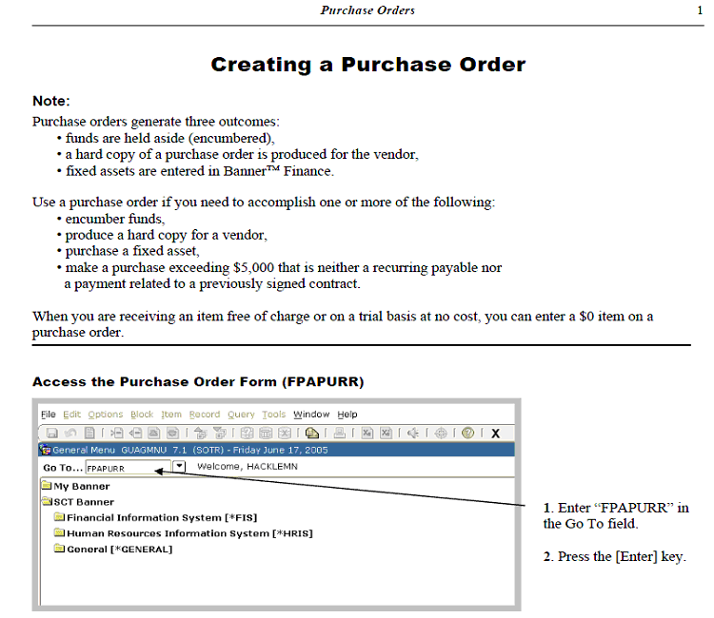
FIS Manual-Purchase Orders
Detailed instructions
Pages 1-18

Slide 9
Examples :
Non-Fixed Asset Purchase
Usually requires a Purchase Order
    Copier Lease
    Software license agreement
    Maintenance agreement (Service/Software)
    Training for Equipment Use

Slide 10
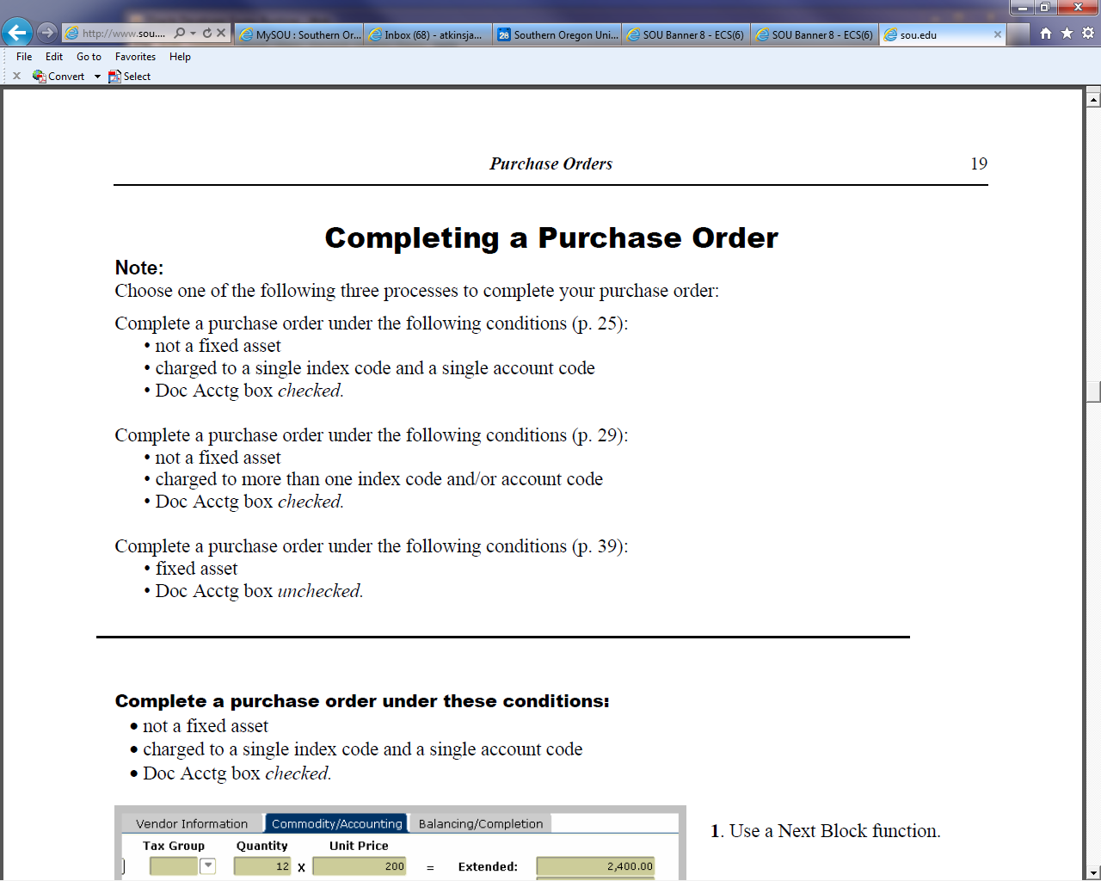
Non-Fixed Asset Purchase Order
Detailed Instructions begin on Page 19 of the FIS User Manual in Banner and continue through Page 49.

Slide 11
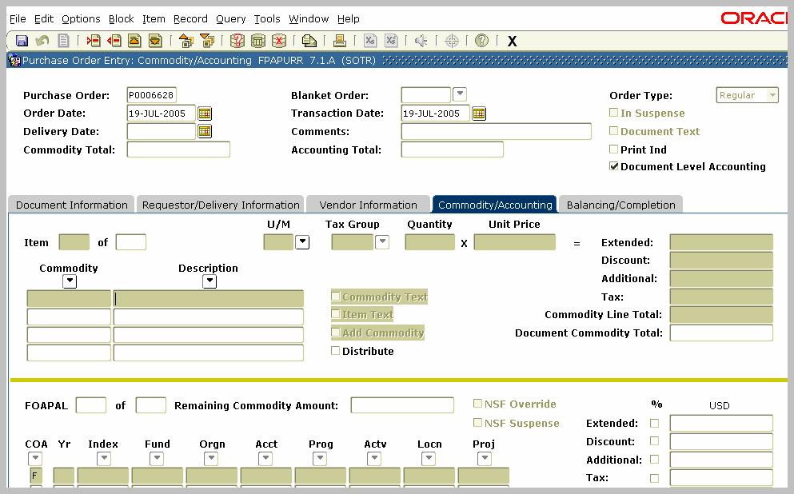
Non-Fixed Asset Purchase Order (cont.)
  Document Level Accounting
Make sure Document Level Accounting Box is CHECKED !

Slide 12
Definition of a Fixed Asset
Fixed Asset
Physical Asset such as
  Property
  Plant
  Equipment
Costing $5,000.00 or greater

Slide 13

Fixed Asset Purchase Orders
  Must pay the invoice using Regular Pay Invoice
  Closed at the end of the Fiscal Year
  Fixed Assets Only
  Use a separate Purchase Order for
    Copier leases
    Software licenses
    Service agreement
    Training on equipment
    Note - Banner will not allow for mixture of fixed asset and non-fixed asset items.

Slide 14
Document vs. Commodity Level Accounting
What is the difference
Document Level
Commodity Level
Assigns the accounting distributions to the document as a whole
Prorates the dollars evenly on generated Otags in Fixed Asset System based on the quantity
Identifies the purchase as a fixed asset
Allows assignment of accounting distributions to individual commodities

Slide 15
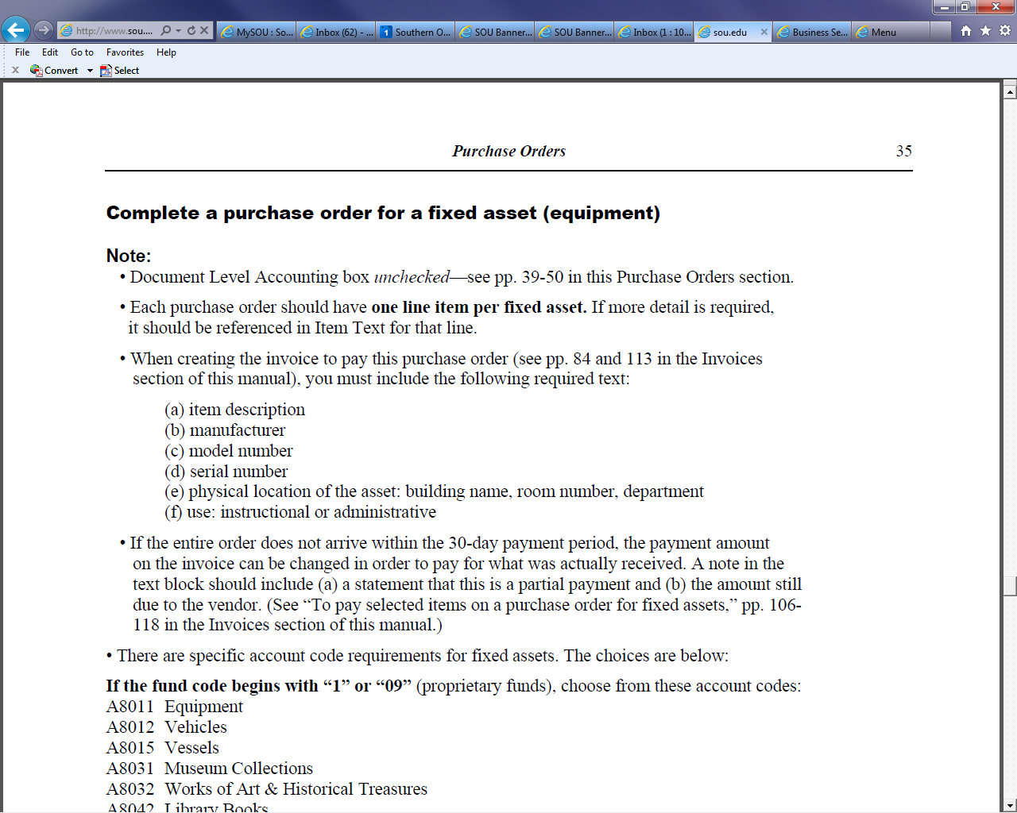
FIS Manual
Completing the Fixed Asset Purchase Order
Detailed Instruction begins on Page 35
Banner Samples begin on Page 39

Slide 16
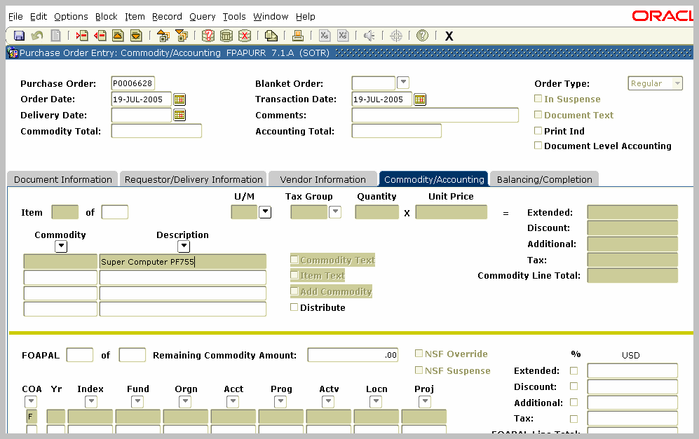
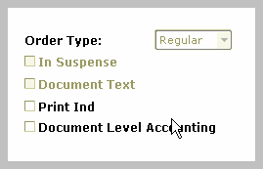
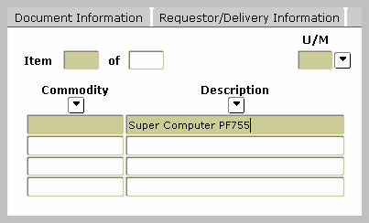
Fixed Asset Purchase Orders (cont’d)
  One line item per fixed asset
  Commodity Level Accounting
Click the Document Level Accounting box to UNCHECK it.
Enter the description of the item.
Note:
To include a longer description of an item or more detailed information
Click Options/Item Text (FOAPOXT)

Slide 17
Next Up
Jayne Atkins, Business Services
Fixed Assets
.

