Slide 1
Financial Irregularities
Reporting Suspected Financial Abuses
Business Services
November 2012

Slide 2
What is a Financial Irregularity?
Intentional misstatements or omissions of information to financial transactions that are detrimental to the interests of the institution or OUS. These may include violations of relevant Federal, State, OUS or institutional laws, rules, and procedures.
These acts include, but are not limited to embezzlement, fraud, and forgery or falsification of reports, documents, or computer files to misappropriate assets.
SOU Financial Irregularities Policy

Slide 3
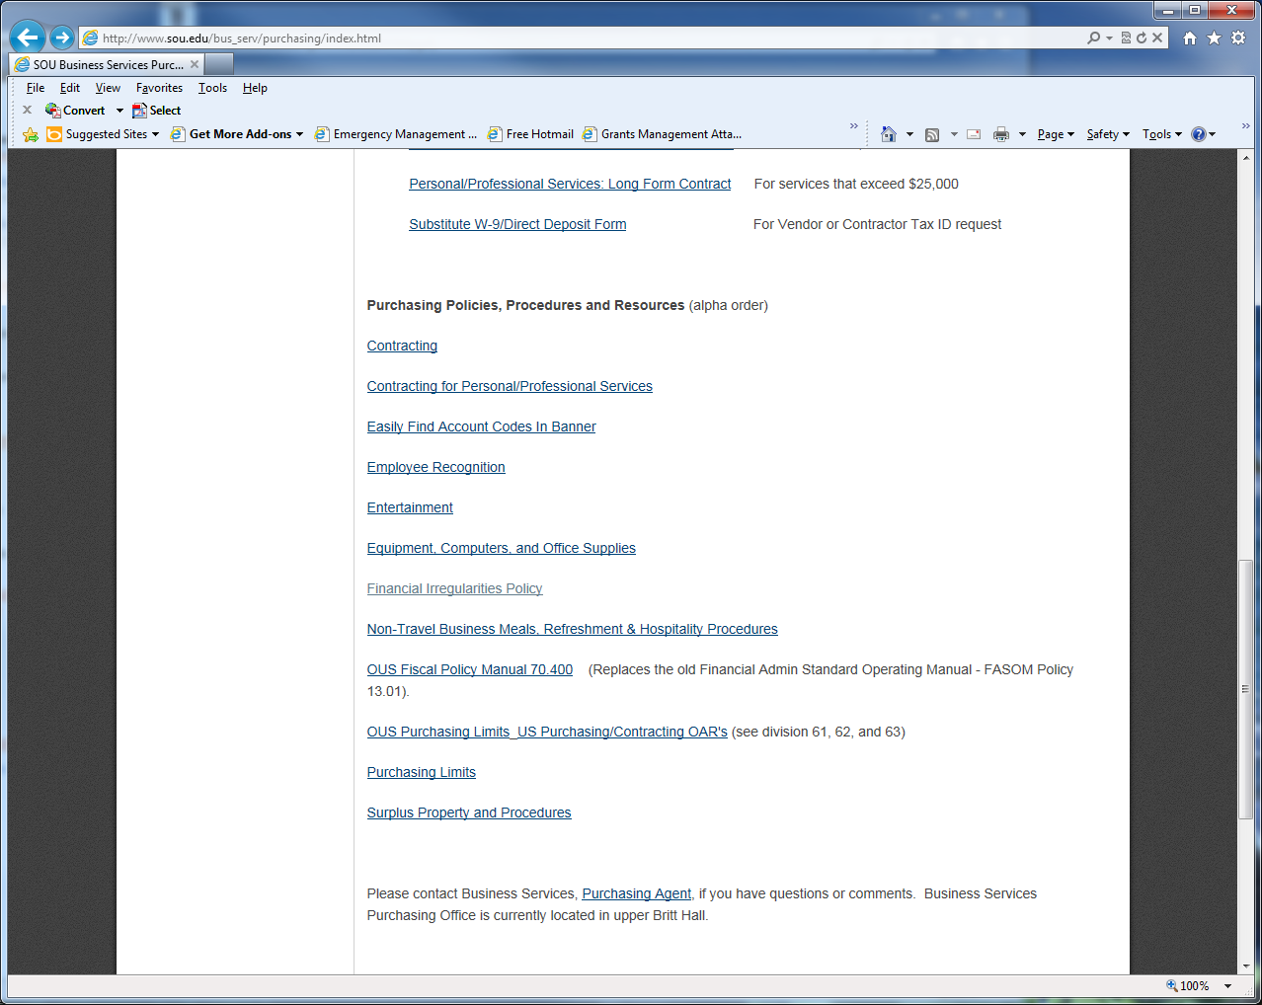
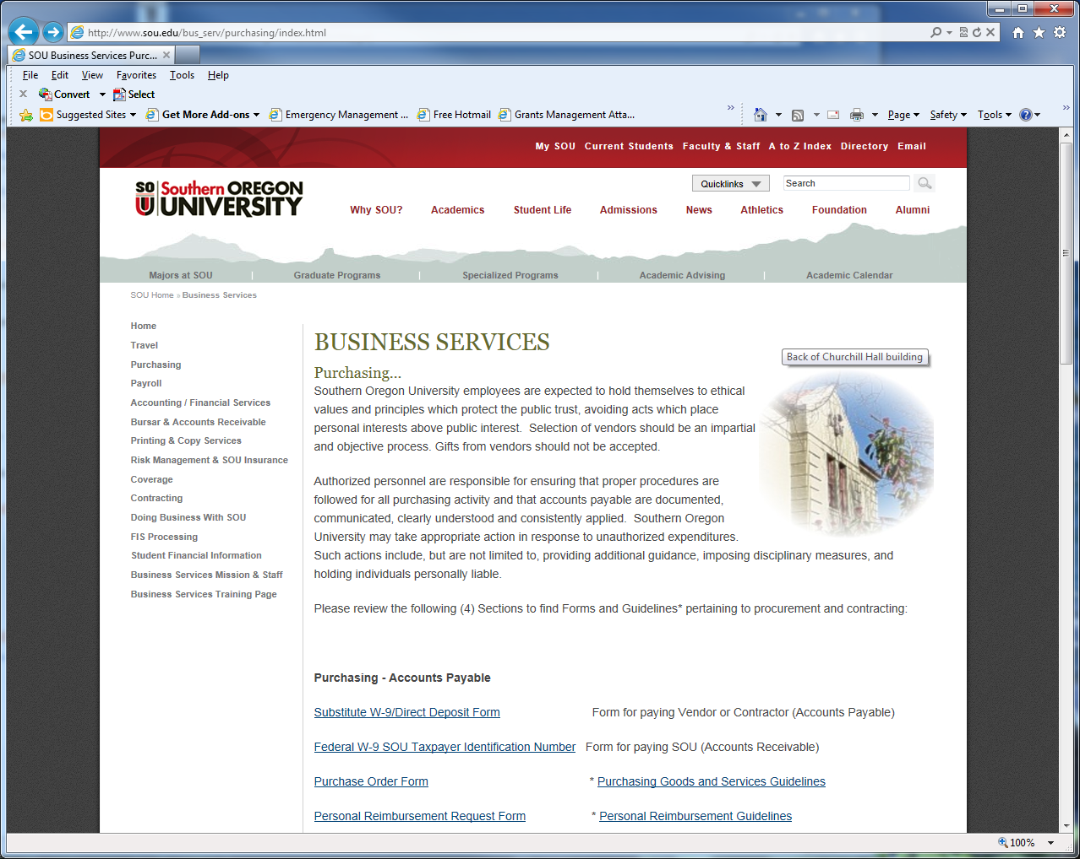
SOU Financial Irregularities Policy
http://www.sou.edu/policies/Financial-irregularities.pdf

Slide 4
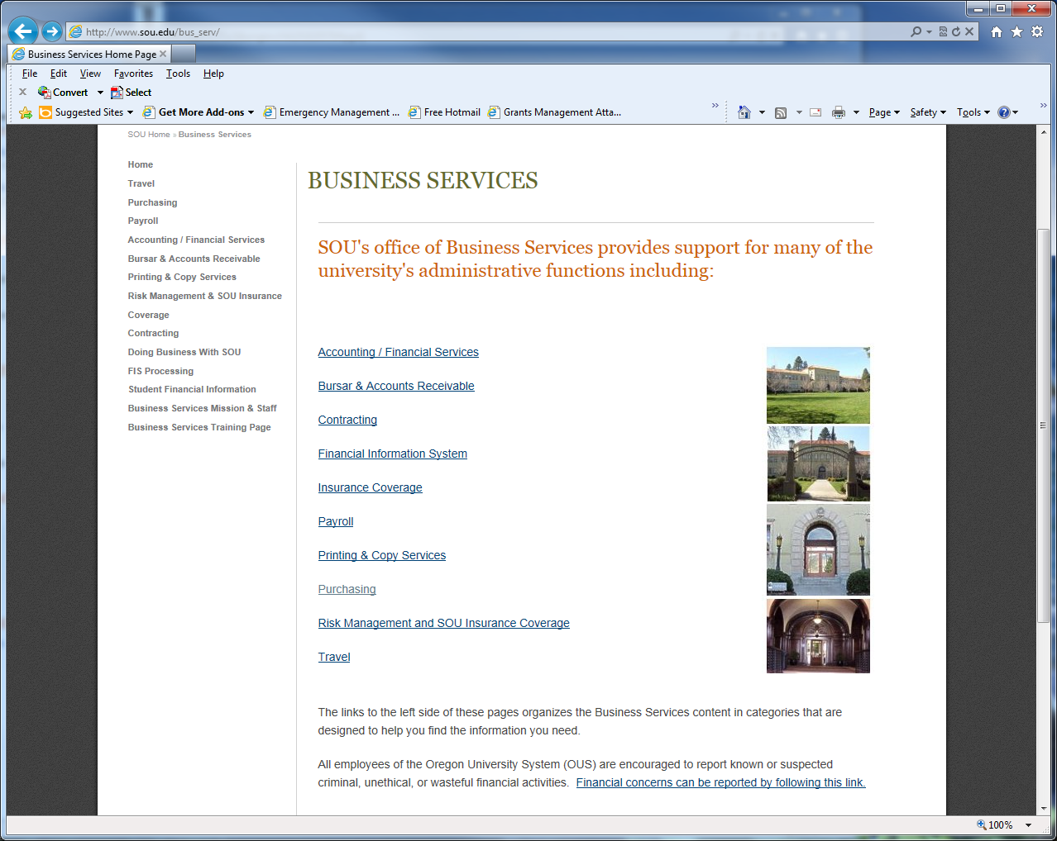
Location on Business Services for Link to OUS Website
http://www.ous.edu/dept/intaudit/fc

Slide 5
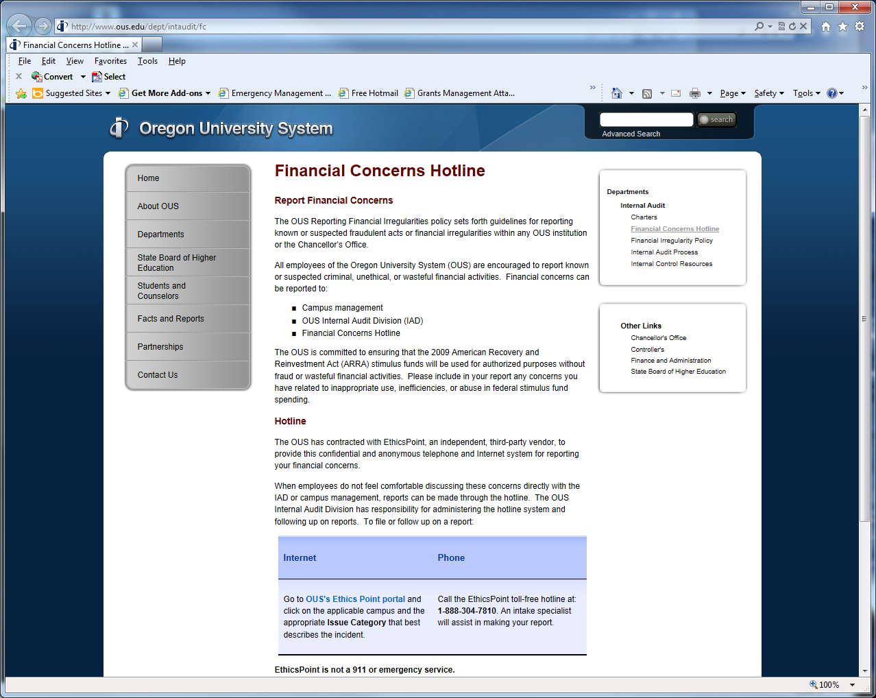
OUS Financial Concerns Website

Slide 6
Contacts
Craig Morris, V.P. for Finance & Administration,
and SOU Designated Administrator
morrisc@sou.edu 552-6319
Steve Larvick, Director of Business Services
larvick@sou.edu 552-6594

Slide 7
Next Up
Steve Larvick, Business Services
Procurement – Bid, RFP or Sole Source
1:00 PM

