Slide 1
Fund and Cash Balances: Definitions and How to Reconcile Them
March, 2015

Slide 2
Fund Codes and Types
A Fund identifies a particular pool of money. Coded within a fund is the source of the fund (institutional, federal, etc.) and whether that pool of money is restricted or unrestricted.
There are several fund types that have specific pertinence to Southern Oregon University:
General Funds are funds that account for the support of for-credit academic program, operations and income of the university.
Agency Funds are funds that the university holds in trust for the benefit of individuals associated with the university. For example, student club funds are agency funds because how the funds are spent is ultimately the responsibility of the club.

Slide 3
Fund Codes and Types
Internal Service Funds are used for operations serving other funds and departments. Certain service providers, such as the copying and printing departments, are internal service funds.
Designated Funds are used for operations that are isolated, so that budgetary authorities can monitor these programs more closely. This fund group includes non-credit workshops and some of the service centers such as Jefferson Public Radio.
Unrestricted vs. Restricted Funds: Unrestricted funds use assets that can be used at the discretion of the governing board. Restricted funds use assets subject to restrictions assigned by the donor, such as grants.
Auxiliary Funds are funds that that support our students and faculty in ways other than direct instruction. These funds operate like individual businesses on campus, engaging in revenue generating activities outside of the main operational goals of the campus. Housing and Parking are both examples of auxiliary funds.

Slide 4
Current Operating Funds Defined
Budgeted Operations
(0-016999
Includes General Funds)
Designated Operations
(050000-070000)
Service Centers
(090000-999999)
Auxiliaries
(100000-199999)
Restricted Funds
(200000-489999)
Student Loan Funds
(490000-494001)
Endowment Funds
(600000-619999)
Plant Funds
(800000-849999)
Agency Funds
(900000-929999)
-----
Funds Associated with Fixed Assets
Funds Associated with Long-Term Debt
Includes
Excludes

Slide 5
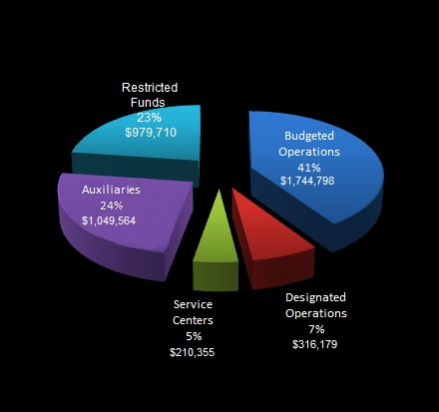
Operating Fund Types at SOU at End of FY 2014

Slide 6
Watch Out for that General Fund!
Unless the Organization is listed as the only authority of a specific fund, funds that help support a department will not display in the Cognos Report.
Cognos lists funds in terms of budgetary authority and departments do not have budgetary authority over General Funds.
The spending authority on the General Fund is the budget itself.

Slide 7
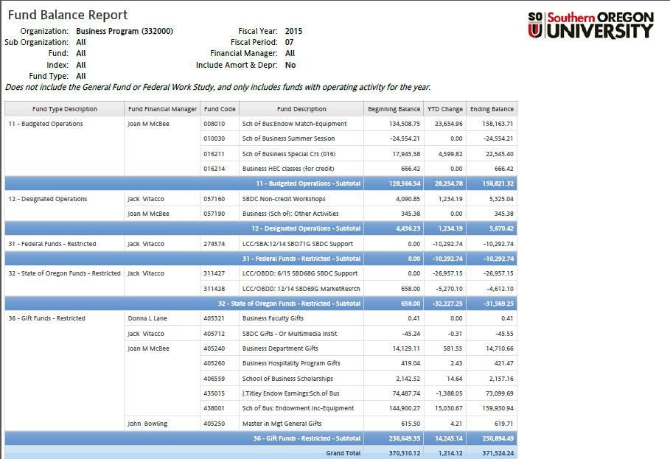
Fund Balance Report- By Fund Type

Slide 8
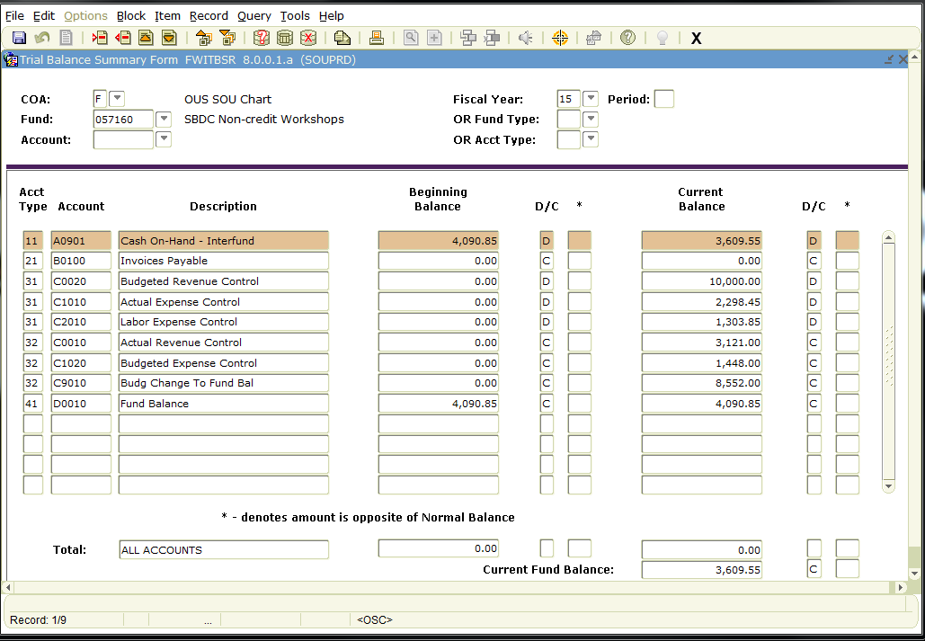
Current Fund Balance
Beginning Fund Balance
+ Actual Revenue Control
Actual Expense Control
Labor Expense Control
= Current Fund Balance

Slide 9
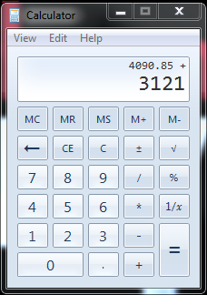
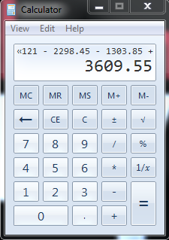
Banner Screen-FWITBSR
Beginning Fund Balance
$4,090.85
Actual Revenue Control
+ $3,121.00
Actual Expense Control
$2,298.45
Labor Expense Control
$1,303.85
Current Fund Balance
$3,609.55

Slide 10
Why Not Just Look Up the Cash Balance?
The Cash Balance is often a less useful planning tool for Fund Managers.
The Cash Balance includes funds that may be earmarked for salaries or debt sinking funds, so while the cash may be physically there, fund managers should not spend it.
The cash balance doesn’t include revenues that were earned but not collected, so the cash balance may be understating the economic position of the fund at the same time.

Slide 11
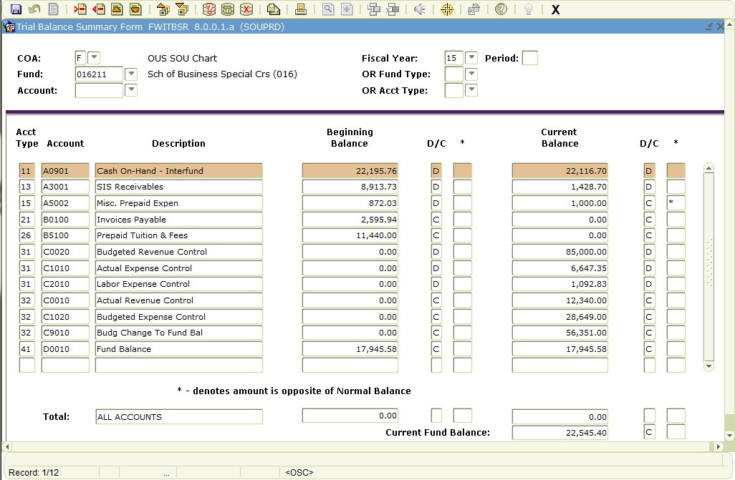
How Does the Fund Balance Relate to the Cash Balance?
Basically,
Cash
+ Current Assets
– Current Liabilities
= Current Fund Balance
Cash on-hand Current Balance
+ SIS Receivables
+ Misc. Prepaid Expenses
- Invoices Payable
Prepaid Tuition and Fees
Current Fund Balance

Slide 12
How Does the Fund Balance Relate to the Cash Balance?
Cash on-hand Current Balance
+ SIS Receivables
+ Misc. Prepaid Expenses
- Invoices Payable
Prepaid Tuition and Fees
Current Fund Balance
$22,116.70
1,428.70
-1,000.00
-0.00
-0.00
$22,545.40

Slide 13
Other Items to Watch Out For!
When looking up the Fund Balance in Banner, there is one additional concern:
In some of the Auxiliaries and Service Centers, the total Fund Balance includes Funds Associated with Undepreciated Fixed Assets and Funds Associated with Debt Obligations. To find out the Fund Balance available to support daily operations, the balance must be netted together.
This does not affect the Cognos Report because that report only includes Operating Activity Funds.

Slide 14
Watch Out!
Fund Balance
+ Undepreciated Fixed Assets
- Debt Obligations
Net Fund Balance Available to Support Daily Operations
Housing Fund Balance, FY 2014
$1,500,358.80
Undepreciated Fixed Assets, FY 2014
$17,458,694.91
Debt Obligations, End of FY 2014
+ ($16,952,177.47)
$993,841.36
Housing Fund Balance End of Year, 2014

Slide 15
Fund or Cash Balance
We are here to support you and your clients with any fund or cash balance questions.
Please contact Business Services if you have any questions or need assistance!

Slide 16
Contacts
For assistance
Contact: Accounting Manager
541.552.6065
Contact: Business Services Director
541.552.6594
http://www.sou.edu/bus-serv/staff.html

