Slide 1


Train the trainer
Business Services
Workshop: Cognos & FIS Banner focus 11/18/2020
This Photo by Unknown Ahor is licensed under CC BY-SA-NC

Slide 2

Train the trainer
Table of Contents
1-Business Services Goals
  Overview of Role(s)
2-Determining Banner Training
  Training Understanding of Financial Reports
    Cognos FIS Reports
    Cognos Fund Balance Report
    FIS Banner Navigation & Functionality
3-Benchmark
    Accelerated Campus Learning & Improving
This Photo by Unknown Author is licensed under CC BY-SA

Slide 3

1-Business services overview of Goals
MISSION BUSINESS SERVICES
Maintain Accelerated Organizational Learning & Improving
Maintain Quality Accounting Data (accurate)
Financial Reports meet campus needs (timely)
3. Accounting practices assure compliance
4. Demonstrate Policy Leadership & Advocacy

Slide 4
Business services – Overview of roles goal: Maintain Accelerated Organizational Learning & Improving
1- accelerated learning > staff roles
Director/Controller | Deputy Director & Management | Fiscal Coordinator 2 | Training Campus 7/1/2015+
Lead: Set Expectations Purpose Set & Processes Explained Shape the direction & supporting procedures/guidelines | Accountability: of Individuals Purpose Implemented- Work together & Cross-Train What is to be Learned | Information in-out: Track: Training Topics Web: Advance work Facilitate the Training Presenter goals Coordinate PPTX handouts/invites Track Process of Improvement & Provide fiscal support to mgt. | BSVC Accounting: 1) FIS Banner navigate 2) Cognos Dashboard 3) Train campus- Understanding Financial Reports / Budget piece SVC Daily Ops: 4) Mutual support & related tasks BSV Accounting Mgr: 5) Pcard Adm & Recon

Slide 5

2-Business services – determine training
“understanding financial reports”
Prepare to Train
Security Profile Request (pdf)
FIS Training – Monday.com tracking (link)
Review & Decide on Training Needs
  Security Class Assignments - Review (pdf)
  Schedule (Zoom) Training
Plan Training Steps
Cognos Reports Dashboard
FIS Banner Admin - Navigation
FIS Banner Functionality - Banner screens

Slide 6
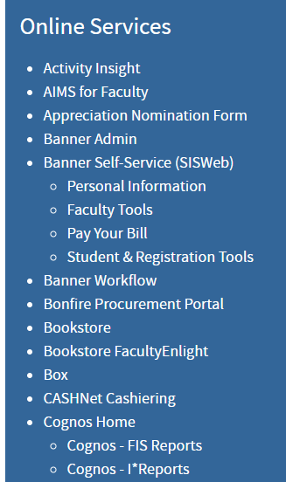

TRAINING – cognos only
Verify that person can access Cognos Reports
Go to: Cognos Dashboard –My Portal - FIS Reports
Set up Zoom training session date
Zoom Meet: Open inside.edu: Demo navigation
Follow Cognos Training Steps (next slide)
Decide who runs Reports they need/Cognos/Banner?
Mark Monday.com as done (note date of training)
This Photo by Unknown Author is licensed under CC BY-NC

Slide 7
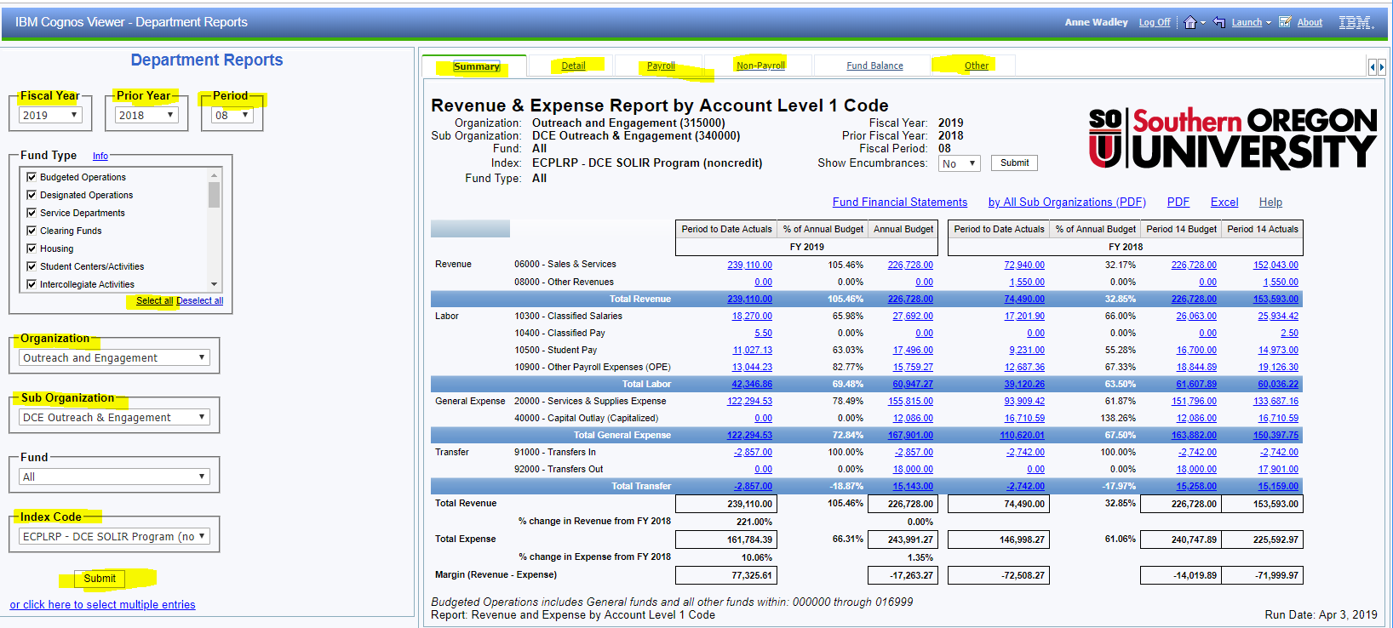
Cognos report training new user….steps
Select appropriate Fund Type:
Bud Ops
or
All Except Bud Ops

Slide 8

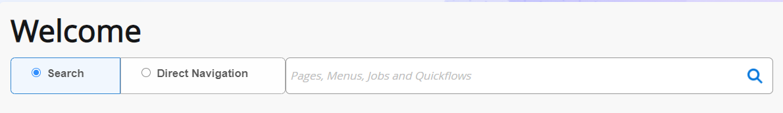
TRAINING – FIS BAnner
Security FIS Banner Profile – What is user position? (links)
Set up Zoom training session date
Zoom: Open inside.edu: Banner Admin train side-panel
Demo Banner 9x Navigation search bar functionality
Demo: FIS Banner Screens
Monday.com – Mark as DONE (note date of training)

Slide 9

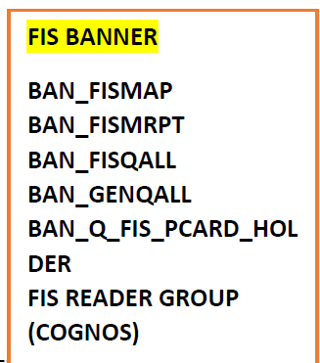
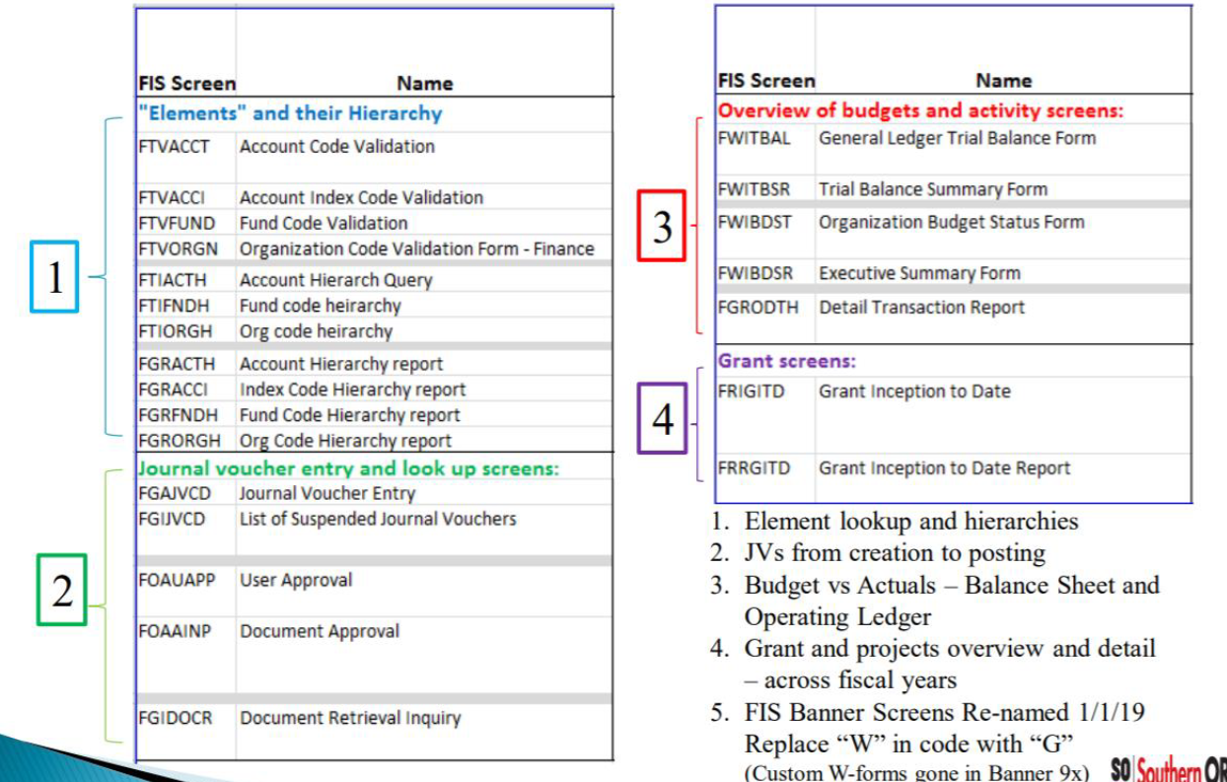
RECAP: Common FIS training
FIS Common Banner Classes
FIS Banner Screens

Slide 10
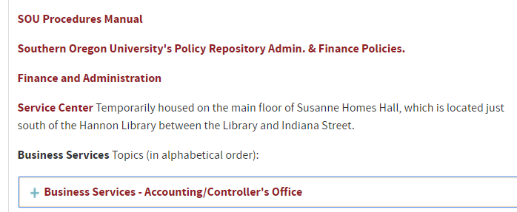

Common “Basic” training
Accounting Cycle
  Month End Close for period
  Financial Reports available - Cognos Dashboard Navigation
  YE Closing of Books
All Campus Training Dates
Web Tour:
https://inside.sou.edu/

Slide 11

COMMON FIS ORIENTATION TRAINING
Business Services link
Service center link
  Hierarchical Structure Reports
  FOAPAL elements
  & Index Code w/Account Coding
  Disposal of Fixed Assets
  Reserves
  Gifts
  Budget to Actual
Contracting
Lease Agreements
Payables
Receivables
Daily Deposits
Procurement Card
Off-campus items
Record Retention

Slide 12

3-Business services – BENCHMARKS finance services link
Maintain accelerated organizational
learning & improving
Maintain quality accounting data
Improve Customer-Competencies
Stay Relevant across campus
Mission 1: Provide customer-driven services to students, campus depts., and SOU community in support of all other departmental missions.
Improve Knowledge Competencies
Transactions monitored/Process control
Mission 2: Insure the accuracy and integrity of financial and business policies, processes, records, and the reporting or publication of financial information.

Slide 14

Train the trainer
Contacts
Business Services
& Helpful links
Mission and Staff
& Training Helpful staff
  Deputy Controller
  Accounting Manager
  Fiscal Coordinator 2
  Accountant Group

