Slide 1


Travel
Business Travel Reimbursement
Summary of Travel and Transportation Rates
One-Day Trips (no overnight stay)
Business Services
January 2016

Slide 2
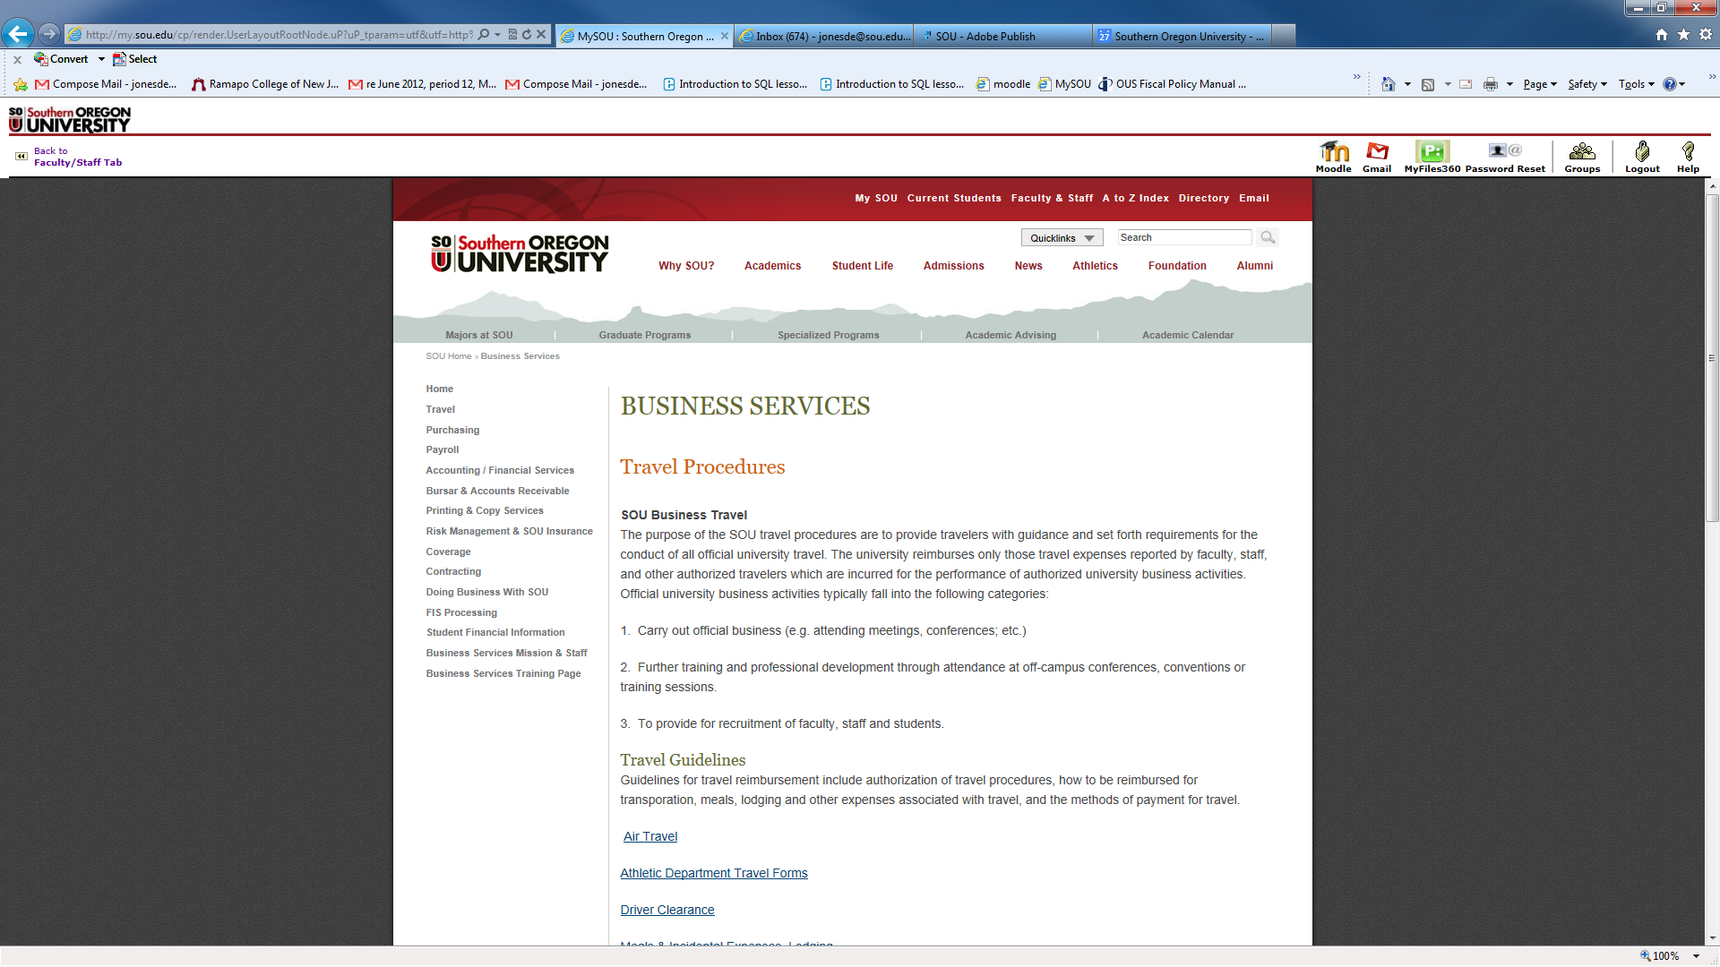
Website – Travel Index
Institutional Policy OUS #95.100.250

Slide 3
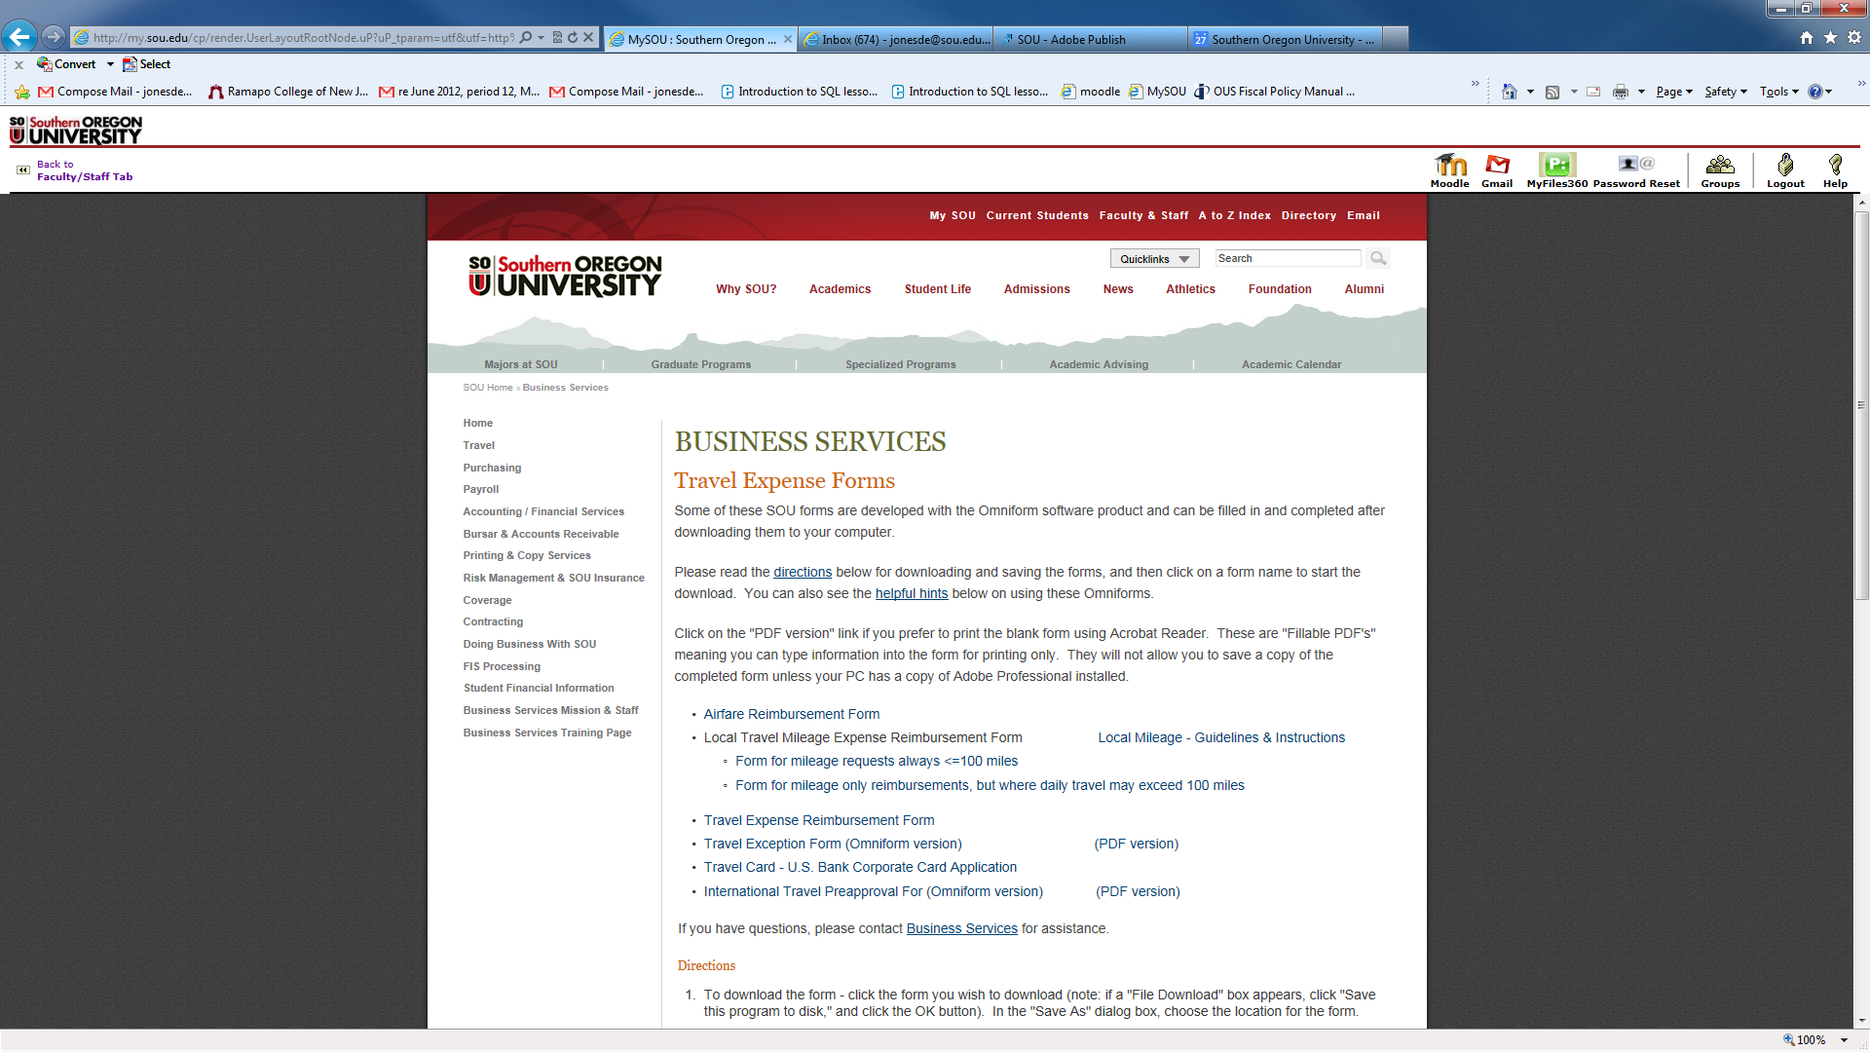
Website -Travel ExpenseForms
Travel Forms

Slide 4





Travel Reimbursement
Actual Meal Expense
Reimbursement of actual expense is only allowed under specific circumstances:
Hosting official guests and groups
Athletic team and student group meal expenses
OUS Board members and unpaid members of advisory committees

Slide 5
Business Travel
Reimbursement Overview
Purpose of Travel – State purpose on Travel Reimbursement Request Form
  Carry out official business of the university
  Professional Development
  Recruitment of faculty, staff and students
Types of Travel
  Overnight Stay [24 hour period]
    Lodging
    Transportation
    Meals & Incidental Expense Per Diem
  One-day Trip
    Mileage
    Meals Allowance (if meet criteria)

Slide 6

Travel Reimbursement
Per Diem on Overnight Stay
Meal and incidental expenses are reimbursed at a per diem rate approved by SOU.
  Refer to:
  http://www.sou.edu/bus-serv/travel/travel-rates.html
Meal and incidental expenses may be reimbursed only if the traveler qualifies for lodging-expense reimbursement, except as noted herein.
Incidental expenses are combined with Meals into a Single Rate.
  Include: Fees and tips give to porters, baggage carriers
  Transportation between lodging and where meals are taken
  Payment of employer-sponsored charge card billings.
  Not Included: Expenses for laundry, lodging taxes, calls.

Slide 7
Travel Reimbursement
Pro-Rate Schedule Per Diem
Full and Partial day travel
Proration of Meals & Incidental Expenses Schedule
(Per Diem for partial days involving an overnight stay)
Meal per diems for initial day of travel and final day of travel will be pro-rated based on the following schedule:
Initial Day of Travel - Leave | Prior to 7:00 AM | 7:00 AM to 12:59 PM | 1:00 PM and after
Meal Allowance | Breakfast, lunch, dinner | Lunch, dinner | Dinner
Final Day of Travel - Return | Prior to Noon | 12:00 Noon to 5:59 PM | 6:00 PM and after
Meal Allowance | Breakfast | Breakfast, lunch | Breakfast, lunch, dinner

Slide 8
Summary of Meal Allowance Per Diem rev. 1.1.2016
Breakfast = 25%
Lunch = 25%
Dinner = 50%
Initial Day of Travel: Departure | Prior to 7:00am | 7:00am to 12:59pm | 1:00pm and after
Meal Allowance | 100% | 75% | 50%
In-State | $57.00 | $42.75 | $28.50
Out-of-State (Low Cost) | $57.00 | $42.75 | $28.50
Out-of-State (High Cost) | $68.00 | $51.00 | $34.00
Final Day of Travel: Return | Prior to Noon | Noon to 5:59pm | 6:00pm and after
Meal Allowance | 25% | 50% | 100%
In-State | $14.25 | $28.50 | $57.00
Out-of-State (Low Cost) | $14.25 | $28.50 | $57.00
Out-of-State (High Cost) | $17.00 | $34.00 | $68.00
No receipts are required for meals that fall within the allowable rates.
  The rate for full day meals at commercial establishments are set at high and low per diem amounts based on destination.

Slide 9

Travel Reimbursement
Meal Allowance on One-Day Trips
Meals on One-Day Trips
This is a meal allowance and, therefore, no receipts are required for meals that fall within the allowable rates.
When a traveler departs and returns the same day, meal expenses are only reimbursed in the following cases:
OUS Board member or unpaid member of an advisory committee
When meal is part of the agenda and the cost of meal has not been previously paid with the registration fee.
When directed to attend mealtime business meeting, including community or public relations meetings.
Trips by athletic teams and student groups.
Meals for one-day travel will not be reimbursed unless as noted above.

Slide 10

Travel Reimbursement
Meal Allowance
Full day Travel - LUNCH ALLOWANCE
OUS Policy FPM 95.100, section .250 states that when a traveler departs and returns the same day, meal expenses are reimbursed "when directed or required to attend mealtime business meetings, including community or public relations meetings."
The standard that has been applied is that "mealtime business meetings" are official business meetings that are scheduled to be held at a specific location during or over the regular meal time, such as Board meetings, Administrative Council, Academic Council, Directors of Business Affairs, or community or public relations meetings, attendance at which is a required part of your work.
If there is no mealtime business meeting, then lunch is not reimbursable.
Be sure to note PURPOSE of trip on the Reimbursement Request Form.
If no overnight stay, then see “One-Day Trip” Travel Reimbursement.

Slide 11
Travel Reimbursement
Meal Allowance
Full day Travel – BREAKFAST ALLOWANCE & Taxability
OUS FPM 95.100, section .250 provides for a breakfast allowance when an employee leaves their official station for out of town business two or more hours before the beginning of the normal work schedule.
These breakfast allowances are taxable to the employee:
Account code 28502 (Overtime Meal Allowance) should be used on the travel reimbursement. The taxable amounts are processed through payroll and taxed on a monthly basis. They will appear on the earning statement as a "perquisite-non-cash" item and will be included in taxable income on the W-2 at the end of the year.
Note: These breakfast allowances are taxable ONLY to employees. These breakfast allowances for non-employees are NOT taxable and should be coded with the appropriate travel account code.
If no overnight stay, then see “One-Day Trip” Travel Reimbursement.

Slide 12
Travel Reimbursement
Meal Allowance
Full day Travel – DINNER ALLOWANCE & Taxability
OUS FPM 95.100, section .250 provides for a dinner allowance when an employee returns to their official station two or more hours after the end of the normal work schedule.
These dinner allowances are taxable to the employee:
Account code 28502 (Overtime Meal Allowance) should be used on the travel reimbursement. The taxable amounts are processed through payroll and taxed on a monthly basis. They will appear on the earning statement as a "perquisite-non-cash" item and will be included in taxable income on the W-2 at the end of the year.
Note: These dinner allowances are taxable ONLY to employees. These dinner allowances for non-employees are NOT taxable and should be coded with the appropriate travel account code.
If no overnight stay, then see “One-Day Trip” Travel Reimbursement.

Slide 13
Meal Allowance One Day Trip rev. 1.1.2016
Breakfast = 25%
Lunch = 25%
Dinner = 50%
Initial Day of Travel: Departure | Prior to 7:00am | 7:00am to 12:59pm | 1:00pm and after
Meal Allowance | 100% | 75% | 50%
In-State | $57.00 | $42.75 | $28.50
Out-of-State (Low Cost) | $57.00 | $42.75 | $28.50
Out-of-State (High Cost) | $68.00 | $51.00 | $34.00
Final Day of Travel: Return | Prior to Noon | Noon to 5:59pm | 6:00pm and after
Meal Allowance | 25% | 50% | 100%
In-State | $14.25 | $28.50 | $57.00
Out-of-State (Low Cost) | $14.25 | $28.50 | $57.00
Out-of-State (High Cost) | $17.00 | $34.00 | $68.00
No receipts are required for meals that fall within the allowable rates.
  Lunch not included unless attending business meeting.

Slide 14
Travel Reimbursement
One day trips and Taxability
Meals on One-Day Trips
The IRS considers breakfast or dinner allowances to be taxable under the following circumstances:
When traveling on a one-day trip, the travelers are entitled to the breakfast per diem if they leave the official workstation two or more hours before their regular work shift, s/he will receive a breakfast (taxable) allowance.
When an employee returns to their official work-station two or more hours after their regular work shift, s/he will receive the (taxable) dinner allowance.
As stated, these meal allowances are reported as taxable income.
ACCOUNT CODE:
If such breakfast and dinner allowances are paid, the account code 28502 – Overtime Meal Allowance should be used.

Slide 15
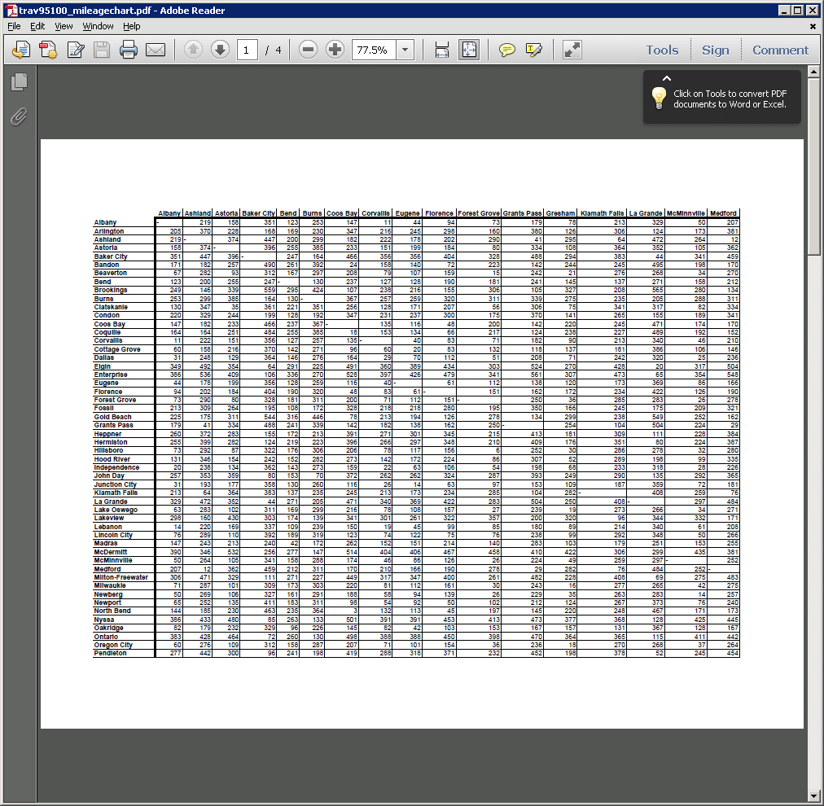
Travel Miles
In-State Mileage Chart
Example: Ashland to Eugene 178 miles

Slide 16
Private Car Reimbursement Rates
SOU changes go in effect once Cabinet approves
100 miles or more: $34.75/day plus $0.2075/mile but should not exceed $0.555/mile rate below.
Less than 100 miles: $0.555/mile (LOCAL travel).
Note: excludes travel to Deer Creek Ranch or Crater Lake Natl. Park, not to exceed $.555/mile federal rate.

Slide 17
Vehicle Rental
Rental Agreement Options
Enterprise Rent-A-Car
Provides discount pricing on vehicle rentals
Payment methods:
Pay with your own credit card or USBank Corporate Travel Card and use the Travel Expense Report Form for reimbursement.
Set up for receiving a “Direct Bill” from the rental agency, and pay by Banner invoice. [Call Local or On-line]

Slide 18
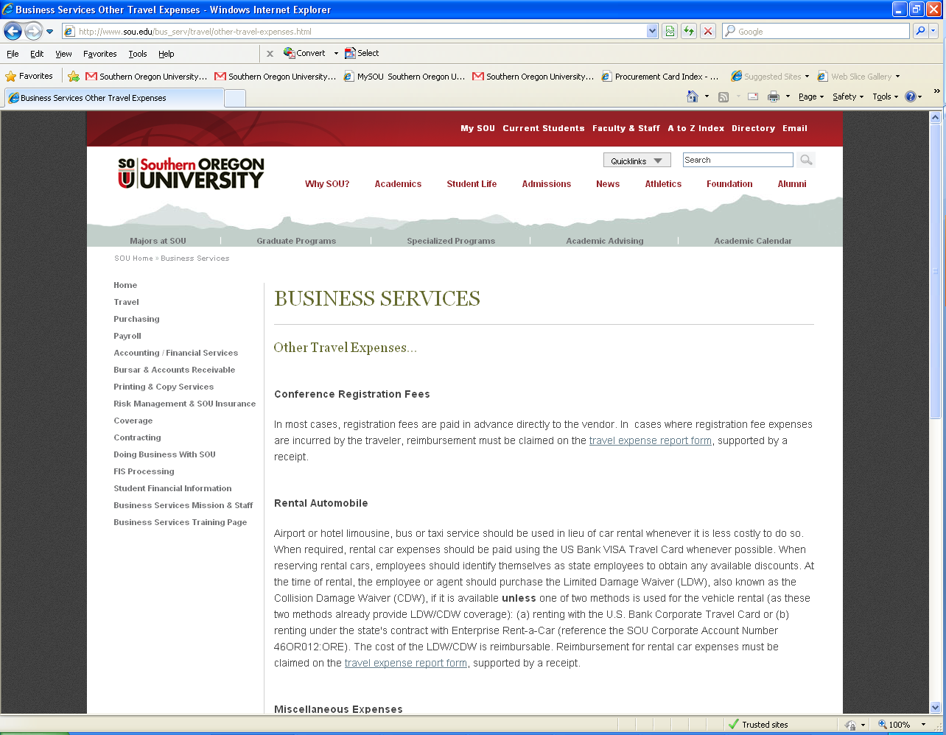
Website Location for Other Travel Expenses

Slide 19
Corporate Travel Card Procedure
SOU has contracted with USBank to provide a Corporate Travel Card to employees who find themselves traveling on a regular basis.
The Corporate Travel Card is a personal bank card issued through U.S. Bank Corporate Card Program.
The benefit of using a Corporate Travel Card is to keep SOU business travel arrangements separated from your personal credit cards.
Note that you have the option to be reimbursed for authorized travel expenses whether you pay cash, or use a personal bank card, or the (personal) Corporate Travel Card.
Employee’s use of the Corporate Travel Card is limited to authorized business travel and no other expenses should be charged.
(For example, please do not charge office supplies on this card).
Application form on Travel Website
Travel Card – US Bank Corporate Card Application

Slide 20
Questions?

Slide 21
Contacts
Jill Hernandez, Travel/Accounts Payable Specialist
hernandj@sou.edu 552-6553
Mark Gibbons, Purchasing Agent gibbonsm@sou.edu 552-6574
Steve Larvick, Business Director larvick@sou.edu 552-6594

