Slide 1

GIFT DEPOSITS
To Report a Cash Gift Received by a Department
http://www.sou.edu/bus_serv/CashHandlingManualOct2010_DM2.doc
Business Services
April 2016

Slide 2


WHAT IS A GIFT?
Definition:
A gift is defined as a donation with no legal consideration imposed by the donor
Nothing is expected by the donor in return for the gift.
A gift may be designated for use by the department only or for a specific purpose, such as the purchase of musical instruments.

Slide 3


GIFTS/DONATIONS
Foundation Gifts
Donors are encouraged to route their contributions through the SOU Foundation
http://www.soufoundation.org/
Checks payable to the SOU Foundation are processed through the Foundation
Department Gifts
Contributions made directly to a university department
Checks are payable to Southern Oregon University
Procedure for depositing gifts outlined in this presentation must be followed

Slide 4
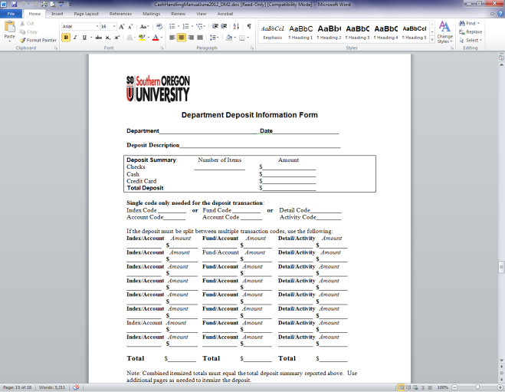
NON-GIFT PAYMENTS
Payments for Sales or Services:
are not donations
should be recorded as income or as an expense reimbursement
should be deposited to an appropriate non-gift index and account code

Slide 5

DEPARTMENT GIFTS
Donations made to a department, even if for general department use:
considered restricted funds
should not be commingled with general fund or self-support funds
spent in accordance with university regulations
must not be overdrawn

Slide 6
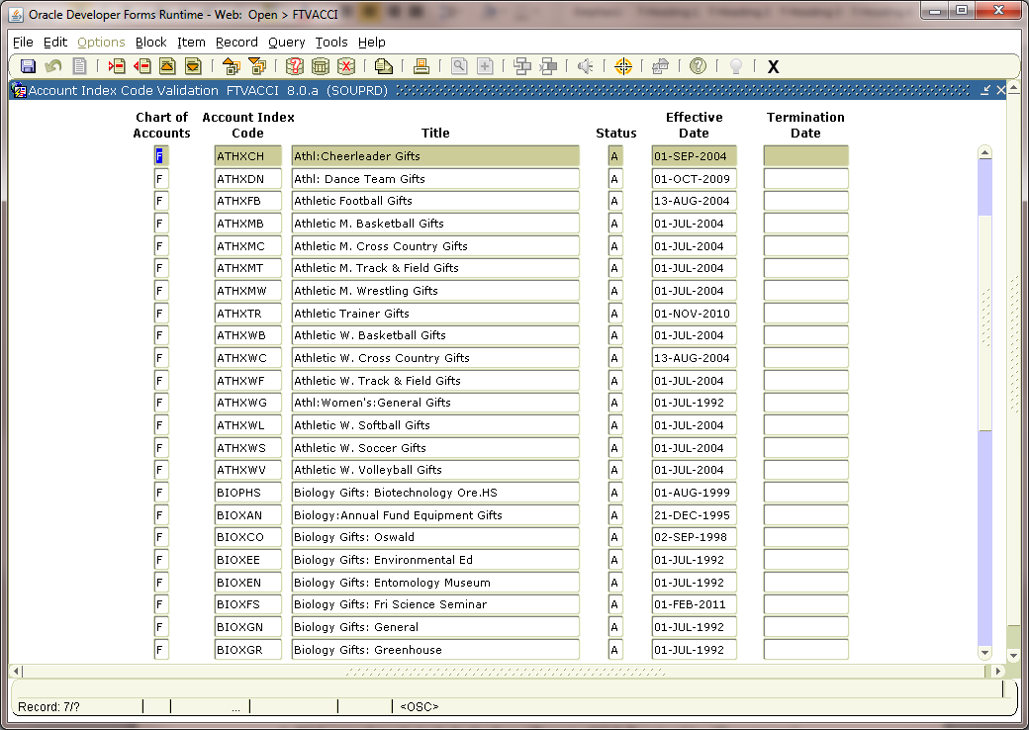

GIFT INDEX
Used to keep track of donations and their use.
  A department can have as many gift indexes as it needs.
  More than one index might be needed if the department receives donations with varying restrictions.

Slide 7
GIFT DEPOSIT PROCEDURES
Step 1
  Step 3
Complete “Report of Gift Received by Department” form
Include a copy of any correspondence from the donor(s) regarding the gift
Check is payable to Southern Oregon University
Obtain a receipt
Maintain copies for the department’s records
  Step 4
Original documentation is kept in the Business Services Office
  Step 2
Bring deposit items to Enrollment Services Center for processing
  Step 5
A letter of acknowledgment is sent to the donor(s) by the Office of Development

Slide 8
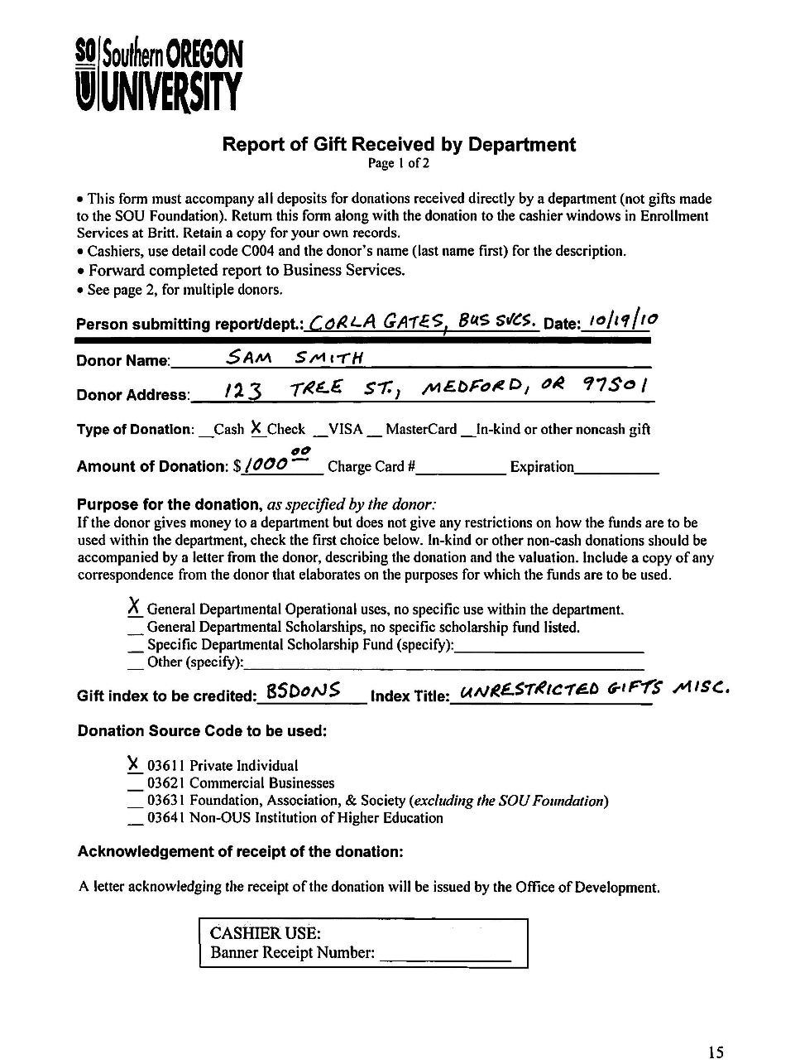
DEPOSIT FORMS
Use a new form for each index and account combination.
If you have multiple donors for the same index and account, use overflow pages.
Example: If you have 6 donations and 5 are to the same index and account, they are reported on Pages 1 and 2 of the gift receipt form.
The sixth donation is recorded on a new form because it is for a different index and account

Slide 9
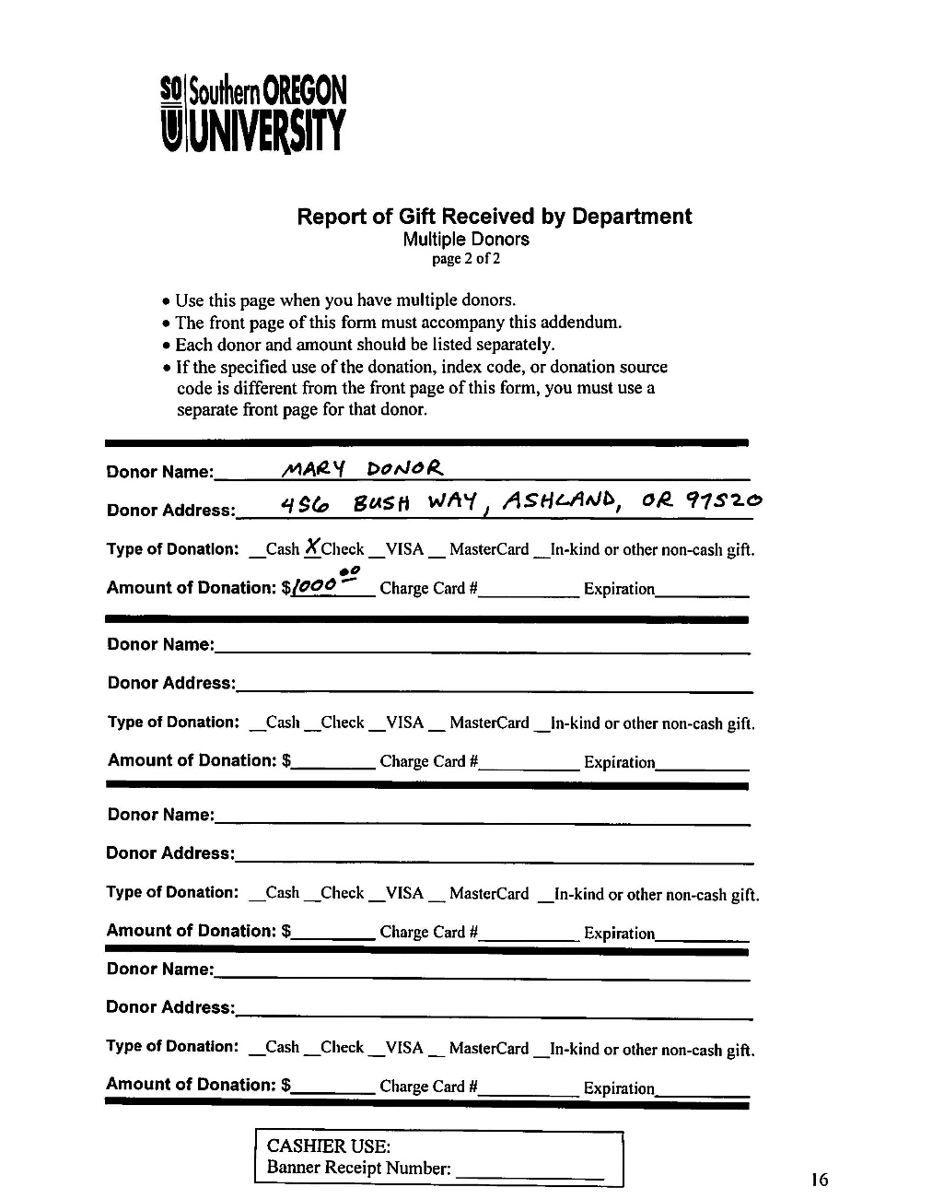
DEPOSIT FORMS
You can use as many forms and overflow pages as needed.
Separate and match the checks for each index and account combination to each gift form so the ESA’s can easily and accurately process the deposit.
The total amount on the forms must equal the checks.

Slide 10
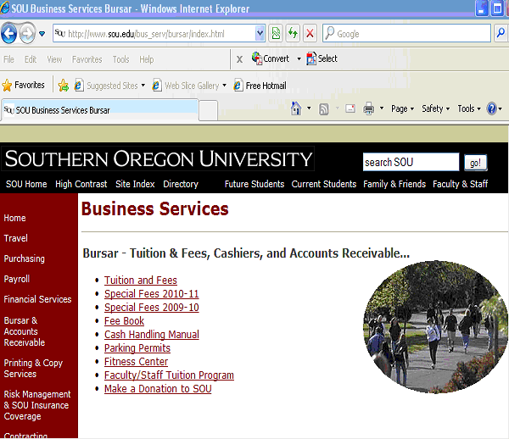
GIFT DEPOSIT INSTRUCTIONS
The instructions and forms are part of the Cash Handling Manual located in the Bursar section of the Business Services website.
http://www.sou.edu/bus_serv/CashHandlingManualOct2010_DM2.doc

Slide 11

Contact
If you need a new donation index or have questions, contact:
Service Center:
Gathers initial information
Forwards requests to:
Business Services, Accounting Manager

