Slide 1

Centralized Billing to Off-campus Organizations
Contracts and Other Obligations Owed to SOU by Outside Organizations
Business Services
March 2016

Slide 2

Centralized Banner Billing
Off-campus organizations (including affiliates) can receive one comprehensive bill from the university.
Outside organizations can route one payment to one central source, rather than routing multiple payments to multiple departments.
Reduced need for departments to issue billing information on their own.
Control over posting charges, and due dates, retained at the campus department level.

Slide 3
Centralized Banner Billing –cont’d
Simplification of the deposit process for handling payments.
More timely recognition of revenues.
Automatic recognition of receivables for balances still owed.
Comprehensive online history of charges and payments.

Slide 4
Agreement Sample

Slide 5
Agreements/Contracts- cont’d
Original contract is to be sent to the SOU Contracts Office, Churchill 170 for final signature before event date.
After review and final signature of Craig Morris, copies of the signed contract are sent to the originating department, Facilities, Campus Public Safety and Business Services.
All contracts must be signed by the appropriate contract authority before services begin.
Originals are kept on file in the SOU Contracts Office.

Slide 6
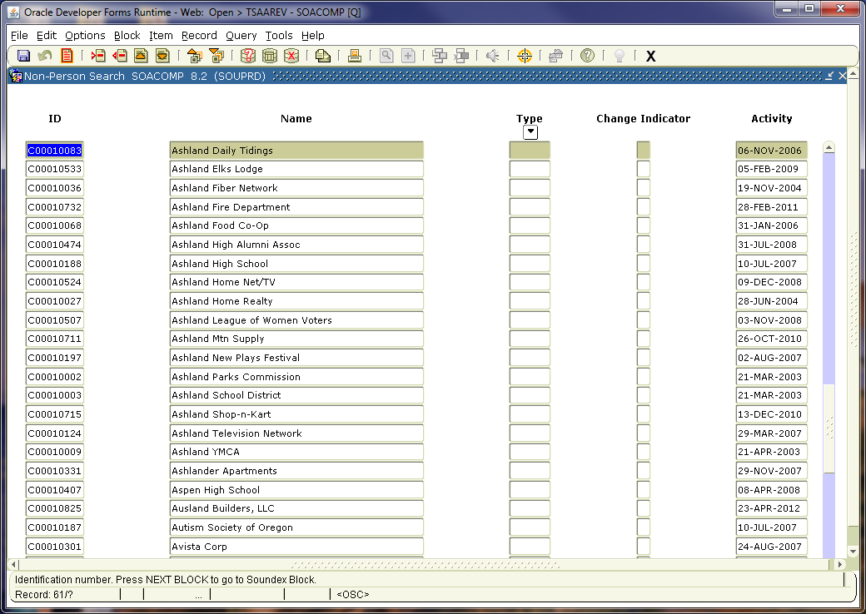
Sample Listing of Off-campus Organization Accounts

Slide 7
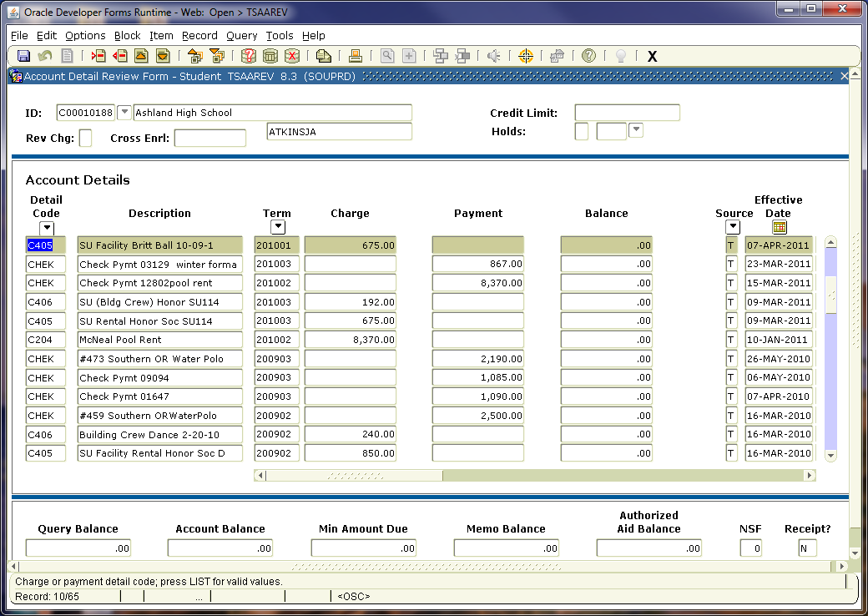
Sample of an Outside Organization Online Banner Account

Slide 8
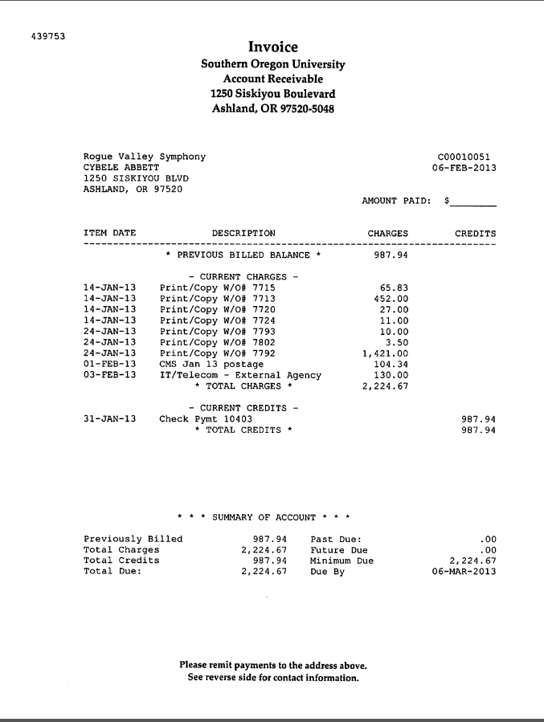
Sample Billing

Slide 9

Role of the Department
Once a contract is signed by the appropriate parties, the administration of the contract falls to the department.
It is the department's responsibility to ensure the following:
payments are made/received as required
performance/goods meet the requirements of the contract
restrictions are not violated
department complies with departmental requirements of the contract

Slide 10
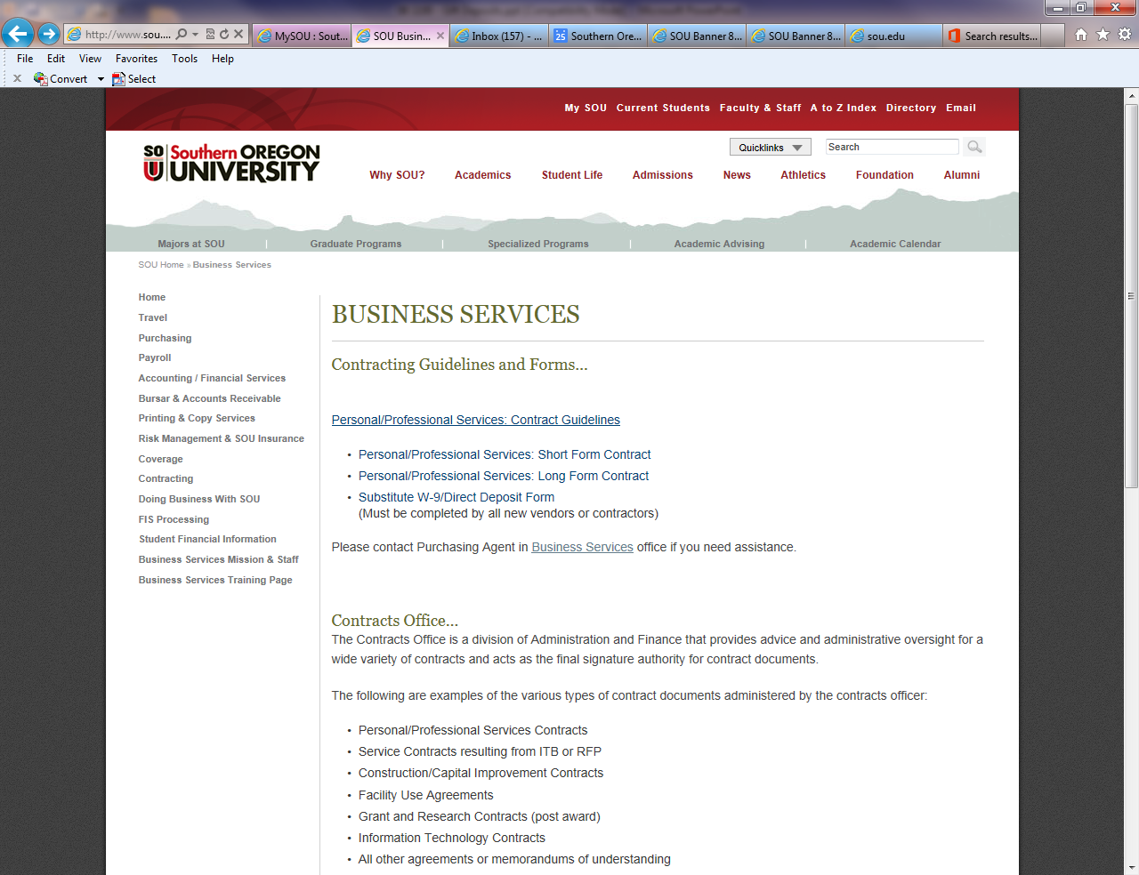

Contracting Guidelines
The Contracting Guidelines can be found under the Contracting Section on the Business Services website.
http://www.sou.edu/bus_serv/contracting

Slide 11
C-Account Request
SOU Departments contact SuAnne Cleveland, Business Services at Britt at clevelas@sou.edu to create a C Account #.
Departments would be responsible to keep records of the detail of the charges.
  The email needs to contain the information for the name, contact person name, address and phone numbers.
  After creation of the account, the department will receive an email containing the C Acct. # to apply their charges for services rendered.

Slide 12
Contacts
C-Account Request:
SuAnne Cleveland, clevelas@sou.edu, 552-6730
Advice and Administrative oversight for contracts:
Treasa Sprague, spraguet@sou.edu, 552-6319
Creating new Banner “charge” Detail Codes:
Patti Eliot, Accounting Manager
eliotp@sou.edu, 552-6065
Reviewing Payment History:
SuAnne Cleveland, clevelas@sou.edu, 552-6730

