Slide 1
Prepare for the fair
How to work the 2017 sou career and internship fair

Slide 2
agenda
Purpose
What to Expect
How to Prepare
How to Make the Most of the Fair
How to Follow-Up

Slide 3
Why should you go?
Get a job or internship
Network with employers
Gather information about the local job market

Slide 4
What will it be like?
Imagine a cocktail party full of people trying to hire you…
Lots of people
Professional environment
Conversations and questions
Employer displays and giveaways

Slide 5
What to do beforehand… resume
Prepare a professional, error-free resume
Utilize resources at www.sou.edu/careers
Resume handout
Resumes for America
Proofread resume
Bring multiple copies

Slide 6
What to do beforehand… resume
Keep it to one page by only sharing most relevant information
No mistakes – read, reread, and read again
Only present true and accurate information
Make it attractive but professional – no photos, colors, unusual fonts, etc
Be consistent in your style and format
Don’t include personal information such as your social security number, age, or nation of origin

Slide 7
What to do beforehand… identify participants
Obtain a list of participating companies
Log into your CareerLink account and click on the Career Events tab OR visit http://www.sou.edu/careers/careerfair.html
Create a target list
Learn what you can about the employers in which you’re most interested
Find out if they have any jobs currently posted

Slide 8
What to do beforehand… find an outfit
If you have business professional attire, wear that…
Men:
Suit in a dark color like black, gray or navy; Solid or pinstripe; Long-sleeve, button-down shirt and a tie; Black or dark brown dress shoes with dark socks that complement your suit; Minimal jewelry and cologne.
Women:
Suit in a dark color like black, gray or navy; Solid or fine pinstripe; Skirt suits should be no shorter than two inches above the knee; Blouse or dress shirt; Mid-heel, closed-toe dress shoes and hose; Minimal jewelry, perfume, and makeup.

Slide 9
What to do beforehand… find an outfit
If you don’t have business professional attire, wear business casual…
Men:
Neat slacks or trousers; Button-down, tucked-in shirt; Professional shoes; A jacket is optional.
Women:
Skirt or pressed slacks; Blouse or sweater; Low-heeled professional shoes; A jacket is optional.

Slide 10
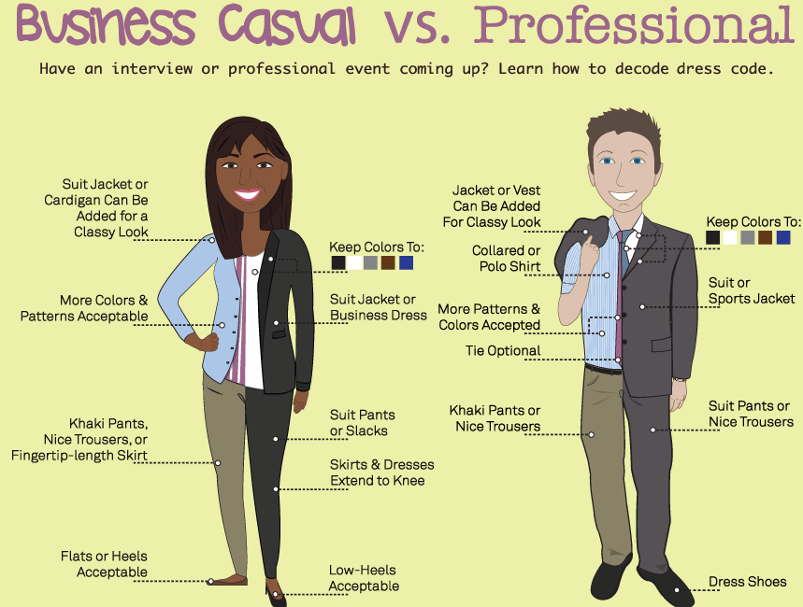

Slide 11
What to do beforehand… elevator speech
Develop a brief “commercial” about yourself
Name, major, graduation date
Qualifications
Interest in the organization

Slide 12
What to do beforehand… prepare questions
Think about what you would like to ask the employers
Contributions of successful candidates?
Key skills they’re looking for?
Role of the position at the company?
How to apply?

Slide 13
The day of the fair… what to bring
Resumes
Notepad
Pen
Folder and/or bag

Slide 14
The day of the fair… talking to employers
Firm handshake, good eye contact and posture, smile
Visit a few employers before heading to your top choices
Ask questions that highlight your research and interests
What positions are available in your organization?
What kind of background do you look for when filling these positions?
How do you see this field changing over the next five years?
What advice would you give me if I wanted to break into this field?
How did you get involved with this industry/organization? What keeps you involved?

Slide 15
The day of the fair… talking to employers
Express your interest and enthusiasm
Offer your resume
Get business cards
Confirm the next steps
Thank them for coming to campus

Slide 16
What to do afterwards…
Write a thank you (or send cover letter and resume) to anyone you had an extended conversation with ASAP
Apply or follow-up per employer instructions

Slide 17
Upcoming events
Marketing the Brand Called “Me”
April 21st at 12:30 and again at 3:30
SU 330
SOU Career and Internship Fair
April 25th from 11:30 until 2:30
SU Rogue River Room and CRC
The Dreamshare Project
April 27th at 4:00
Hannon Library Meese Roome

Slide 18
resources
Max Brooks, Career Preparation Coordinator
brooksm@sou.edu
552-6131
www.sou.edu/careers

