Slide 1
Tuition and Mandatory Fees
FY16 Options and Recommendations

Slide 2
Tuition and Mandatory Fees
Tuition
Tuition Rates
Differential Tuition Rates
Mandatory Fees
Housing / Dining Fee (not technically a mandatory fee)
Student Health Fee
Student Incidental Fee
Recreation Center Fee
Building Fee

Slide 3
Tuition
Tuition Advisory Council
Recommends a 5% tuition increase
Supports the Retrenchment Plan
Allows for investment in programs to boost performance against Outcomes based funding model
Support successful entry to the University
Improve persistence in year 1 and 2
Move students to graduation
SOU response to HECC 2015-17 biennium funding request
http://www.sou.edu/budget/budget-presentations.html

Slide 4
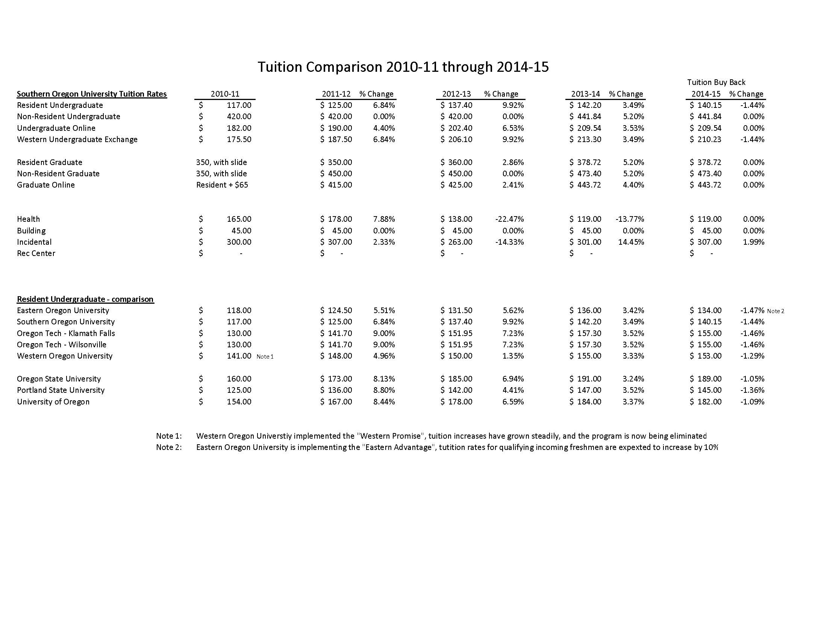
Except for Eastern Oregon University, SOU currently has the lowest tuition for Resident Undergraduate
Students of all seven Oregon Public Universities
Eastern Oregon is initiating their Eastern Advantage and is expected to have a 10% tuition increase for FY16

Slide 5
Impact of tuition increase
Student Category | Current Tuition | Proposed Tuition | Current Annual 12 credits/Term | Proposed Annual 12 credits/Term | Total increase per year
Resident UG | $140.15 | $147.00 | $5,045.40 | $5,292.00 | $246.60
Nonresident UG | $441.84 | $464.00 | $15,906.24 | $16,704.00 | $797.76
WUE | $210.23 | $221.00 | $7,568.10 | $7,956.00 | $387.90
Resident Grad (8 cred) | $378,72 | $398.00 | $9,089.28 | $9,552.00 | $462.72
Nonresident Grad | $473.40 | $497.00 | $11,361.60 | $11,928.00 | $566.40

Slide 6
Mandatory Fees
Housing / Dining Fee (not technically a mandatory fee)
Student Health Fee
Student Incidental Fee
Recreation Center Fee
Building Fee

Slide 7
Housing / Dining Fees
Dining Plans |  | Cost Per Year |  | Annual | Percent
 |  | 2014-15 | 2015-16 | Increase | Increase
Red Plan |  | $ 4,995 | $ 5,250 | $ 255 | 5%
Black Plan |  | $ 4,995 | $ 5,250 | $ 255 | 5%
(S) Plan |  | $ 4,230 | $ 4,440 | $ 210 | 5%
(O) Plan |  | $ 4,230 | $ 4,440 | $ 210 | 5%
(U) Plan |  | $ 4,230 | $ 4,440 | $ 210 | 5%
Madrone Plan |  | $ 2,100 | $ 2,400 | $ 300 | 14%
Madrone Hawk Plan |  | $ 2,100 | $ 2,400 | $ 300 | 14%
Residence Plans
Shasta - Double |  | $ 7,431 | $ 7,655 | $ 224 | 3%
Shasta - Single |  | $ 8,226 | $ 8,805 | $ 579 | 7%
McLoughlin Double |  | $ 7,863 | $ 8,100 | $ 237 | 3%
McLoughlin Single |  | $ 8,595 | $ 9,210 | $ 615 | 7%
McLoughlin Super Single |  | $ 9,180 | $ 10,110 | $ 930 | 10%
Madrone Single |  | $ 9,132 | $ 9,780 | $ 648 | 7%
Greensprings Double |  | $ 6,402 | $ 6,855 | $ 453 | 7%
Greensprings Single |  | $ 8,341 | $ 9,180 | $ 839 | 10%

Slide 8
Student Health Fee
Three Proposals
# 1 – Keep the rate flat $119
Does not fund necessary increases for Mental Health Counselor
Doesn’t fund anything to building reserve
Continues deficit spending – reserve currently at 11%
# 2 – $119 to $123 per term - $12 annual increase
Funds necessary increases for Mental Health Counselor
Allows $5K to Building fund
Still deficit spending, but much less – reserve currently at 11%
#3 - $119 to $125 per term - $18 annual increase
Funds necessary increases for Mental Health Counselor
Allows $5K to Building fund
Reverses deficit spending – reserve currently at 11%

Slide 9
Student Incidental Fee
Currently at $307 per term
3rd highest of 4 Technical and Regional Universities in Oregon
Includes Green Tag Fee at $13 per term – if removed, would be second lowest
Slightly higher reliance on Incidental fee for support of Athletics, hard to gauge impact if reduced.
3 Big universities can have economy of scale that SOU cannot to keep rate down
Yet U of O is still $576/term, $320/218 for OSU/PSU respectively
Governed by Student Fee Process
Winding down toward completion
Looking at 1-2% increase maximum
$307- $312/term range

Slide 10
Recreation Center Fee
New for FY16
Represents sale of bonds and initial debt service payment
Proposal to Students was $35/term FY16, $75/term FY17, $95/term FY18
Student Fee Process will determine

Slide 11
Building Fee
Used to fund deferred maintenance of university buildings and minimal capital projects
Set by OUS – expect to be set by HECC after this year
Currently at $45/term for all 7 Oregon Public Universities
No change announced

Slide 12
Total Mandatory Fees
SOU is currently the lowest of the four
Technical and Regional Universities for
Total Mandatory Fees

Slide 13
Total Mandatory Fees
Except for Portland State, SOU is currently
The lowest of all seven Oregon Public Universities
For total mandatory fees

Slide 14
Combined impact
Component of Costs | Current Annual Cost | Annual Increase | Projected Annual Cost
Tuition – Resident UG | 5,045.40 | 246.60 | 5,292.00
Dining (S) (O) or (U) plans | 4,230.00 | 210.00 | 4,440.00
Residence: Shasta, Double | 7,431.00 | 224.00 | 7,655.00
Health Fee | 357.00 | 12.00 | 369.00
Incidental Fee | 921.00 | 6.00 | 927.00
Building Fee | 135.00 | 0 | 135.00
Rec Center Fee | 0 | 150.00 | 105.00
Total Cost to attend: | 18,119.40 | 803.60 | 18,823.00
Percent increase: |  | 4%
Percent increase (tuition and Fees only) |  | 6%

