Slide 1
SOU Institutional Review Board
The Who, What, When, Where, How, and Whys
of the IRB.
Presented by Deborah Hofer

Slide 2
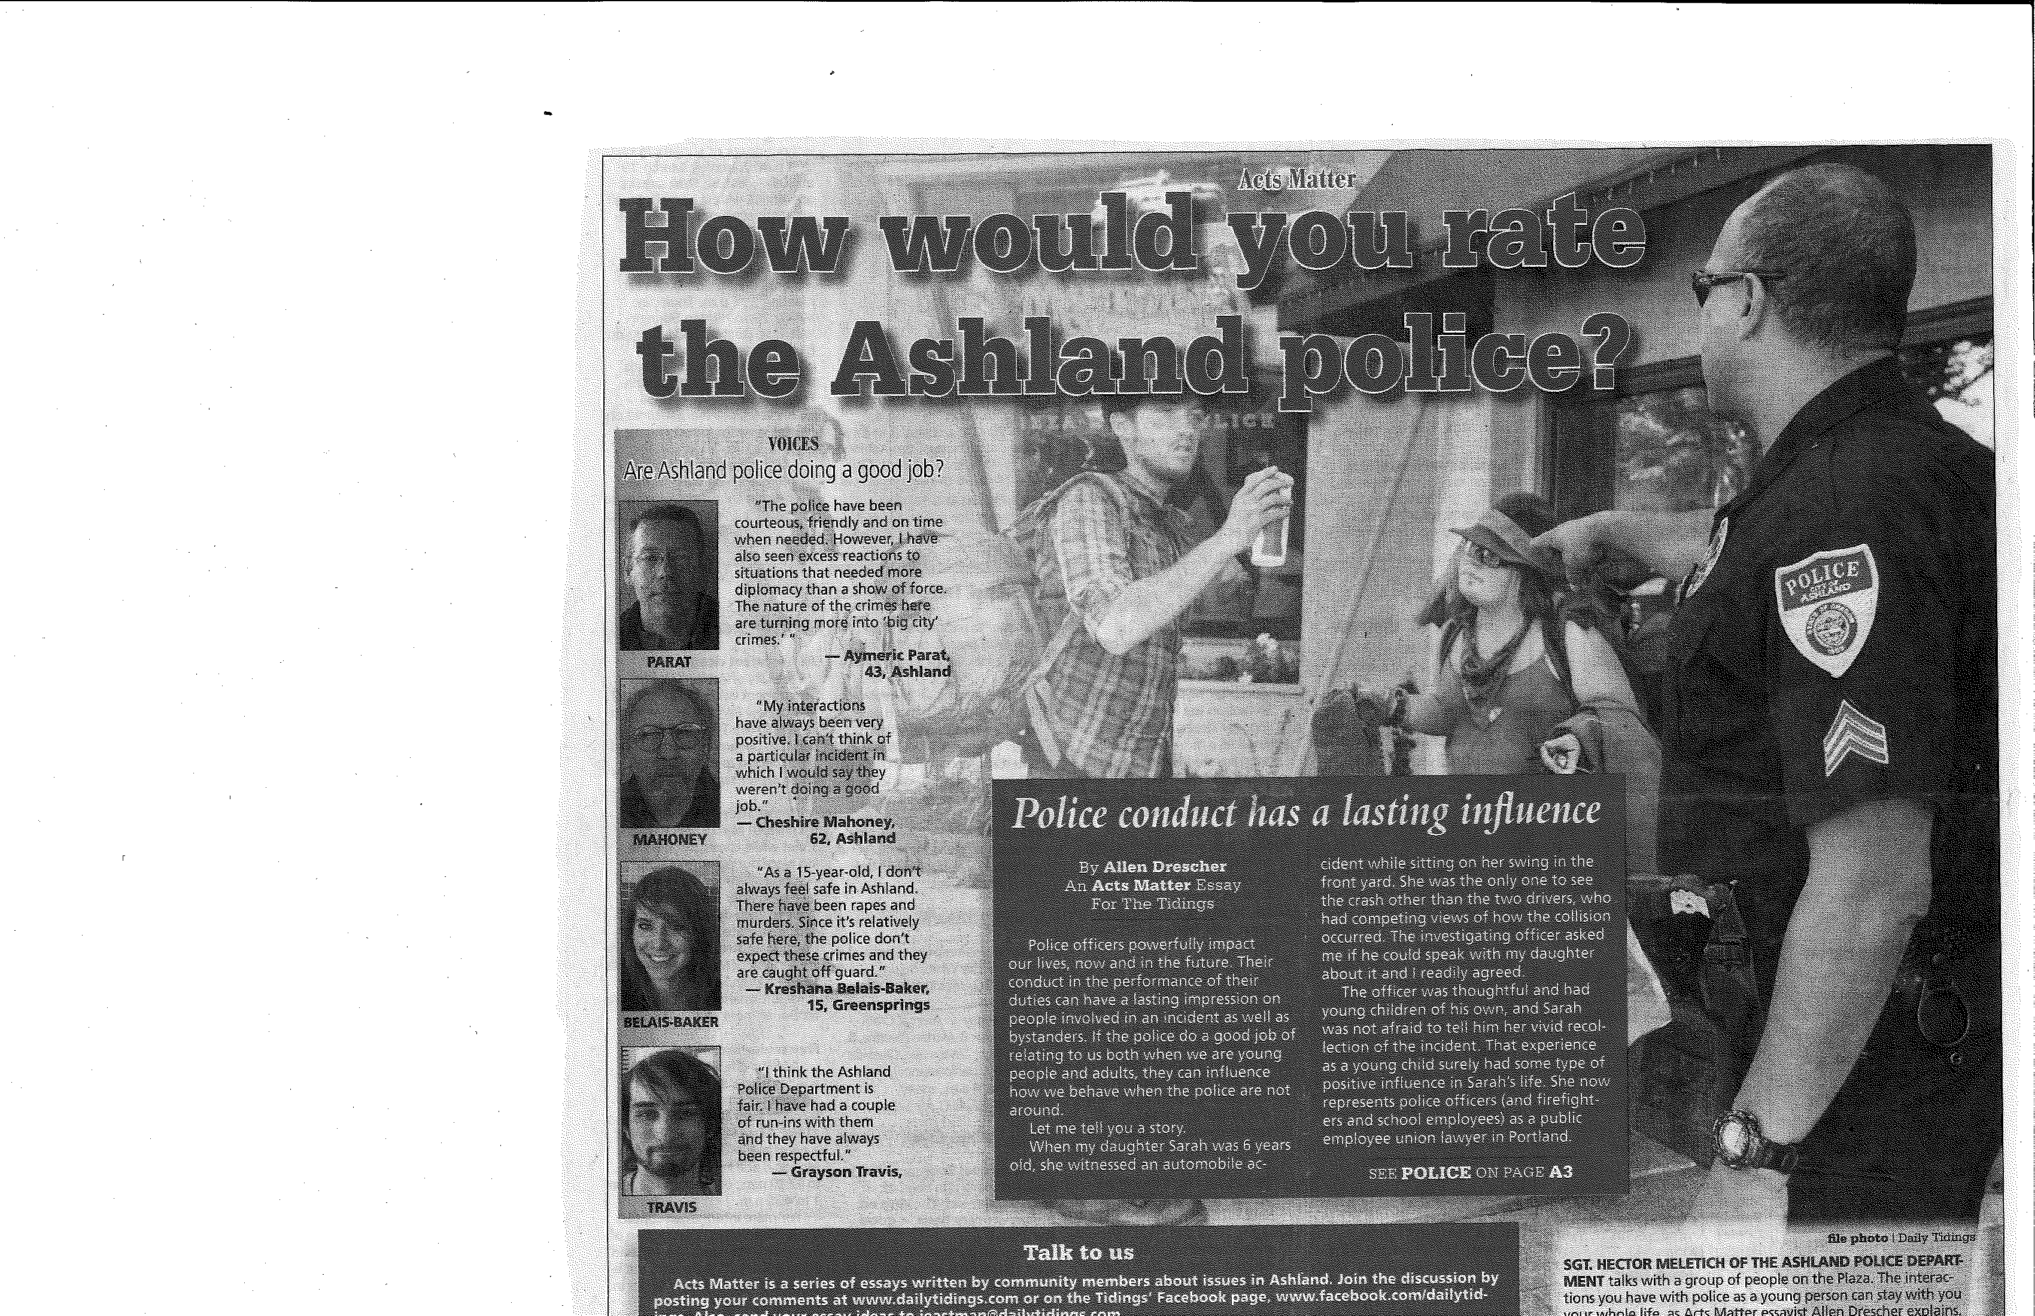

Slide 3
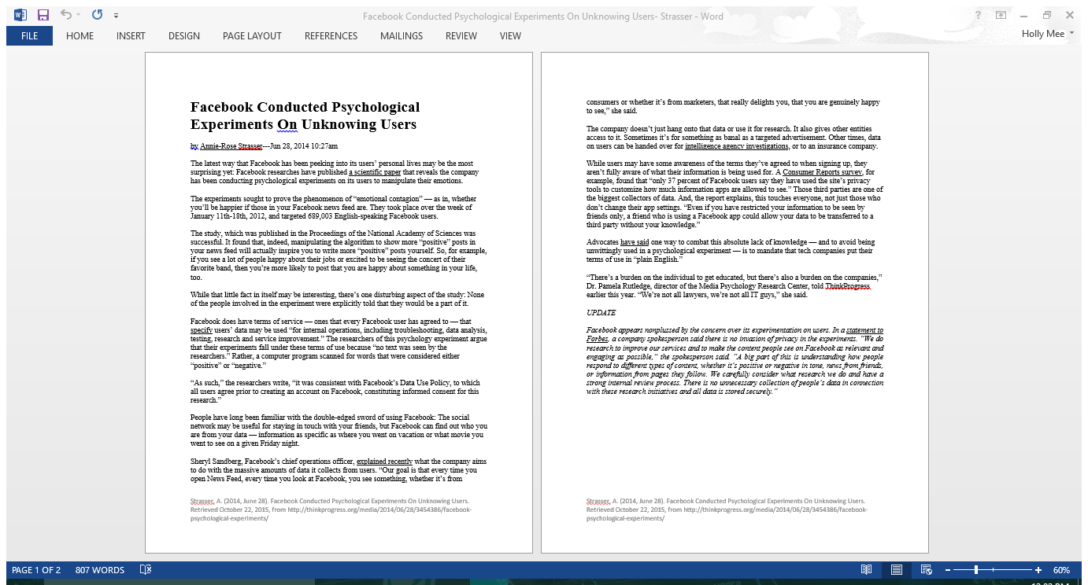

Slide 5
What is the IRB?
Presidential committee mandated by Federal guidelines.
Reviews all research activities involving the use of human subjects.
Serves as resource to assure ethical treatment of human subjects and compliance with institutional policy.

Slide 6
What the IRB is not
NOT the university ‘research police’.
NOT a committee set up to critique and mandate research design.
NOT an overly burdensome, bureaucratic hoop to drive students crazy.

Slide 7
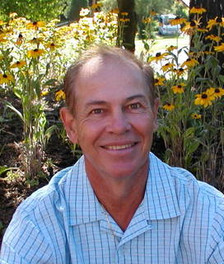
Who is the IRB?
A committee of 7 members of diverse experience, training, and education.
Current members:
Dr. Alison Burke, Criminology
Greg Frownfelter, The Jobs Council, Medford
Deborah Hofer MM, Grants Administrator
Dr. Jennifer Slawta, Health & PE
Dr. Matt Stillman, Institutional Research
Dr. Dee Southard, Sociology/McNair Program
Dr. Douglas Smith, Psychology

Slide 8
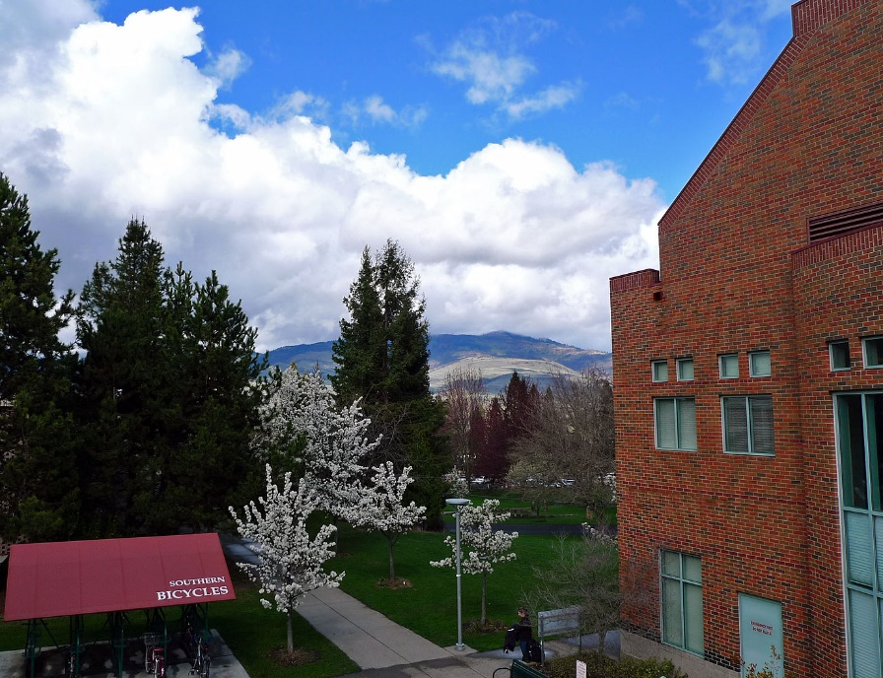
Where is the IRB?
Administration, review, and documentation are overseen by the Office of Grants & Sponsored Programs
Deborah’s Office–
Computing Services East #234

Slide 9
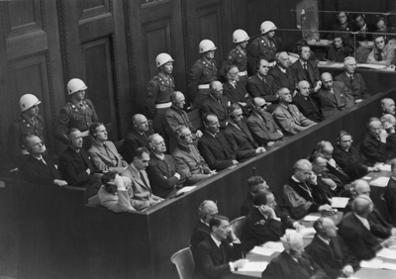
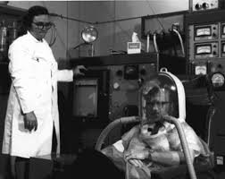
Why have an IRB?
Nazi war crimes (1940’s)
US Government research on untreated syphilis - “Tuskegee”
(1932 - 1972)
US Government tests subjecting workers to radiation exposure without their knowledge -“Human Radiation Experiments”

Slide 10
Protecting Human Subjects
as outlined by the Belmont Report
Respect for persons
(informed consent and right to withdraw)
Respect for privacy and confidentiality
Risk/ benefit analyses
(research yields useful results and benefits outweigh risks)

Slide 11
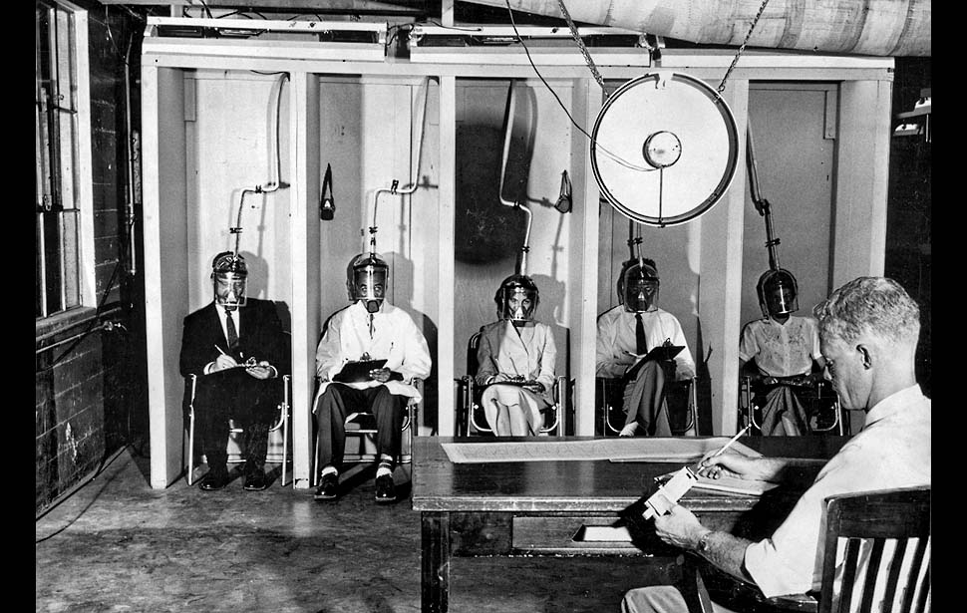
What requires IRB review?
Research involving human subjects.

Slide 12
What if the research is limited to:
Class projects
or
Program evaluations
or
Surveys or interviews?

Slide 13
Yes, review is required if…
Results will be presented in a public forum such as poster or capstone presentations.
There is the possibility that data will be published or maintained for later use.
Data or results will be used in a graduate project.

Slide 14
How can the IRB help me?
Determine if the activity is research.
Definition:
A systematic investigation, including research development, testing and evaluation designed to develop or contribute to “generalizable knowledge”.

Slide 15
Determine if the research involves human subjects.
Definition:
Living individual(s) about whom an investigator conducting research obtains data through intervention or interaction with the individual, or obtains identifiable private information.

Slide 16
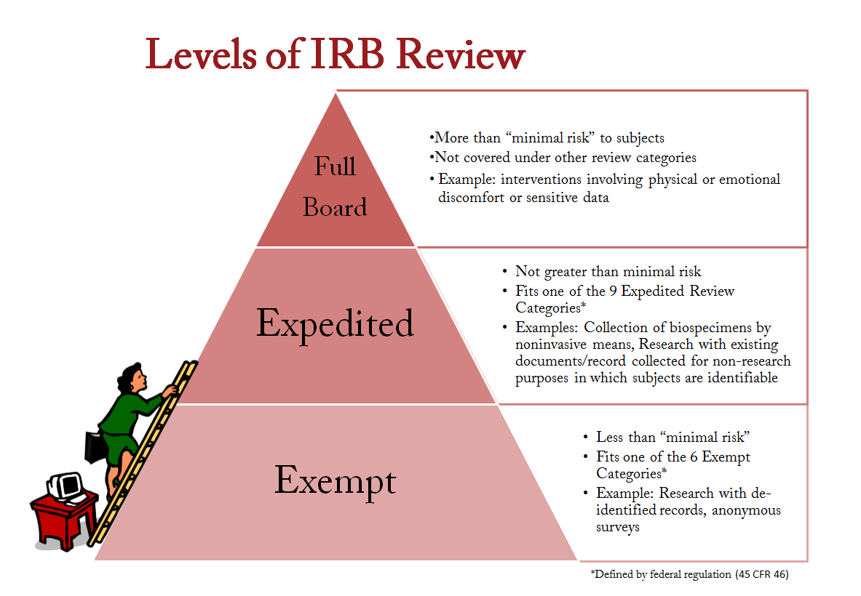
What are the levels of review?
Exempt
Expedited
Full Board

Slide 17
Exempt
Research that complies with one of the Categories of Exemption. Examples include research on education strategies or involving the study of existing data .
Only an IRB member may determine if a proposal is exempt from IRB oversight.

Slide 18
Expedited
Research that presents no more than minimal risk or consists of minor changes to a previously approved protocol.
Research that fits the categories for expedited research may be reviewed and approved by one IRB member.

Slide 19
Full Board
A project is research, is not exempt, and does not qualify for expedited review must go to full board review, i.e., high risk.
Proposal must be reviewed and approved at a convened, IRB meeting with a quorum present.

Slide 20
How do I submit my research proposal for review?
Complete IRB Review Form for Projects Using Human Subjects.
Submit one hard copy and one electronic copy of the review request to Grants Administration, Computing Services East #234.
Include all related documents.

Slide 21
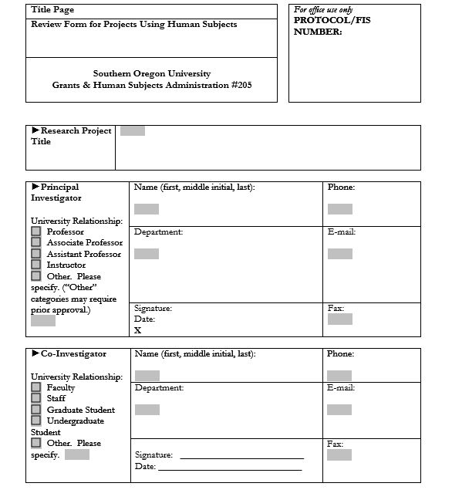
Title
Principal Investigator:

Slide 22
Purpose:
Any problems that may occur due to your research
What must the subjects do?
Benefits of the research

Slide 23
Type of subject: Helps determine IRB consent
Informed Consent
Confidentiality

Slide 24
What are my responsibilities as an investigator?
Do no harm.
Maximize benefits.
Seek approval prior to initiating research.
Assure research provides useful results.

Slide 25
What’s next?
Obtain legally effective informed consent from subjects.
Key components of informed consent:
Who you are
Purpose of research
Participation is voluntary
Level of confidentiality
What is required of participants, i.e. time, activities, etc.
Contact information for investigator, IRB administrator, and resources should the subject experience adverse effects.

Slide 26
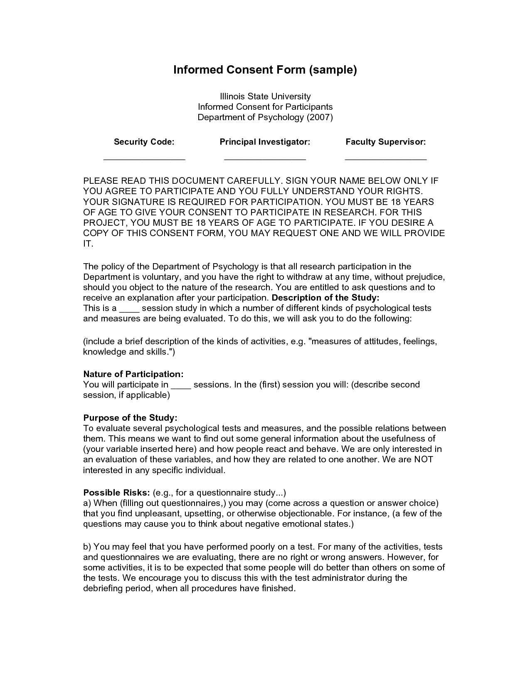
Who you are
Contact info
Voluntary Participation
Right to Withdraw
Purpose
What will they be doing?
Any risks (IMPORTANT)

