Slide 1
2014 Economic Forecast
Southern Oregon University
Economic Forecasting Team

Slide 2
Table of Contents
How We Got Here
Forecast Methodology
Economic Sectors With Assumptions
Comparisons With Other Forecasts
Questions

Slide 3
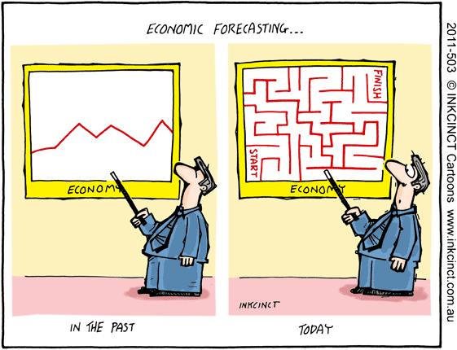
What is Economic Forecasting

Slide 4
How We Got Here
Housing bubble
2008 Recession
Increased money supply/ low interest rates
Fiscal stimulus policies enacted
2009- Recession technically ends
Increased income inequality
(Top 1%)
Weak economy/ poor confidence

Slide 5
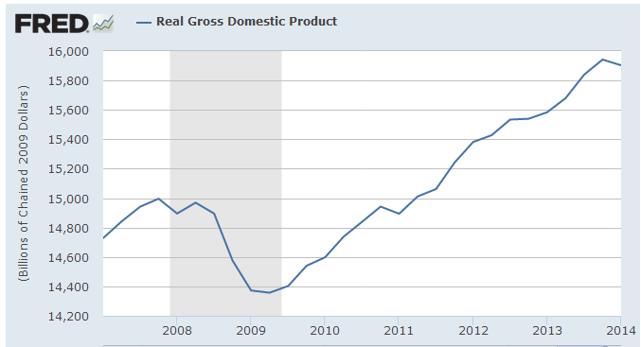
GDP 2007-2014

Slide 6
Forecast Methodology
Forecasting Model: Fairmodel
Determines interactions throughout economic sectors
Quantifies equations
Uses equations to explain interactions
Created by Dr. Ray Fair, Yale University

Slide 7
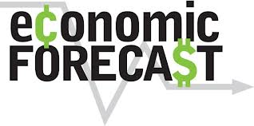
Process
Economic Research
Model
Expert Judgment
Forecast

Slide 8
Economic Sectors
Fiscal Policy
Monetary Policy
International Economic Factors
Consumer Spending
Business Investment
Housing
Employment

Slide 9
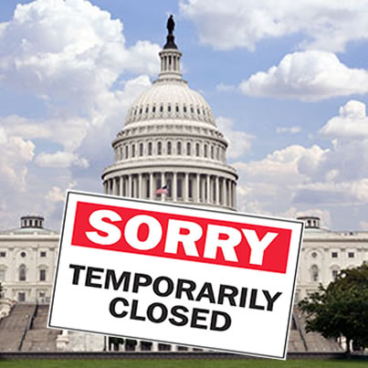
Federal Government Spending & Taxes
Government Spending/ Taxes
Transfer Payments Rates Decrease
Government Shutdown
Predicted 2015
Congressional Paralysis

Slide 10
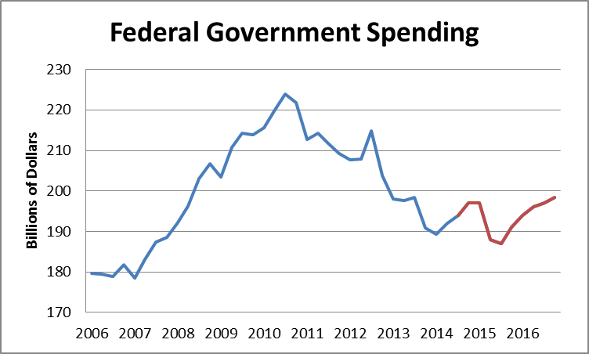
Historical Data
SOU Forecast

Slide 11
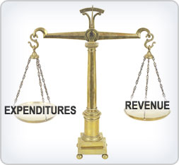
State & Local Governmental Spending
State & Local Spending = 20% of GDP
Balanced Budget (no deficit spending)
Surpluses + Increased Revenues => Increase in State and Local Government Spending.

Slide 12
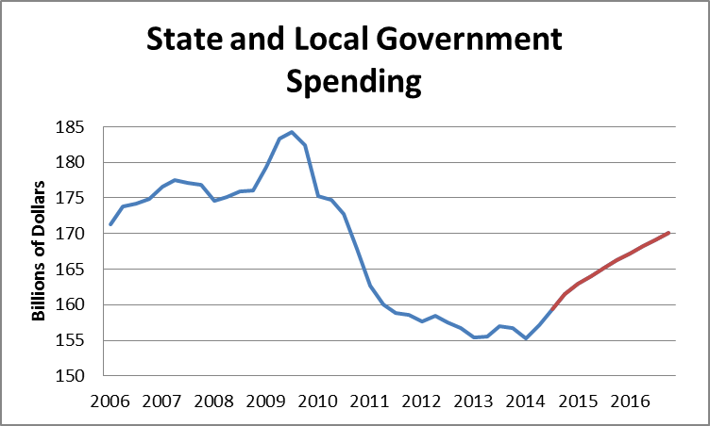
Historical Data
SOU Forecast

Slide 13
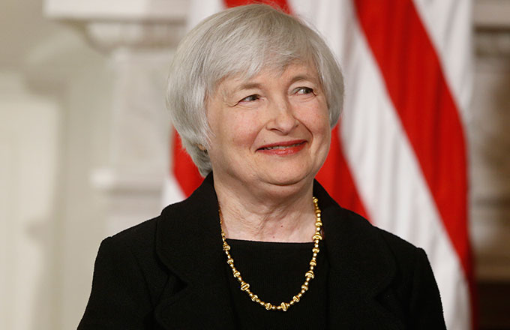
Monetary Policy
Loose Monetary Policy
Fed Adjusts Money Supply
Near 0% 3-month Treasury Bill Rates

Slide 14
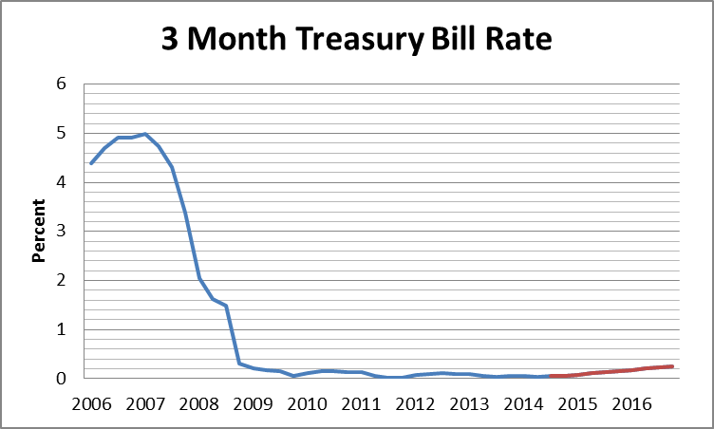
Historical Data
SOU Forecast

Slide 15
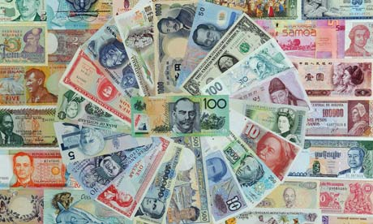
International Economic Factors
Small Decrease In Oil Prices
Stable Exchange Rates For the Near Future
Slight Decrease Beginning in 2015

Slide 16
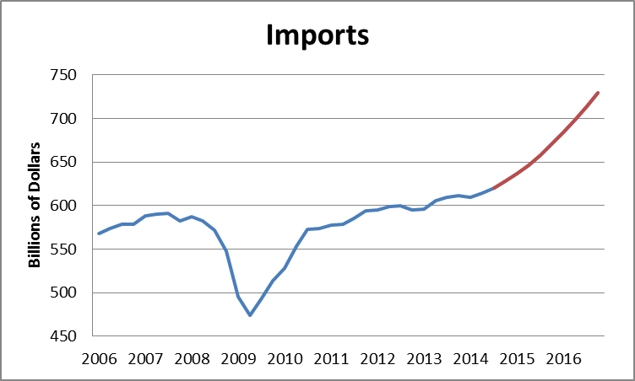
Historical Data
SOU Forecast

Slide 17
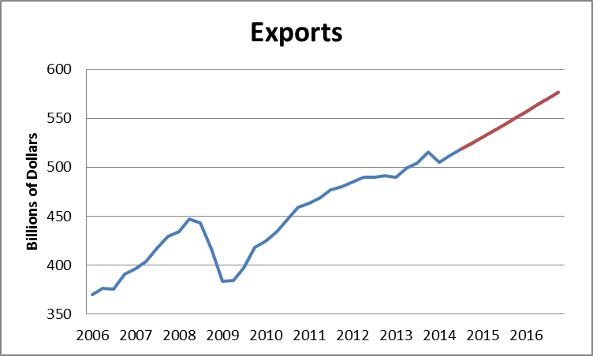
Historical Data
SOU forecast

Slide 18
Consumer Spending
Consumer
Confidence
Increased
Demand
Increased Production
More Jobs
Low Consumer Confidence
Consumption Follows GDP
Slow Increase In Consumer Spending

Slide 19
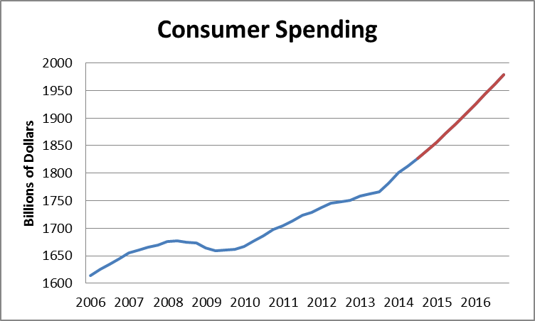
Historical Data
SOU Forecast

Slide 20
Business Investment
Low Interest Rates
Growing Investment
High Consumer Demand

Slide 21
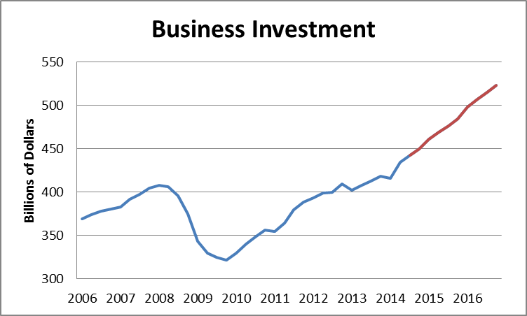
Historical Data
SOU Forecast

Slide 22
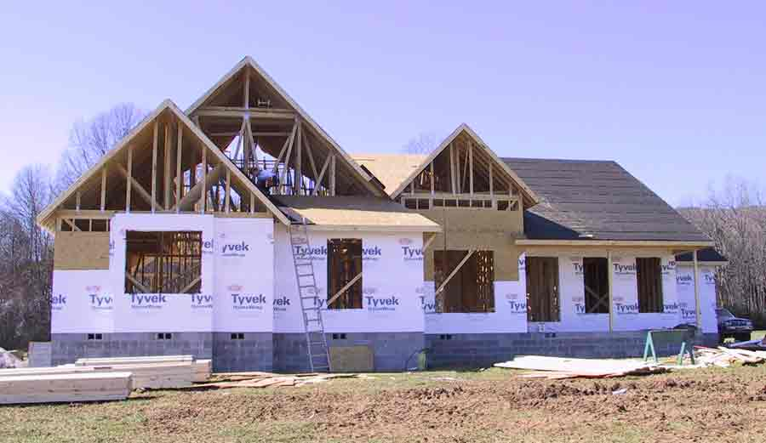
Construction
Large Surplus of Houses After Recession
Sluggish Market Growth Until 2014
Forecasted Increases Post 2014

Slide 23
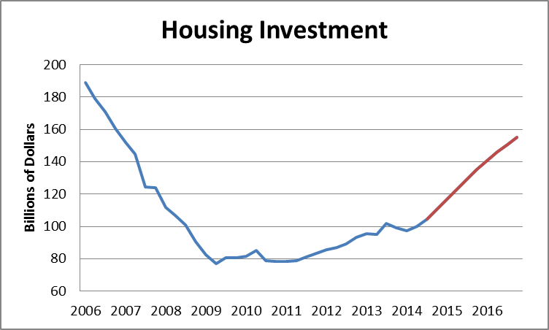
Historical Data
SOU Forecast

Slide 24
Employment
Growing Employment
Continued Improvement in Labor Markets
Unemployment Rate Expected at 6.4%-2016

Slide 25
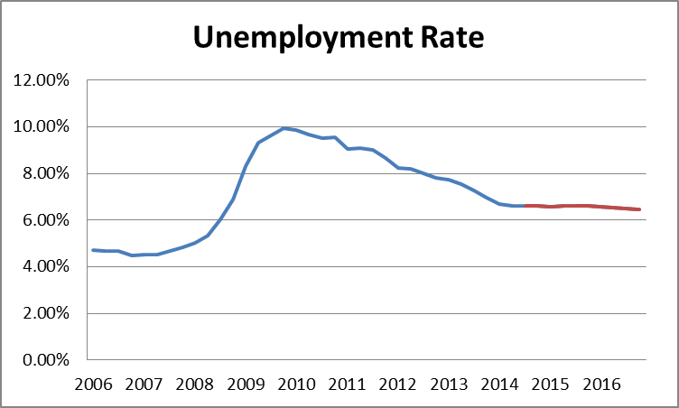
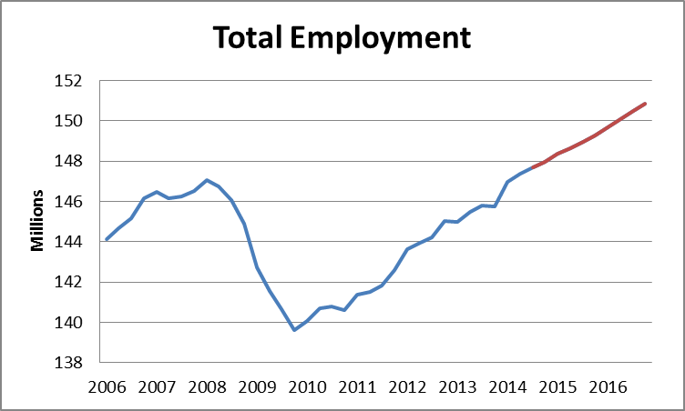
Historical Data
SOU Forecast

Slide 26
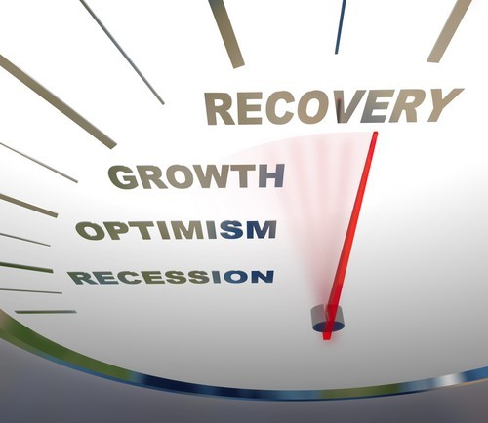
Summary
Increasing Growth Rates in All Sectors
Government Shutdown in 2015 Slows Growth, but Economy Will Rebound Quickly
GDP Growth Increasing to an Average of 3% Annualy

Slide 27
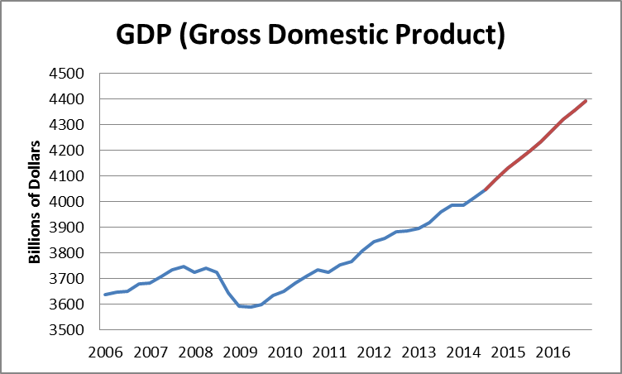
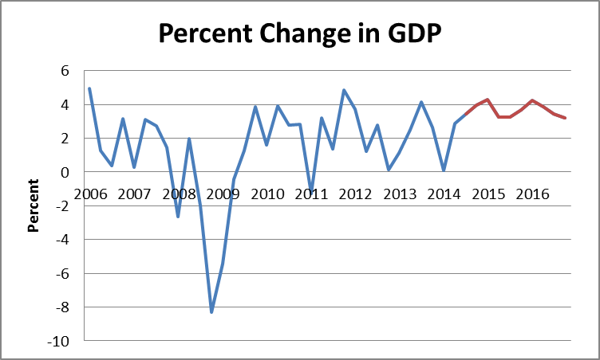
Historical Data
SOU Forecast

Slide 28
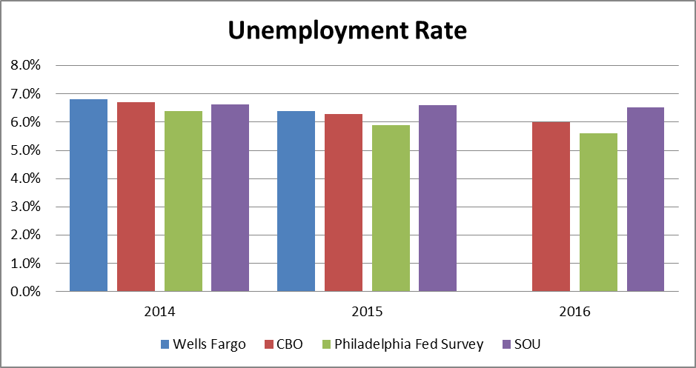
Forecast Comparison

Slide 29
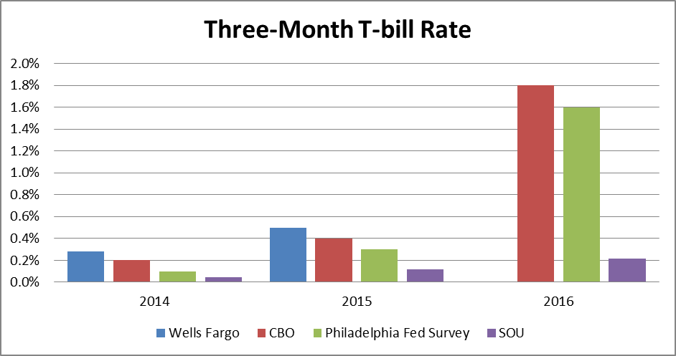
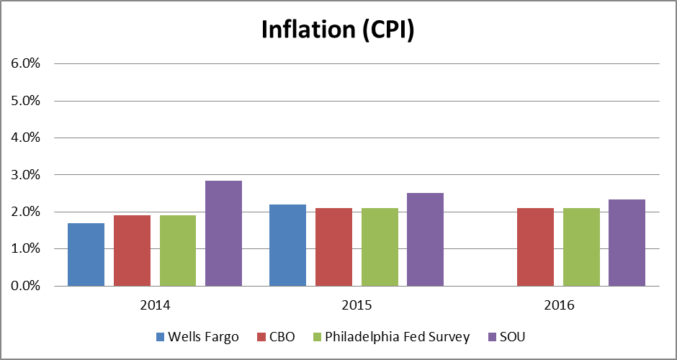
Forecast Comparison

Slide 30
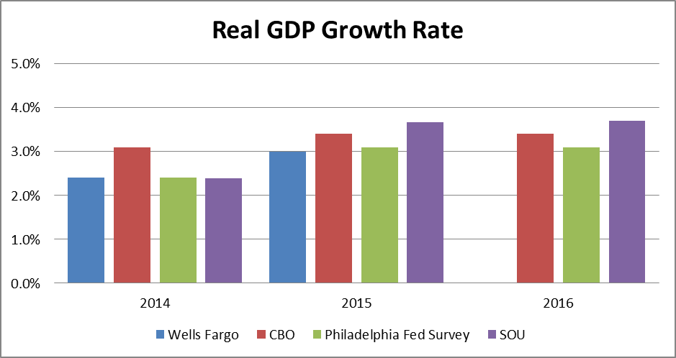
Forecast Comparison

Slide 31
Forecast Team
Emily Starbuck
Wes Wade
Jaeseok Lee
Kyudae Lee
Benjamin Bennett
Azhar Khan
Stephanie Keaveney
Andrei Bica
Jordan Browne -Moore
Brad Johnson
Alex Godvin
William Howard
Nolan Fincher
Zachary Hess
Frederic Geiger

Slide 32
Questions?

